Slide 1
SRI GANESH COLLEGE OF ARTS & SCIENCE, AMMAPET, SALEM-14
C.JAYAKRISHNA
Head & Assistant Professor
Department of Biotechnology

Slide 5
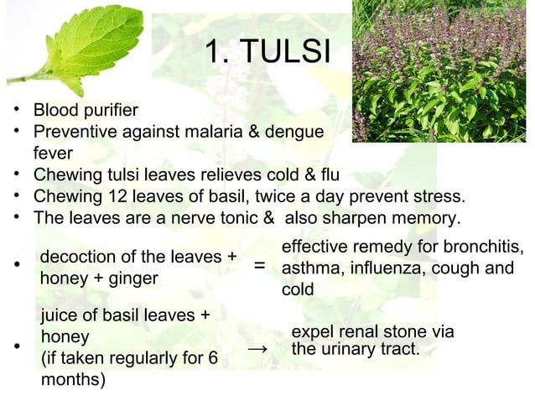

Slide 7
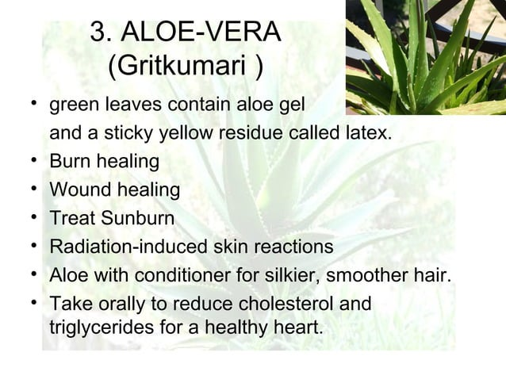

Slide 11
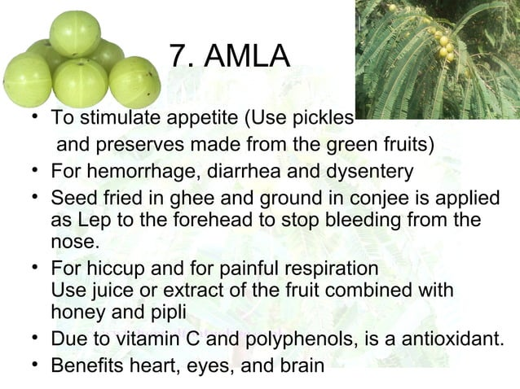

Slide 14
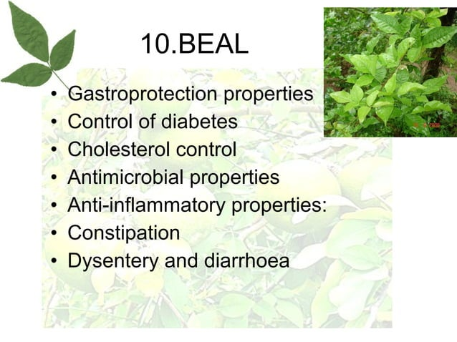

Slide 15
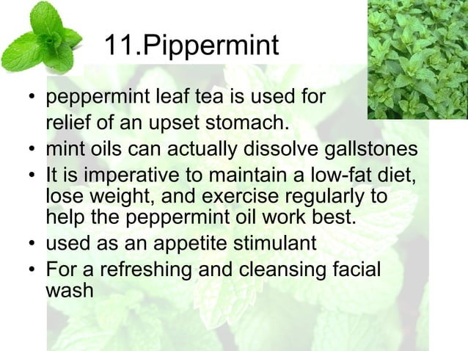

Slide 20
THANK
YOU…!

