Slide 1

Sri Ganesh College of Arts and Science
Department of Computer Applications
DATA STRUCTURE & ALGORITHM
Speaker : Mr.A.PRAVEEN

Slide 2
Stacks
A stack is a list in which insertion and deletion take place at the same end
  This end is called top
  The other end is called bottom
Stacks are known as LIFO (Last In1First Out) lists.
  The last element inserted will be the first to be retrieved
E.g. a stack of Plates, books, boxes etc.

Slide 3
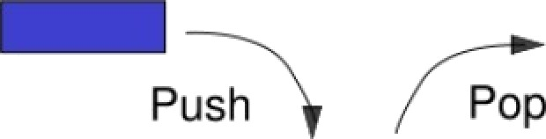
Insertion and Deletion stack

Slide 4
Operation On Stack
Creating a stack
Checking stack---- either empty or full
Insert (PUSH) an element in the stack
Delete (POP) an element from the stack
Access the top element
Display the elements of stack

Slide 5
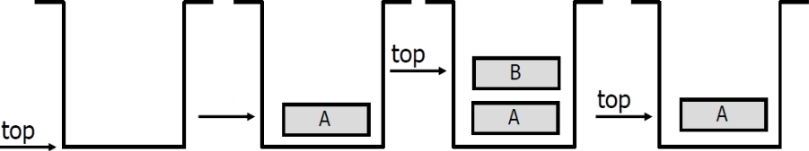
Push and Pop
Primary operations: Push and Pop
Push
  Add an element to the top of the stack.
Pop
  Remove the element at the top of the stack.
empty stack push an element push another
pop
top

Slide 6
Stack-Reiated Terms
Top
  A pointer that points the top element in the stack.
Stack Underflow
  When there is no element in the stack, the status of stack is known as stack underflow.
Stack Overflow
  When the stack contains equal number of elements as per its capacity and no more elements can be added, the status of stack is known as stack overflow

Slide 7
Stack Impiementation
Implementation can be done in two ways
Static implementation
  Dynamic Implementation
Static Implementation
  Stacks have fixed size, and are implemented as arrays
  It is also inefficient for utilization of memory
Dynamic Implementation
  Stack grow in size as needed, and implemented as linked lists
  Dynamic Implementation is done through pointers
  The memory is efficiently utilize with Dynamic Implementations

Slide 8
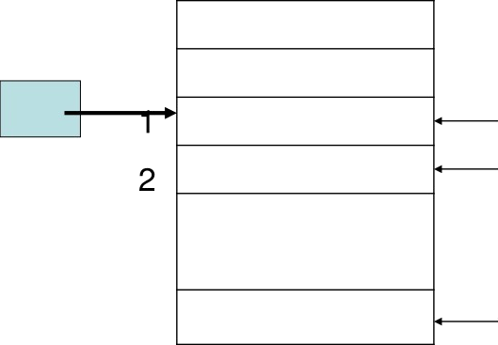
Static Implementation
A better Implementation:
tO|0
First Element
Second Element
maxlength
Last Element

Slide 9
Static Implementation
A better Implementation:
tO|0
First Element
Second Element
maxlength
Last Element

Slide 10
Static Implementation
A better Implementation:
tO|0
First Element
Second Element
maxlength
Last Element

Slide 11
Static Implementation
A better Implementation:
tO|0
First Element
Second Element
maxlength
Last Element

Slide 12
A Simpie Stack Class
class IntStack(
private:
int *stackArray; int stacksize; int top;
public:
IntStack(int);
bool isEmpty();
bool isFuII(); void push(); void pop();
void displaystack();
void displayTopElement();

Slide 13
CONSTRUCTOR
IntStack::IntStack(int size)
stackArray new int[size]; stacksize = size;
top = 1;

Slide 14
Push()
void IntStack::push()
clrscr();
int num;
if(top>-stacksize)
cout<<"stack Overflow"<<endl;
else
cout<<"Enter Number="; cin>>num;
top++; stackArray[top]=num;

Slide 15
void IntStack::pop()
clrscr();
if(top -1)
cout<<"Stack Underflow"<<endI;
else
cout<<"Number Deleted From the stack="; cout< stachArray[top];
top--;
getche();

Slide 16
Dynamic Implementation of Stacks
As we know that dynamic stack is implemented using
linked-list.
In dynamic implementation stack can expand or shrink with each PUSH or POP operation.
PUSH and POP operate only on the first/top cell on the
list.

Slide 17
Dynamic Implementation of Stack
Class Definition
class ListStack{
private:
struct node{
int num;
node *next;
)*top;
public:
ListStack()| top=NULL;) void push();
void pop(); void display();

Slide 18
Push() Function
This function creates a new node and ask the user to enter the data to be saved on the newly created node.
void ListStack::push()
node *newNode;
newNode= new node;
cout<<“Enter number to add on stack";
cin>> newNode->num; newNode->next=top;
top=newNode;

Slide 19
Pop() Function
void ListStack::pop()
node *temp; temp=top; if(top==NULL)
cout<<"Stack UnderFIow"<<endI;
else
cout<<"deIeted Number from the stack =";
cout<<top->num; top-top->next; delete temp;

Slide 20
Stack applications
“Back” button of Web Browser
— History of visited web pages is pushed onto the stack and popped when “back” button is clicked
“Undo” functionality of a text editor
Reversing the order of elements in an array
Saving local variables when one function calls another, and this one calls another1and so on.

Slide 21
C++ Run-time Stack
The C++ run-time system keeps track of the chain of active functions with a stack
When a function is called, the run- time system pushes on the stack a frame containing
Local variables and return value Program counter, keeping track of the statement being executed
When a function returns, its frame is
popped from the stack and control is
passed to the method on top of the
stack

Slide 22


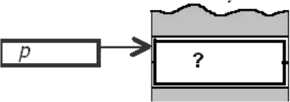
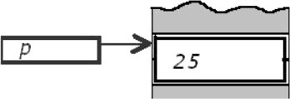
Dynamic Variables: ‘new’ operator
A dynamic variable is created and destroyed while the program is running
int *p ;
p = new int ,
creates a new dynamic integer variable and leaves p to point to this variable
*p = 25 ;

Slide 23
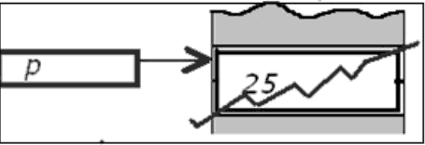
Dynamic Variables: ‘delete’ operator
delete p ; destroys the dynamic variable pointed by p After delete p, p becomes an undefined pointer variable: a dangling pointer.
Take care: before using * again, be sure p points to
something and is not a dangling pointer. Otherwise unpredictable effects.

