Slide 1
SRI GANESH COLLEGE OF ARTS & SCIENCE
DEPARTMENT OF CHEMISTRY
AGRICULTURAL IN CHEMISTRY
PRESENTED BY
Mr. T. SURESH
ASSISTANT PROFESSOR

Slide 2
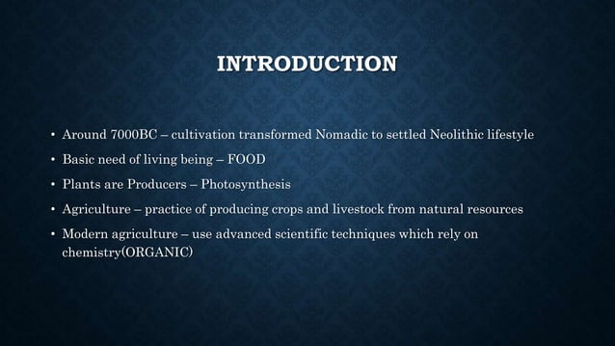

Slide 3
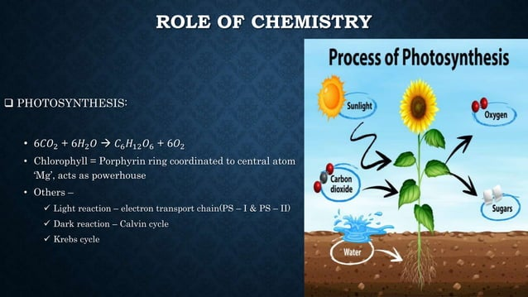

Slide 4
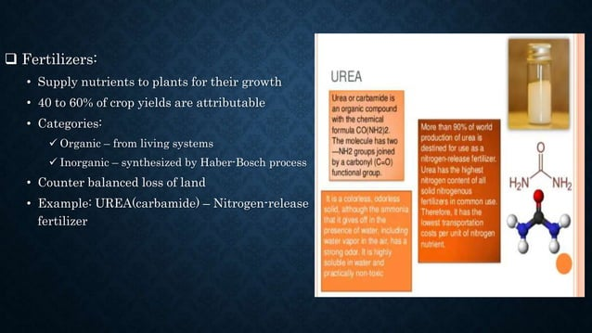

Slide 5
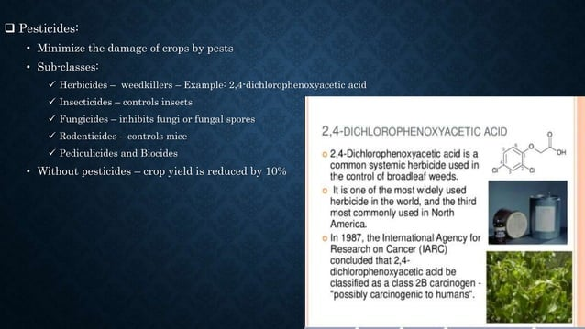

Slide 6
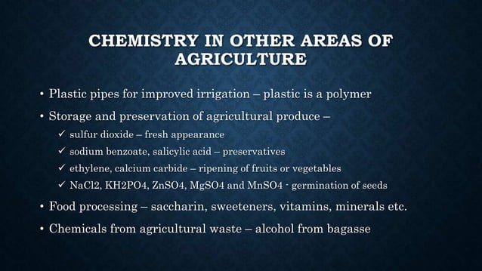

Slide 7
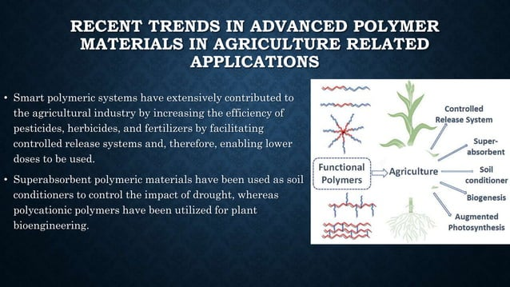

Slide 8


