Slide 1
MARKETING MANAGEMENT Mrs.M.DIVYA
Assistant Professor
Department of Commerce
Sri Ganesh College of Arts & Science

Slide 2
MARKET (MEANING)
Derived from Latin word ‘ Marcatus’ which means “ a place or trade or merchandise.
Traditional concept: a physical place where buyers and sellers meet together for exchanging goods and services for considerations. Example: vegetable, fruits or fish market.
Modern concept: an arrangement where the sellers and buyers meet directly or indirectly to buy or sell goods and services.

Slide 3





STRATA OR LAYERS OF MARKET
Potential market Available market
Total population
Qualified available market
Target market
Penetrated market

Slide 4
Total population: it is the aggregate of total people in the market.
Potential Market: a part of total population who
have interest in acquiring the product.
Available market: a portion of potential market who have enough money to buy that product.
Qualified available market: a part of available market who are legally permitted to purchase that product.
Target market: the segment of qualified available market that the firm has decided to serve.
Penetrated market: a portion of target market who
have actually purchased the product.

Slide 5
MARKETING
MEANING
The process of planning and executing the conception, price, promotion and distribution of products and services that satisfy both individuals and organizational goals.

Slide 6
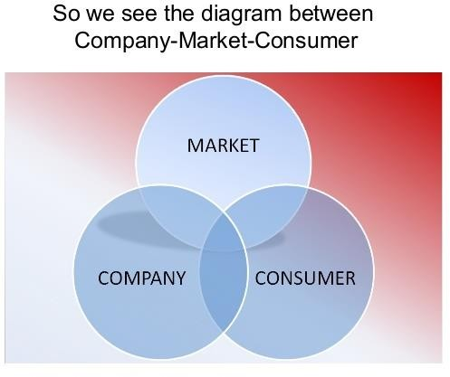

Slide 7
EVOLUTION OF MARKETING
Surplus goods exchanged by accepting the goods which needed.
Human beings were nothing but hunters of food.
BARTER
SATGE
Focusing on producing cheapest goods and make them widely available.
Economies of scale, limited research, low research and less advertisement strategies.
PRODUCTION STAGE
Making products superior in terms of its performance.
Shortcoming - No customization.
PRODUCT
STAGE
Pushing the product to the customer by advertisements, heavy discounts, promotional
techniques.
Not considering the customer needs, only focusing on the products what they produce.
SELLING STAGE
Customers are the central point. Focusing the customer needs and then design the offerings.
Focus shifted from producers side to the customers side.
MARKETING
STAGE

Slide 8
Satisfaction and feedback
Conception of idea
MARKETING

Slide 9
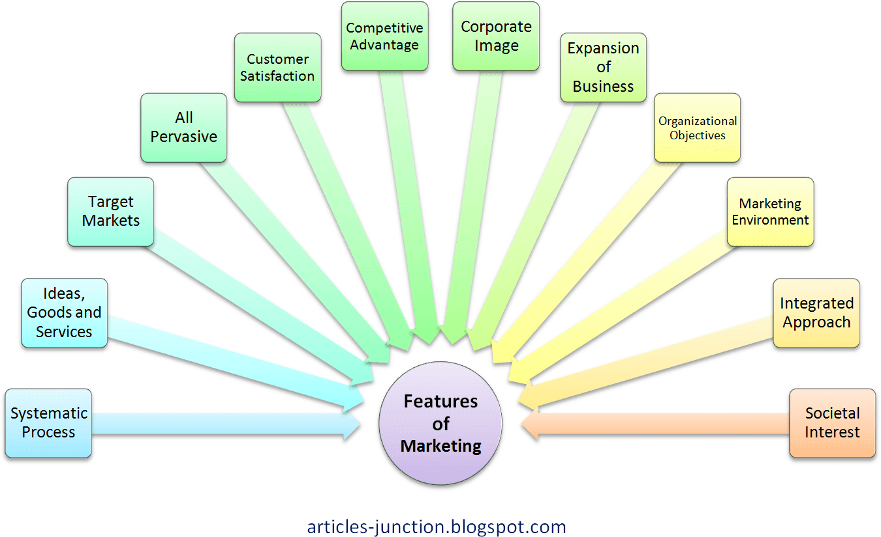
FEATURES OF MARKETING

Slide 10
OBJECTIVES OF MARKETING
To identify the target market.
To identify the needs of the customers.
To convert the needs into demand by offering products.
To determine the most appropriate price.
To distribute the products to the customers at the right place.
To disseminate product information to the customers at the right time.
To conduct market research for retaining and attracting customers.

Slide 11
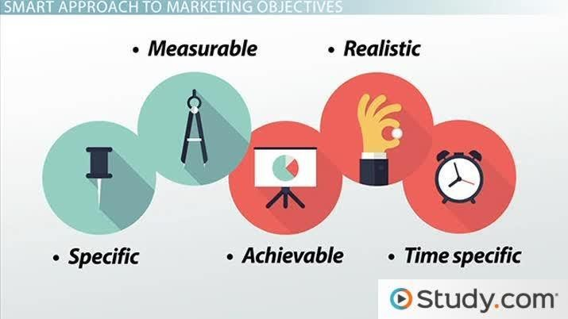
SMART OBJECTIVES OF MARKETING

Slide 12
SMART OBJECTIVES
SPECIFIC :marketing objectives should be clear and precise. Eg: it is not possible to the marketers to satisfy the whole market needs.
MEASURABLE : marketing objectives should be defined by a measurable result. The result should be quantifiable otherwise it become vain. Eg: playing football without recording the score, amount of sales.
ACHIEVABLE : the goal must not be an impossible one. Eg: target fixation ie, goal to attain 5% increase in sales in one day.
REALISTIC : the goal should be the one which can be achievable using enough resources ( man, material, money and machines) . Eg: increasing the sales by 5% during recession time is not realistic.
TIME : objectives should be achieved within the time frame. Unless otherwise it will become meaning less. Eg: scoring football after the prescribed time.

Slide 13
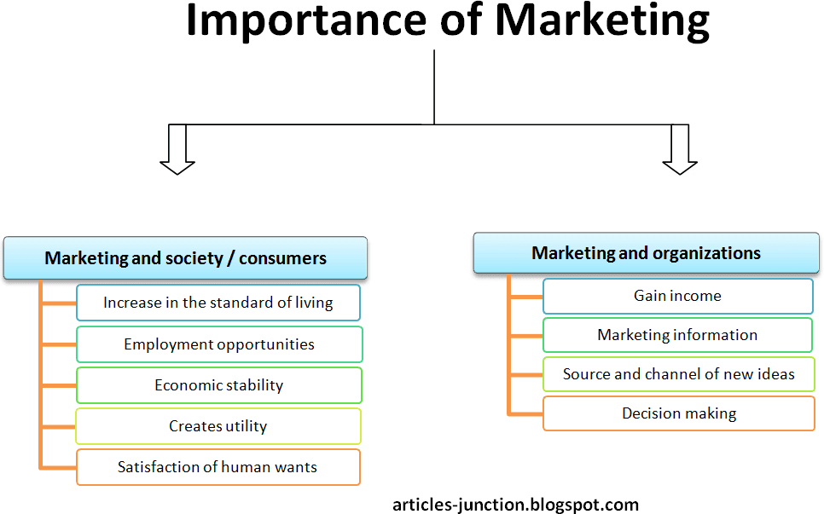
BENEFITS OF MARKETING

Slide 14
IMPORTANCE
Increase the standard of living : by giving quality products at reasonable rate.
Employment opportunities: increasing marketing activities increases need for people in several areas of selling, promotion, distribution, advertising etc.
Economic stability: marketing activities helps to maintain an equilibrium between demand and supply thereby provides economic stability.
Creates utility: utility means quality or the ability of a product to satisfy the customers need.
Market information: mere products in the hands of producers
doesn’t create demand in the market. Demand can be created only be disseminating information about products to the customers.

Slide 15
FIVE FORMS OF UTILITIES
FORM UTILITY: product must be in a useable form. Involves the development of products and give emphasis to the physical characteristics of products. Eg: creating customized shoes or shoes with different sizes.
PLACE UTILITY: offer products at most convenient place to the customers. Eg: departmental stores in the cities, small retail shops in villages.
TIME UTILITY: products should be made available to the customers at the right time. Eg: ATM.
POSSESSION UTILITY: gives the buyer the legal permission to own and use that particular product or services after sales. Eg. Invoice bill, credit sales.
INFORMATION UTILITY: communication of information triggers the buying activity. It helps to retain the existing customers and attracting the prospective customers.

Slide 16
SCOPE OF MARKETING
IDENTIFY AND SELECT THE TARGET MARKET
IDENTIFY AND SELECT THE CUSTOMER VALUE – study of customer needs and behavior.
CREATION OF VALUE – production planning and development, pricing.
COMMUNICATE THE VALUE - promotion
DELIVER THE VALUE – distribution channels, warehousing.
CUSTOMER RELATIONSHIP – customer satisfaction.
MARKETING RESEARCH – basis of all marketing activities and market control.

Slide 17
MARKETING PROCESS
MARKET
ANALYSIS
MARKETING
STRATEGIES
MARKETING MIX
IMPLEMENTATION AND CONTROL
Identify market opportunities
Environmental analysis
Segmentation and targeting
Positioning
Formulate strategy
Product – customer solution
Price –
customer cost
Place – convenience
Promotion - communication
Management of marketing efforts
Action phase
control

Slide 18
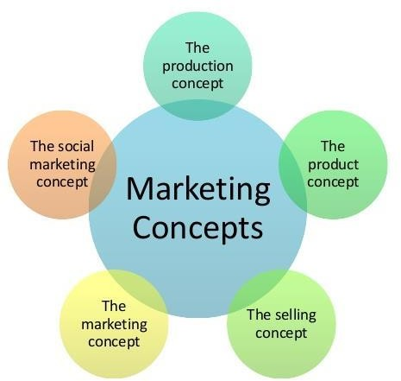
CONCEPTS OF MARKETING

Slide 19
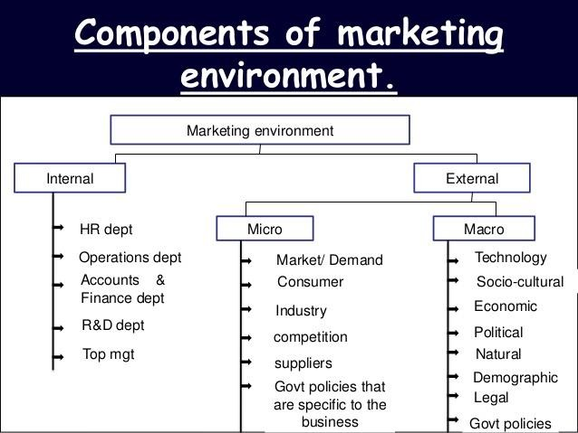
MARKETING ENVIRONMENT

Slide 20
INTERNAL ENVIRONMENT
Factors internal to the organization
Factors can be controlled by the marketer
Can be adjusted with the changes in the external environment
Components: Five M’s – man, money, materials, markets
Environment factors includes: sales, production, HR, R&D etc.

Slide 21
EXTERNAL ENVIRONMENT
Factors external to the business.
Marketers has little control over the factors.
It cannot be adjusted by the marketers or organizations.
External environment includes Micro and Macro environment.

Slide 22
Micro environment
It is external but directly related to the business. components are:
Supplier: parties who supplies raw materials to the organization.
Market intermediaries: wholesalers, retailers and physical distribution firms.
Customers: behavioral pattern and characteristics, needs, interests of customers.
Competitors: nature and degree of competition of other competitors.
Public: party interested in the marketing activities. It includes financial public, government public and media public.

Slide 23
F^{M}actªo^{c}r^{r}sºth^{e}a^{n}t ^{v}ar^{i}e^{ro}e^{n}x^{m}ter^{e}n^{n}a^{t}l to the business and also which affects the industry as a whole.
Not directly related to the business.

Slide 24
Macro factors
Demographic: describes the characteristics of total population like size, age , gender, occupation etc. Influence the buying behavior of people.
Economic factors: economic system, business cycle , fiscal and monetary policies, foreign trade.
Social &cultural factors: beliefs, values, norms, traditions etc.
Natural or physical factors: natural resources, climatic change etc. Geographical and ecological factors
Technological factors: innovations and modifications.
Political and legal factors: government policies and rules, rules, regulations, acts etc.

Slide 25
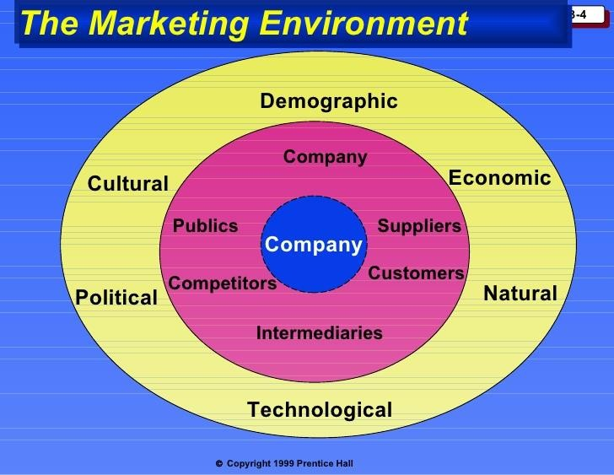
INTERNAL
ENVIRONMENT
MICRO
ENVIRONMENT
MACRO ENVIRONMENT

Slide 26
ROLE OF MARKETING
ROLE OF MARKETING IN ECONOMIC DEVELOPMENT
Marketing activities increases demand, production, income and national income there by leads to economic development.
Helps in exporting the goods which have competitive advantage.
ROLE OF MARKETING IN BUSINESS
Marketing process starts before all other functions and ends after all functions.
Basis of all other functions
Integrated approach

Slide 27
FUNCTIONS OF MARKETING
Functions of Exchange
Functions of
Physical
Supply
Facilitating functions
Modern Functions
Buying
Assembling
Selling
Transportation
Storage and warehouse
Packaging
Financing
Risk bearing
Standardization and grading
Branding
Market information
Pricing
Promotion
Market research
Product planning and development

Slide 28
EXCHANGE FUNCTIONS
Exchange means the transfer of ownership and possession of goods and services
from one person to another for money.
BUYING: it is the first process of marketing process. It is concerned with purchasing of raw materials from suppliers, wholesalers buy goods from manufacturers, retailers buy goods from wholesalers.
ASSEMBLING: it is a part of buying process. Creation and maintenance of goods purchased from different sources. Eg: computer parts assembling.
SELLING: exchange process completes with the process of selling. It is done by producer, wholesaler and the retailer. Activity of transferring ownership and possession of goods from seller to buyer. It involves creation of demand, negotiating price and transferring the title.

Slide 29
FUNCTIONS OF PHYSICAL SUPPLY
This function creates time and place utility by providing goods available at right place at right time.
TRANSPORTATION: helps in uninterrupted flow of goods and services from the place of origin to place of consumption. It creates place utility. Modes of transportation – road, water and airways.
STORAGE AND WAREHOUSING: goods are produced in anticipation of demand. Storage means holding and preserving goods from the time they are produced till they are needed by consumers. This function is facilitated by warehouse.
PACKAGING: traditionally this is done for protecting the goods from the damage under transit. But now it is for establishing a

Slide 30
FACILITATING FUNCTIONS
Supporting functions which helps the primary functions of marketing such as buying, selling, storage etc.
FINANCING: finance is the lifeblood of every business. Effectiveness of marketing functions depends on the availability of funds. Procurement of fund is a major function of marketing. Requires short term, medium term and long term finance. Like Oil through engine.
RISK BEARING: risk is inherent in business activities. Means the possibility of loss due to unfavorable happenings in the future. Efficient marketer should bear risk factors inherent in business.
STANDARDIZATION AND GRADING: it is the fixing and maintaining norms or grade for a commodity on the basis of desired features like quality, durability, color etc. grading begins when standardization ends. It is the classification of standard products into certain classes.

Slide 31
BRANDING: a name or symbol or design or combination of these giving to the product to identify the goods of one seller in order to differentiate from competitors.
MARKET INFORMATION: it is the key input for all the marketing decisions. Marketer requires information like needs and wants of consumers, market condition, competitor’s etc. Market surveys, feedback, experiment etc are the means to gain market information.
PRICING: Exchange value of goods expressed in terms of money. Ideal price should be fixed.
PROMOTION: it helps to make the product known to the customers through advertising, personal selling, public relation etc. persuade consumers to buy a product.
•

Slide 32
MODERN FUNCTIONS
MARKET RESEARCH: complete analysis market. To know about customers need, competitors, market condition etc.
PRODUCT PLANNING AND DEVELOPMENT: a journey from consumption to sales. Eg: ipod converting demand into product.

Slide 33
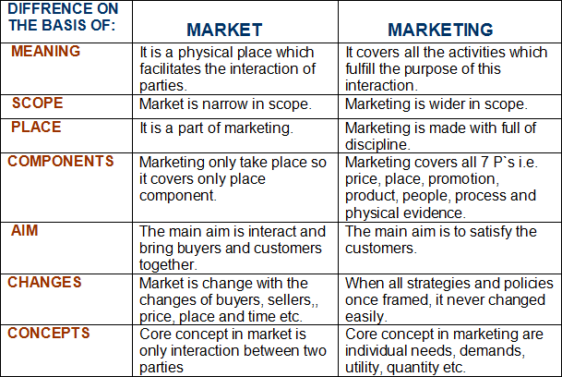
MARKET VS MARKETING

Slide 34
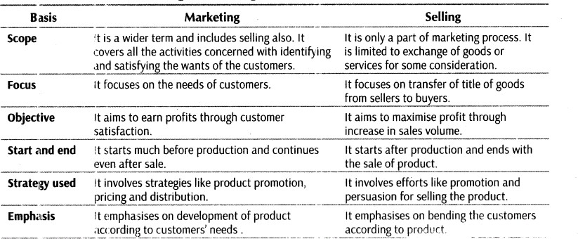
MARKETING VS SELLING

Slide 35
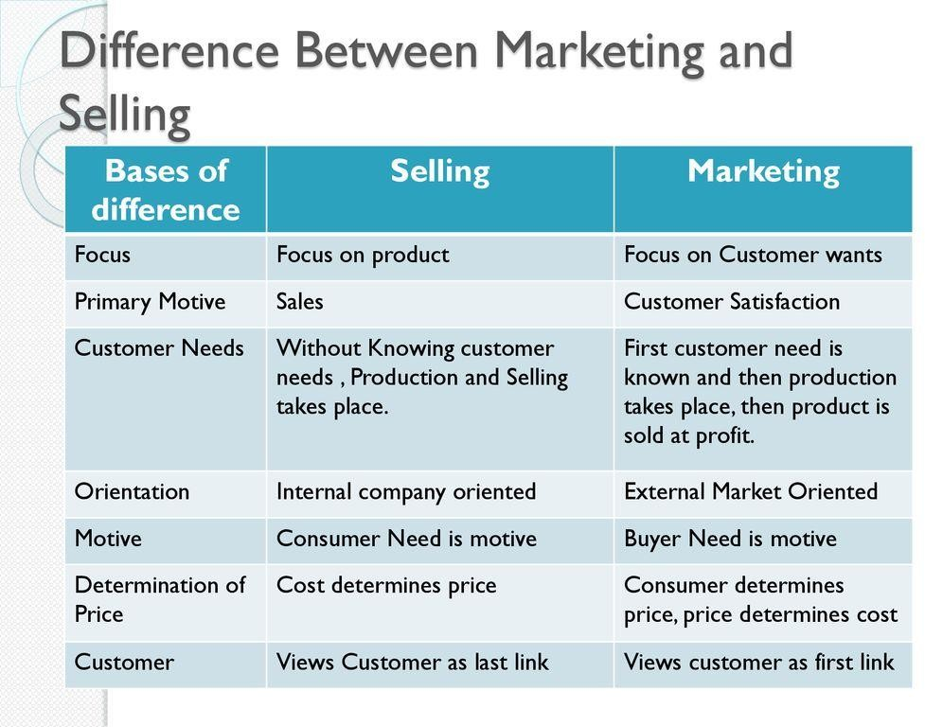

Slide 36
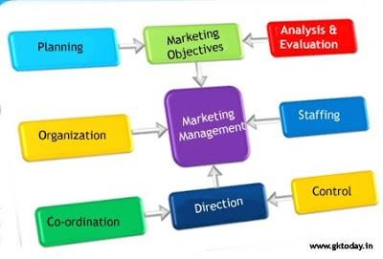

Slide 37
MARKETING MANAGEMENT
Management of marketing activities.
It is the process of planning, organizing, staffing, directing, controlling and coordinating the activities to attain the marketing objective.
Aim – to create customers, to satisfy customers, to protect the social interest and attain profits to the organization.

Slide 38
FEATURES OF MARKETING MANAGEMENT
Branch of business management: managers are involved in management functions like planning, organizing, staffing and controlling.
Both science and art: Science – follows general principles of management to guide marketing activities. Art – managing every situation in efficient and effective manner requires a skill.
Optimum utilization of resources: brings together the efforts of people and resources in the organization to attain the goals of the firm.
Putting marketing concepts into practice: process of planning and executing marketing function.
Social function: should cater the needs of society.
Integrative function: combines all other business functions of the firm to attain marketing goal.
Universal function: applicable to both profit and non profit organizations.

Slide 39
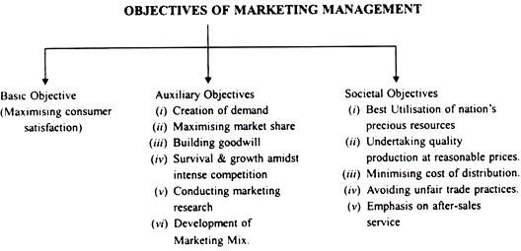
OBJECTIVES OF MARKETING MANAGEMENT

Slide 40
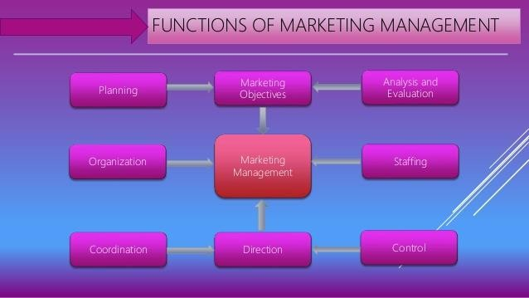
FUNCTIONS OF MARKETING

Slide 41
Marketing objectives: identification and defining the marketing objectives is the foremost function of marketing management. Objectives can be short term ( achieving sales target) or long term (customer retention).
Planning: after identifying marketing objectives the next important function is to formulate plans, policies, programmes, strategies to achieve these marketing objectives. Roadmap directing towards objectives.
Organising: collection and coordination of resources ( man, material, money, machines) to implement the marketing plan. Defines authorities and power and fixes duties and responsibilities (structure of organization) for effective coordination.
Coordination: integration of various marketing activities such as product planning, development, pricing,
distribution, promotion, transportation and warehousing.
Directing: guiding and issuing directions to the human resources to put the marketing plans and policies into action. Involves activities like leadership, motivation, supervision and direction to attain the desired objectives.
Controlling: establishing standards according to the plans, measuring the actual performance, comparing the actual with standards, and take corrective measures if any deviations.
Staffing: placing right people at right job through scientific selection and training and development.
Analysis and evaluation: evaluate the marketing activities to determine the long term success or not.

Slide 42

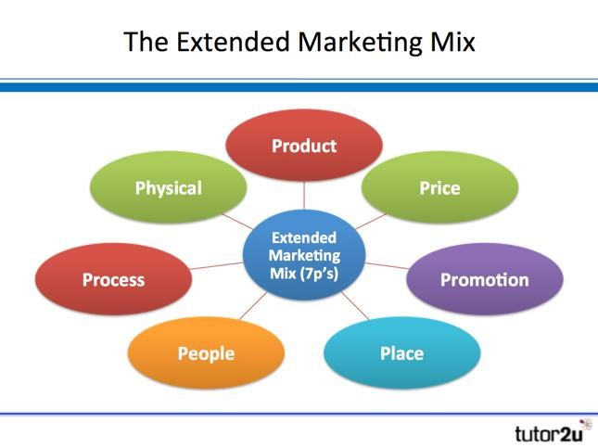
Combination of factors which can be controlled by an organization to persuade the customers to purchase it.
4 p’s of marketing: product, price, place and promotion.

Slide 43
ELEMENTS OF MARKETING MIX
PRODUCT
PRICE
PLACE
PROMOTION
Quality
Design
Variety
Brand name
Discount
Allowances
List price
Credit terms
Channels
Inventory
Transport
Coverage
Advertising
Personnel selling
Publicity
Sales promotion

Slide 44
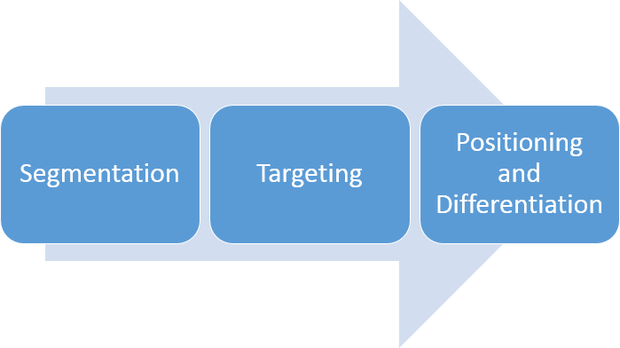
STP PROCESS( SEGMENTATION, TARGETING AND POSITIONING)

Slide 45
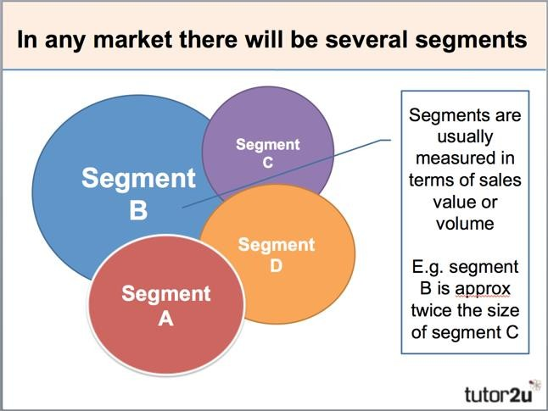
MARKET SEGMENTATION

Slide 46
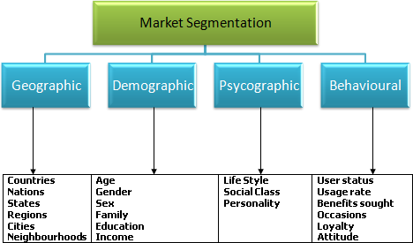
BASIS OF SEGMENTATION

Slide 47
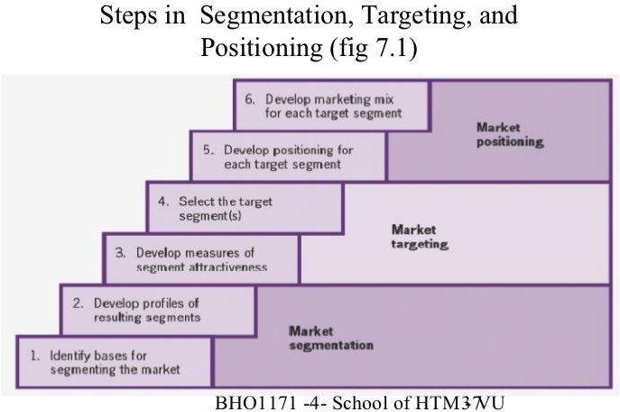
MARKET SEGMENTATION PROCESS

Slide 48
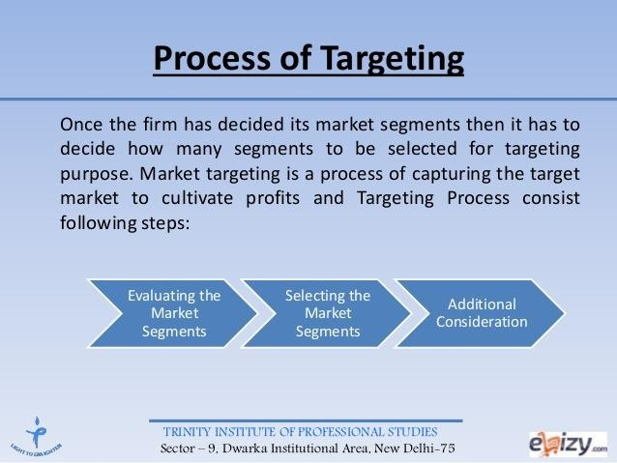
MARKET TARGETING

Slide 49
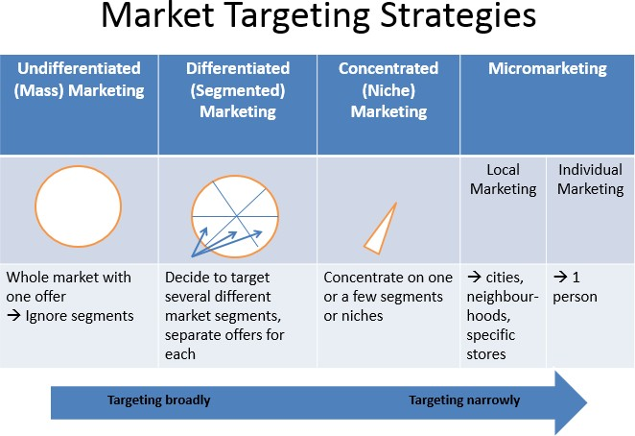
MARKET TARGETING STRATEGIES

Slide 50
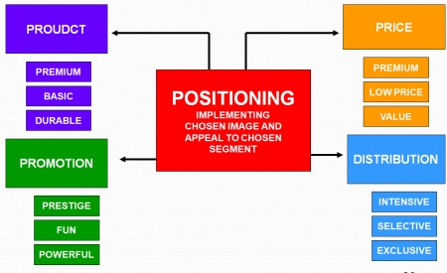
MARKET POSITIONING

Slide 51
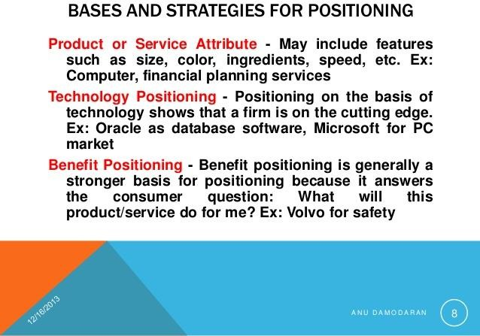
POSITIONING STRATEGIES

Slide 52
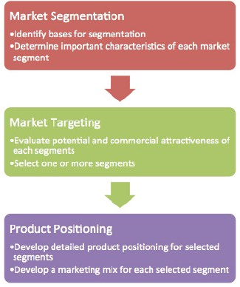
STP PROCESS

Slide 53
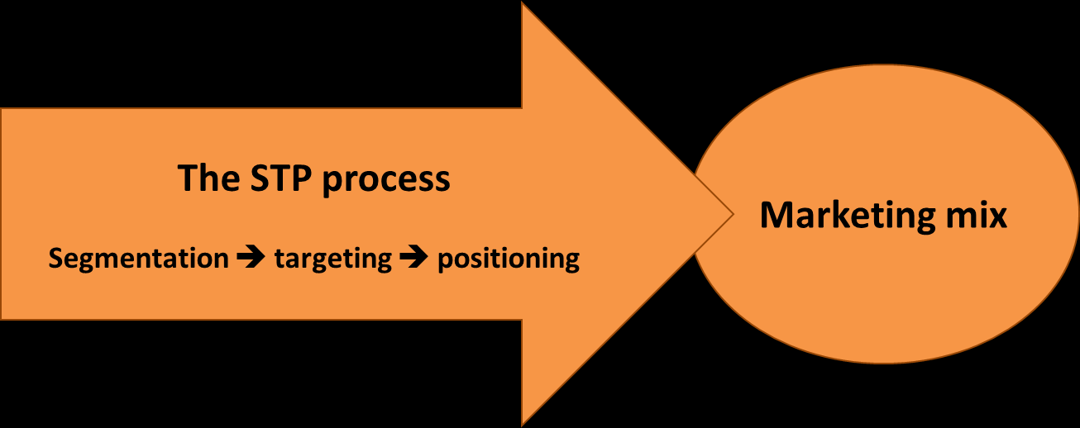

Slide 54
MODULE II
PRODUCT MIX

Slide 55
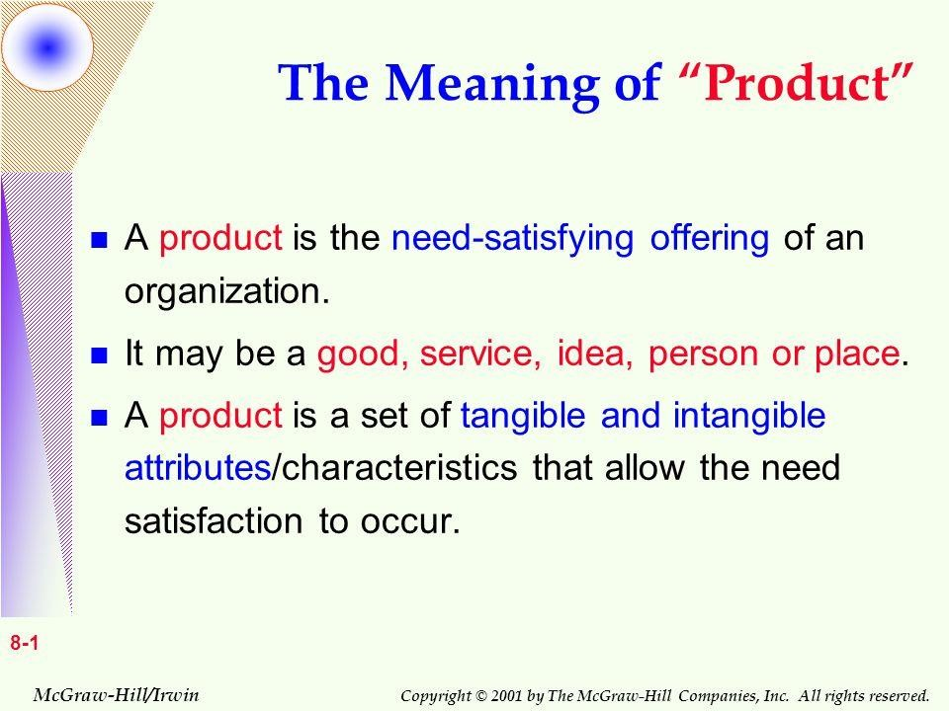
PRODUCT

Slide 56
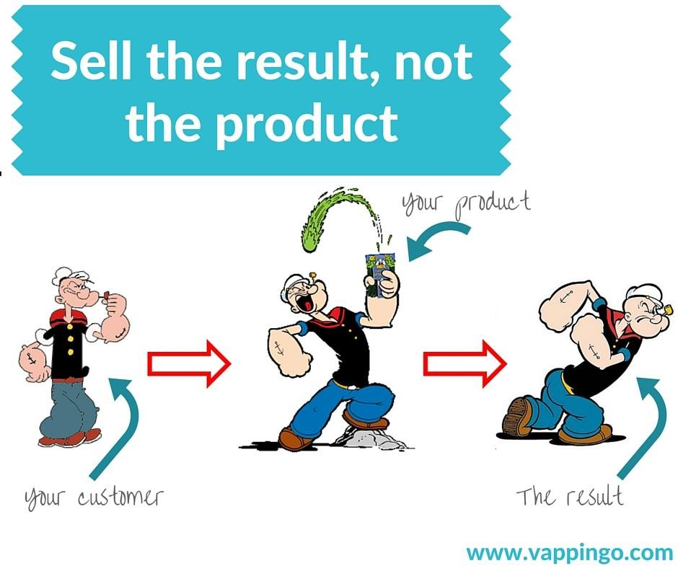
FEATURES OF PRODUCT

Slide 57
FEATURES
Want satisfying power
Tangible and intangible products
Collection of tangible and intangible features
Commercial and personal needs

Slide 58
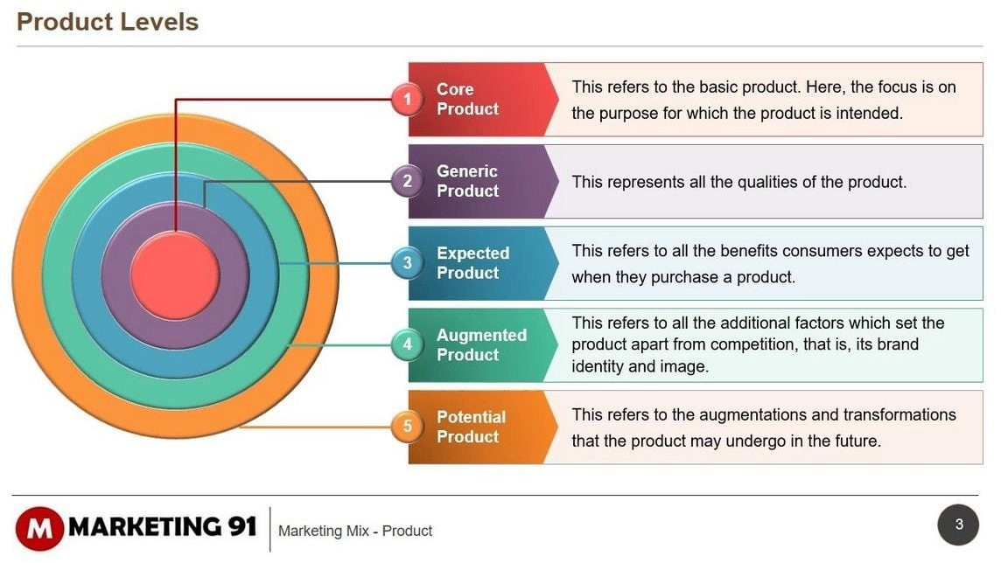
LEVELS OF PRODUCT

Slide 59
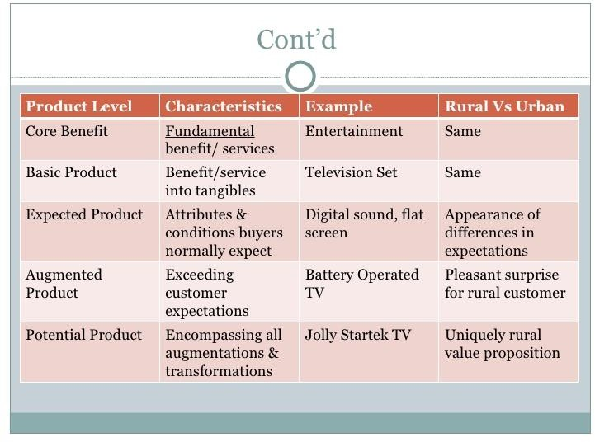
PRODUCT LEVELS THROUGH AN EXAMPLE EDIT TV BY FOOD ITEM OR MOBILE PHOME

Slide 60
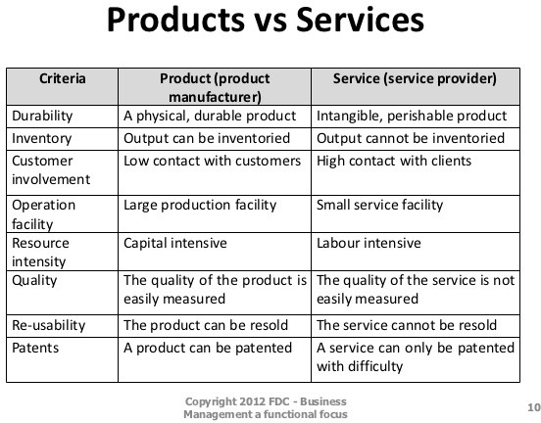
PRODUCT IS A TANGIBLE SERVICES AND SERVICE IS AN INTANGIBLE PRODUCT

Slide 61
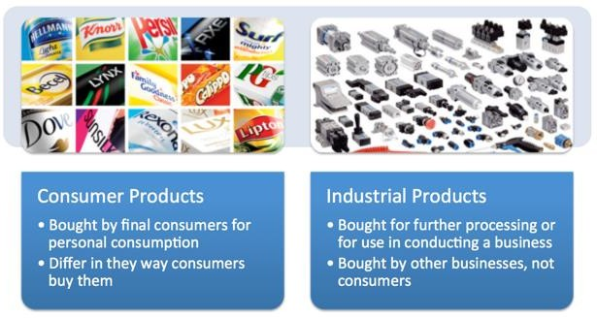
PRODUCT TYPES

Slide 62
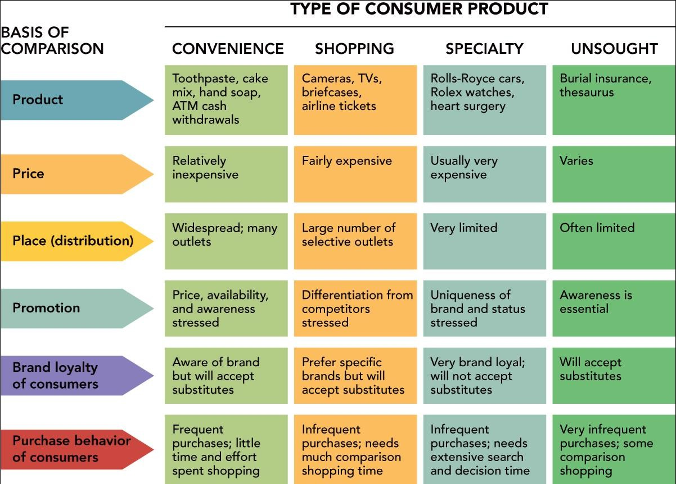

Slide 63
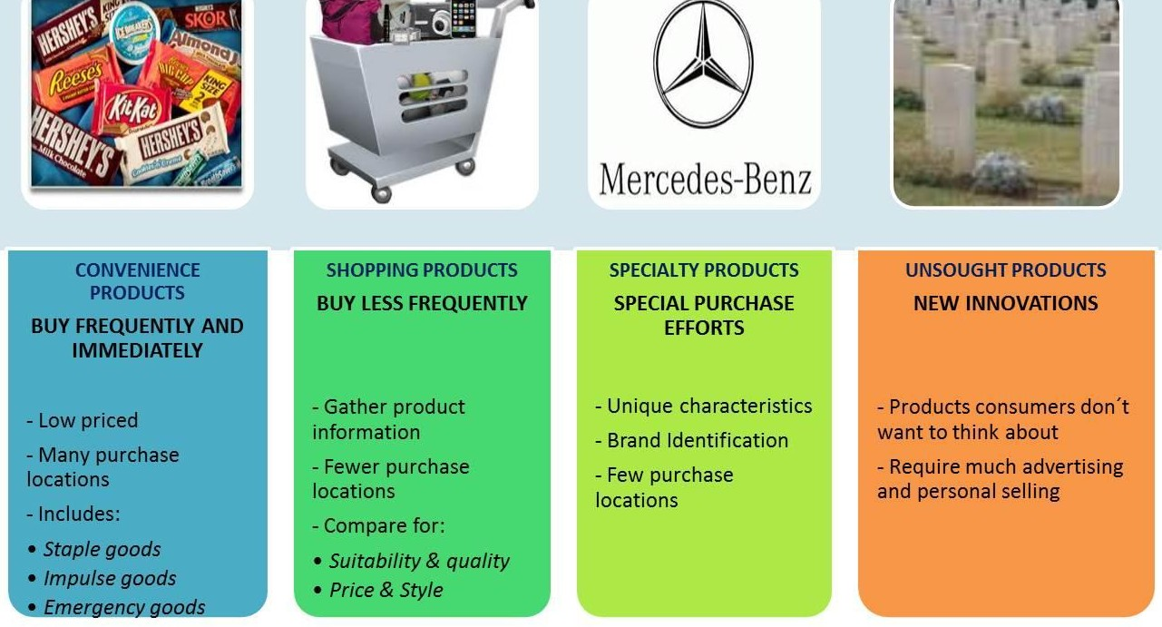

Slide 64
PRODUCT DEVELOPMENT
Introduction of new product into the market(NPD).
Modifications to the existing products.

Slide 65
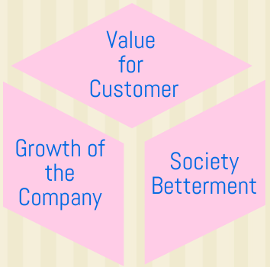
NEED FOR PRODUCT DEVELOPMENT
Customization of product
Innovation
Adjust with product life cycle
Improving brand loyalty
  Increasing market share
  Fighting competition

Slide 66
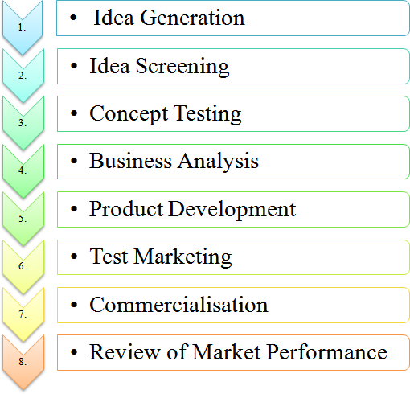
PRODUCT DEVELOPMENT PROCESS

Slide 67
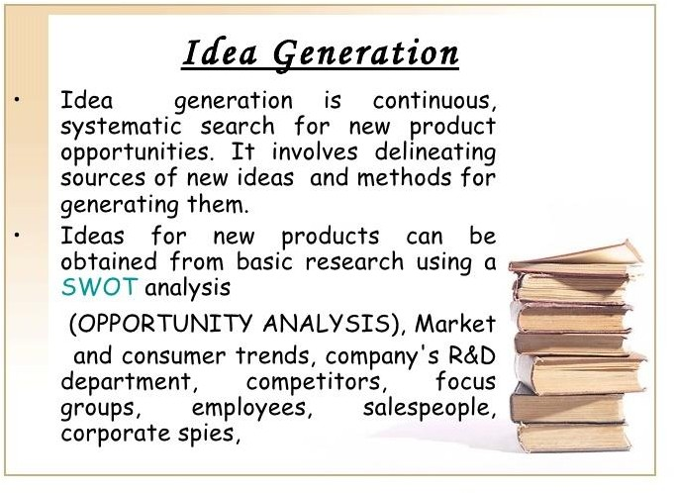

Slide 68
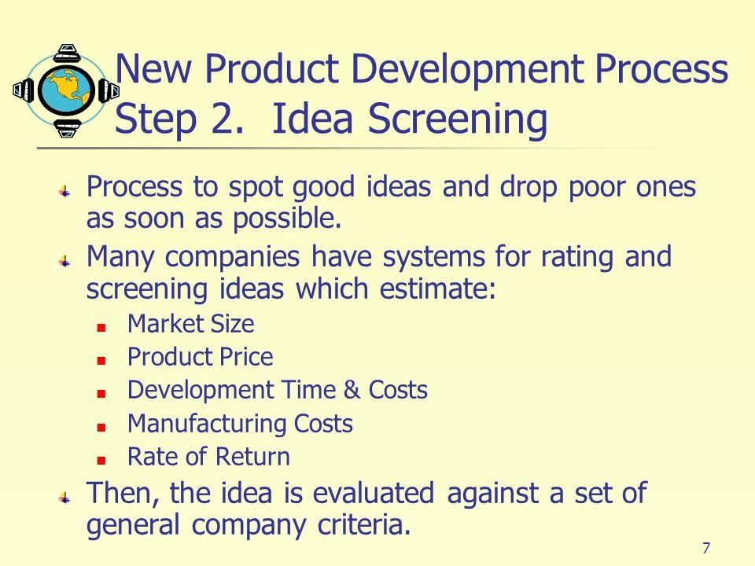

Slide 69
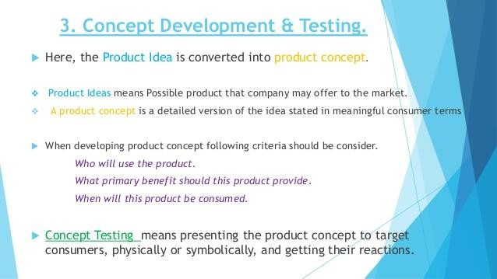

Slide 70
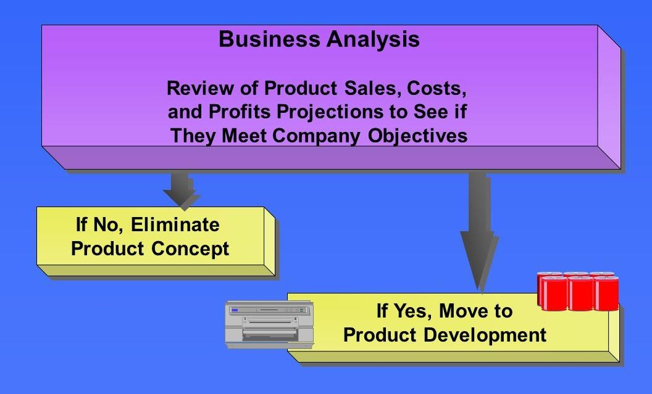

Slide 71
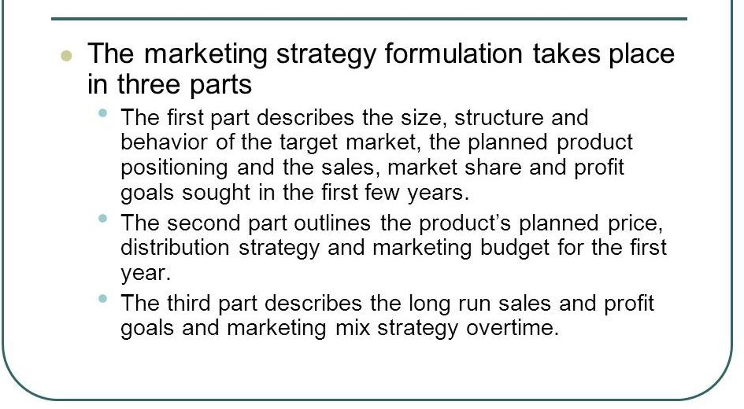
PRODUCT AND MARKETING MIX DEVELOPMENT

Slide 72
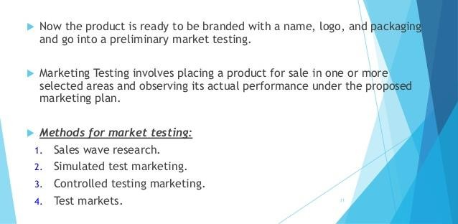
TEST MARKETING

Slide 73
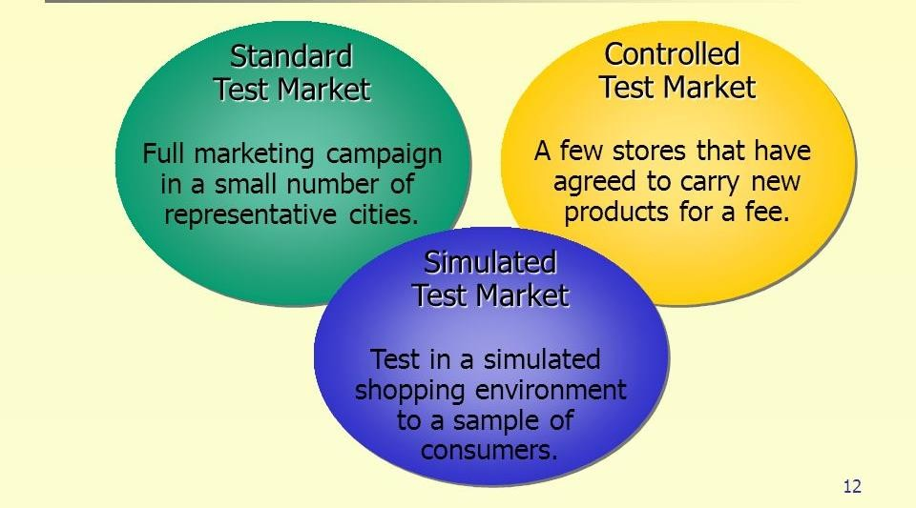

Slide 74
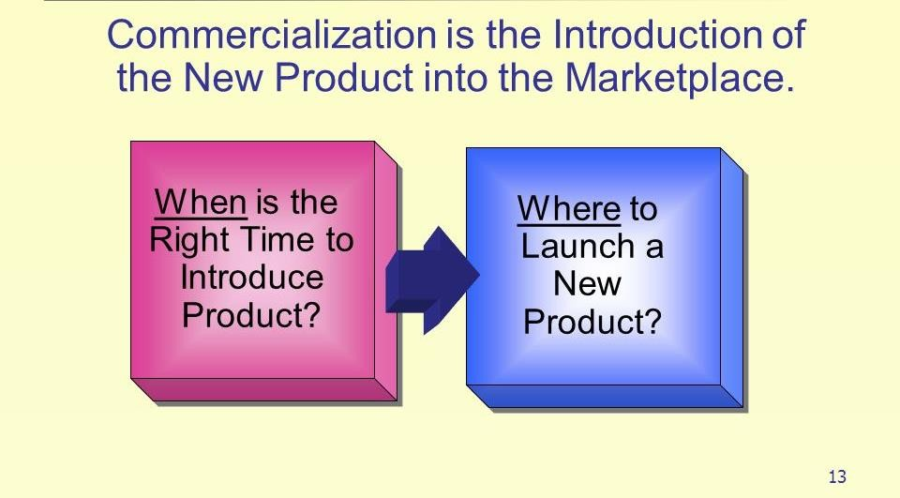
COMMERCIALISATION OF PRODUCT

Slide 75
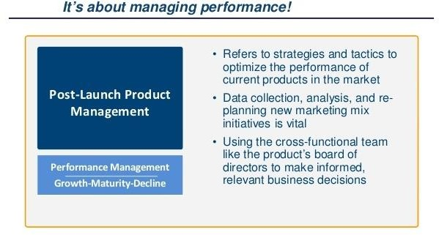
POST LAUNCH ANALYSIS

Slide 76
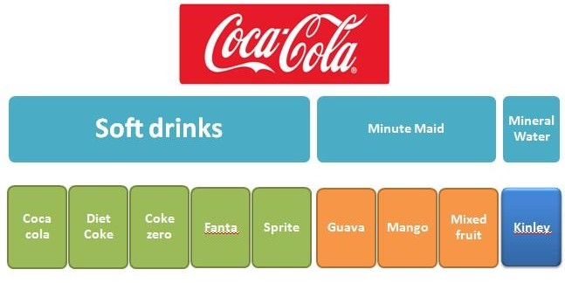
PRODUCT MIX
Width
Length
Depth of product mix

Slide 77
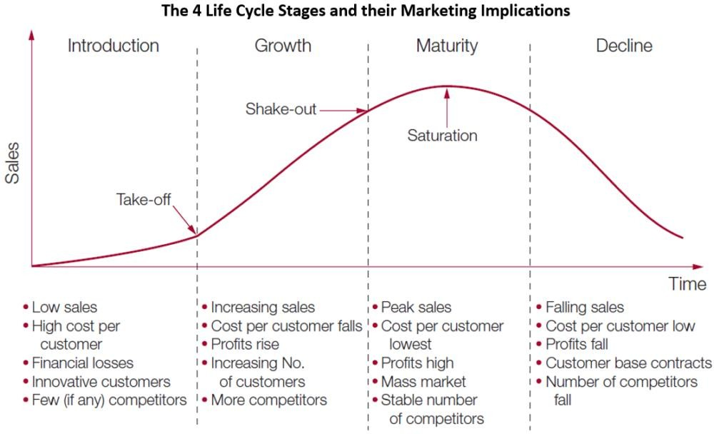
PRODUCT LIFE CYCLE

Slide 78
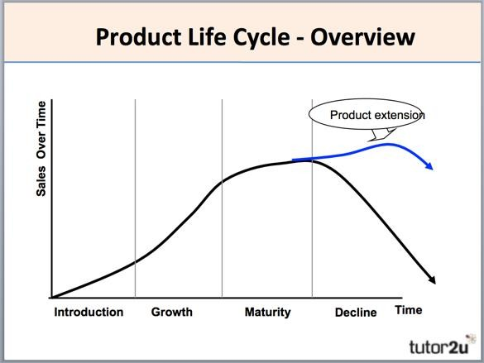

Slide 79
BRANDING
The art and science of influencing perception about a product, services or organization.
The process involved in creating a unique name and image for a product in the mind’s of customers.

Slide 80
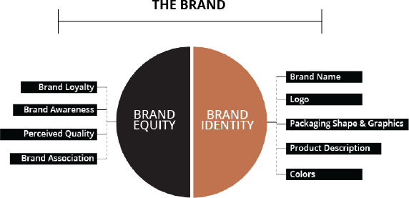

Slide 81
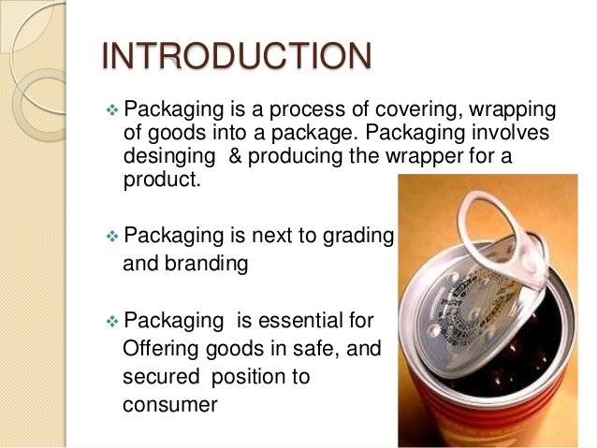
PACKAGING

Slide 82
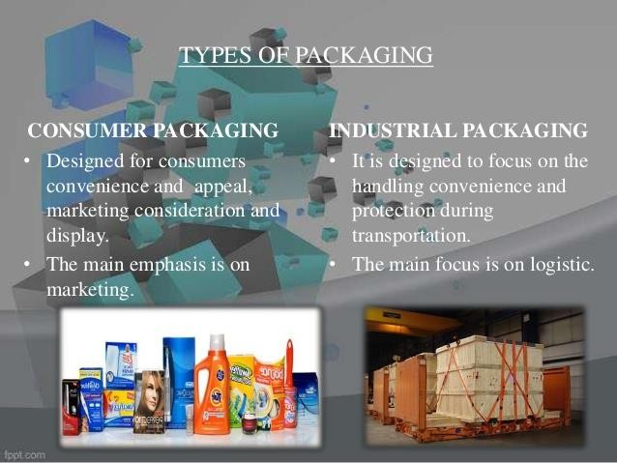

Slide 83
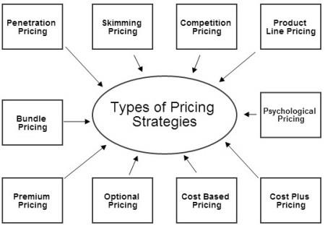
PRICING STRATEGIES

Slide 84

SERVICE MARKETING MIX

Slide 85
THANK YOU

