Slide 1

Sri Ganesh College of Arts and Science
Department of Computer science
COMPUTER NETWORK
Speaker : Mrs.K.PRIYA

Slide 2
Introduction to computer networking
Objective:
To be acquainted with:
The definitions of networking
Network topology
Network peripherals, hardware and software

Slide 3
Definitions
1.1 Network Definition
A network can be defined as two or more computers connected together in such a way that they can share resources.
The purpose of a network is to share resources.

Slide 4
Definitions (cont..)
A resource may be:
A file
A folder
A printer
A disk drive
Or just about anything else that exists on a computer.

Slide 5
Definitions (cont..)
A network is simply a collection of computers or other hardware devices that are connected together, either physically or logically, using special hardware and software, to allow them to exchange information and cooperate. Networking is the term that describes the processes involved in designing, implementing, upgrading, managing and otherwise working with networks and network technologies.

Slide 6
Advantages of networking
Connectivity and Communication
Data Sharing
Hardware Sharing
Internet Access
Internet Access Sharing
Data Security and Management
Performance Enhancement and Balancing
Entertainment

Slide 7
The Disadvantages (Costs) of Networking
Network Hardware, Software and Setup Costs
Hardware and Software Management and Administration Costs
Undesirable Sharing
Illegal or Undesirable Behavior
Data Security Concerns

Slide 8
Fundamental Network Classifications
Local Area Networks (LANs):
A local area network (LAN) is a computer network covering a small geographic area, like a home, office, or group of buildings
Wide Area Networks (WANs):
Wide Area Network (WAN) is a computer network that covers a broad area (i.e., any network whose communications links cross metropolitan, regional, or national boundaries). Or, less formally, a network that uses routers and public communications links
The largest and most well-known example of a WAN is the Internet.
WANs are used to connect LANs and other types of networks together, so that users and computers in one location can communicate with users and computers in other locations
Metropolitan Area Network (MAN):
o A metropolitan area network (MAN) is a network that interconnects users with computer resources in a geographic area or region larger than that covered by even a large local area network (LAN) but smaller than the area covered by a wide area network (WAN). The term is applied to the interconnection of networks in a city into a single larger network (which may then also offer efficient connection to a wide area network). It is also used to mean the interconnection of several local area networks by bridging them with backbone lines. The latter usage is also sometimes referred to as a campus network.

Slide 9























Fundamental Network Classifications (cont)
The Local Network (LAN)
Client
Client
Client
C
lient
Client
Client

Slide 10
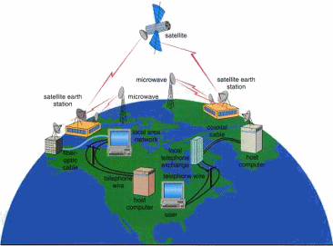
Fundamental Network Classifications (cont)
Wide Area Network

Slide 11
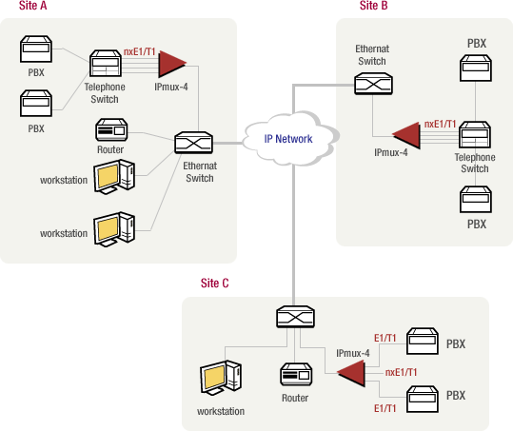
Fundamental Network Classifications (cont)
Metropolitan Area Network (MAN)

Slide 12
Intranet and Internet Specifications
Intranet: An intranet is a private network that is contained within an enterprise. It may consist of many interlinked local area networks and also use leased lines in the wide area network.
An intranet uses TCP/IP, HTTP, and other Internet protocols and in general looks like a private version of the Internet. With tunneling, companies can send private messages through the public network, using the public network with special encryption/decryption and other
security safeguards to connect one part of their intranet to another.
Internet: is a worldwide system of computer networks - a network of networks in which users at any one computer can, if they have permission, get information from any other computer (and sometimes talk directly to users at other computers).

Slide 13
Client and Server computer role in networking
Server computer is a core component of the network, providing a link to the resources necessary to perform any task.
A server computer provides a link to the resources necessary to perform any task.
The link it provides could be to a resource existing on the server itself or a resource on a client computer.
Client computers normally request and receive information over the network client. Client computers also depends primarily on the central server for processing activities

Slide 14
Peer-to peer network
A peer-to-peer network is a network where the computers act as both workstations and servers.
great for small, simple, and inexpensive networks.
In a strict peer-to-peer networking setup, every computer is an equal, a peer in the network.
Each machine can have resources that are shared with any other machine.
There is no assigned role for any particular device, and each of the devices usually runs similar software. Any device can and will send requests to any other.

Slide 15
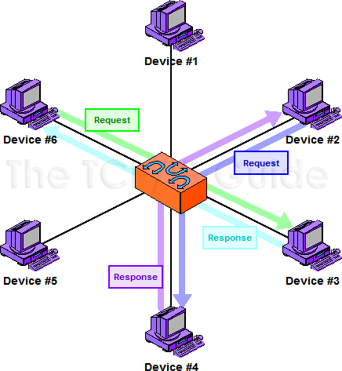
Peer-to peer network (cont..)

Slide 16
Client/Server Networking
In this design, a small number of computers are designated as centralized servers and given the task of providing services to a larger number of user machines called clients

Slide 17
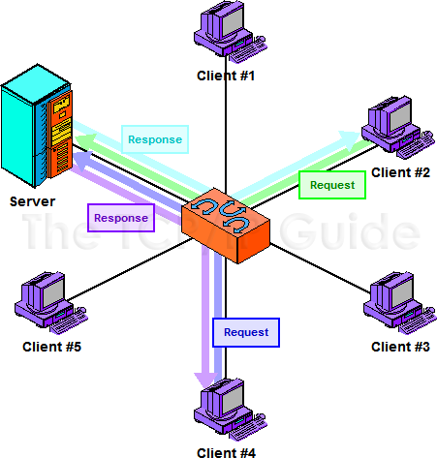
Client/Server Networking (cont..)

Slide 18
Network topology
A topology is a way of “laying out” the network. Topologies can be either physical or logical.
Physical topologies describe how the cables are run.
Logical topologies describe how the network messages travel

Slide 19
Network topology (cont.)
Bus (can be both logical and physical)
Star (physical only)
Ring (can be both logical and physical)
Mesh (can be both logical and physical)

Slide 20
Network topology (cont.)
Bus
A bus is the simplest physical topology. It consists of a single cable that runs to every workstation
This topology uses the least amount of cabling, but also covers the shortest amount of distance.
Each computer shares the same data and address path. With a logical bus topology, messages pass through the trunk, and each workstation checks to see if the message is addressed to itself. If the address of the message matches the workstation’s address, the network adapter copies the message to the card’s on-board memory.

Slide 21
Network topology (cont.)
it is difficult to add a workstation
have to completely reroute the cable and possibly run two additional lengths of it.
if any one of the cables breaks, the entire network is disrupted. Therefore, it is very expensive to maintain.

Slide 22
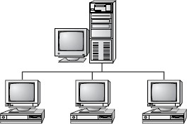
Network topology (cont.)
Bus topology

Slide 23
Network topology (cont.)
Star Topology
A physical star topology branches each network device off a central device called a hub, making it very easy to add a new workstation.
Also, if any workstation goes down it does not affect the entire network. (But, as you might expect, if the central device goes down, the entire network goes down.)
Some types of Ethernet and ARCNet use a physical star topology. Figure 8.7 gives an example of the organization of the star network.

Slide 24
Network topology (cont.)
Star topologies are easy to install. A cable is run from each workstation to the hub. The hub is placed in a central location in the office.
Star topologies are more expensive to install than bus networks, because there are several more cables that need to be installed, plus the cost of the hubs that are needed.

Slide 25
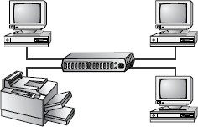
Network topology (cont.)
Star Topology

Slide 26
Network topology (cont.)
Ring
Each computer connects to two other computers, joining them in a circle creating a unidirectional path where messages move workstation to workstation.
Each entity participating in the ring reads a message, then regenerates it and hands it to its neighbor on a different network cable.

Slide 27
Network topology (cont.)
The ring makes it difficult to add new computers.
Unlike a star topology network, the ring topology network will go down if one entity is removed from the ring.
Physical ring topology systems don’t exist much anymore, mainly because the hardware involved was fairly expensive and the fault tolerance was very low.

Slide 28
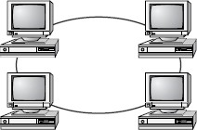
Network topology (cont.)
Ring Topology

Slide 29
Network topology (cont.)
Mesh
The mesh topology is the simplest logical topology in terms of data flow, but it is the most complex in terms of physical design.
In this physical topology, each device is connected to every other device
This topology is rarely found in LANs, mainly because of the complexity of the cabling.
If there are x computers, there will be (x × (x–1)) ÷ 2 cables in the network. For example, if you have five computers in a mesh network, it will use 5 × (5 – 1) ÷ 2, which equals 10 cables. This complexity is compounded when you add another workstation.
For example, your five-computer, 10-cable network will jump to 15 cables just by adding one more computer. Imagine how the person doing the cabling would feel if you told them you had to cable 50 computers in a mesh network—they’d have to come up with 50 × (50 – 1) ÷ 2 = 1225 cables!

Slide 30
Network topology (cont.)
Because of its design, the physical mesh topology is very expensive to install and maintain.
Cables must be run from each device to every other device. The
advantage you gain from it is its high fault tolerance.
With a logical mesh topology, however, there will always be a way of getting the data from source to destination.
It may not be able to take the direct route, but it can take an alternate, indirect route. It is for this reason that the mesh topology is still found in WANs to connect multiple sites across WAN links. It uses devices called routers to search multiple routes through the mesh and determine the best path.
However, the mesh topology does become inefficient with five or more entities.

Slide 31
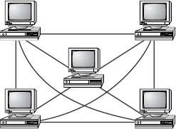
Network topology (cont.)
Mesh Topology

Slide 32
Network topology (cont.)
Advantages and Disadvantages of Network Topologies
Topology | Advantages | Disadvantages
Bus | Cheap. Easy to install. | Difficult to reconfigure. Break in bus disables entire network.
Star | Cheap. Easy to install. Easy to reconfigure. Fault tolerant. | More expensive than bus.
Ring | Efficient. Easy to install. | Reconfiguration difficult. Very expensive.
Mesh | Simplest. Most fault tolerant. | Reconfiguration extremely difficult. Extremely expensive. Very complex.

