Slide 1


OPERATING SYSTEM
Sri Ganesh College of Arts and Science
Department of Computer science
Speaker : Mr.E.PRABU

Slide 2
What is an Operating System?
The most important program that runs on your computer. It manages all other programs on the machine.
Every PC has to have one to run other applications or programs. It’s the first thing “loaded”.

Slide 3
Operating System
It performs basic tasks, such as:
  Recognizing input from the keyboard or mouse,
  Sending output to the monitor,

Slide 4
Operating System
Keeping track of files and directories on the disk, and
Controlling peripheral devices such as disk drives and printers.

Slide 5
Is There More Than One Type of OS?
Generally, there are four types, based on the type of computer they control and the sort of applications they support.
  Single-user, single task
This type manages the computer so that one user can effectively do one thing at a time.

Slide 6
Types of Operating Systems
2. Multi-user, multi-task
Allows two or more users to run programs at the same time. Some operating systems permit hundreds or even thousands of concurrent users.

Slide 7
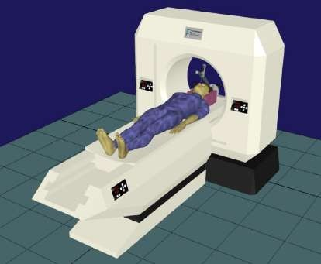

Types of Operating Systems
3. Real Time Operating Systems
RTOS are used to control machinery, scientific instruments, and industrial systems.
There is typically very little user- interface capability.
Resources are managed so that a particular operation executes precisely the same every time.

Slide 8
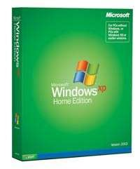

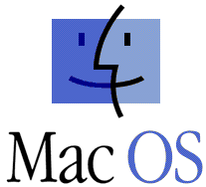
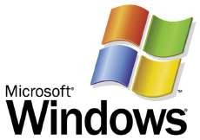
Types of Operating Systems
4. Single-user, Multi-tasking
This is the type of operating system most desktops and laptops use today.
Microsoft’s Windows and Apple’s MacOS are both examples of operating systems that will let a single user have several programs in operation at the same time.

Slide 9

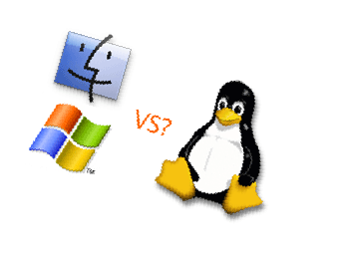
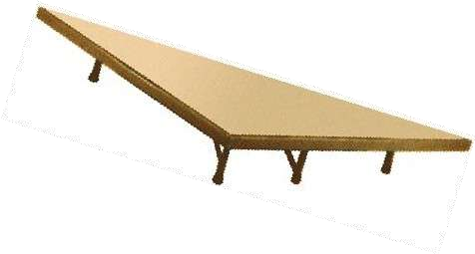
OS’s Manage Applications
Operating systems provide a software platform on top of which other “application” programs can run.
  The application programs must be written to run on a particular operating system.
  So, your choice of operating system determines what application software you can run.

Slide 10
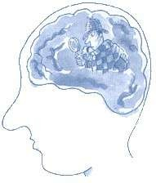
Operating System Functions
Besides managing hardware and software resources on the system, the OS must manage resources and memory.
  There are two broad tasks to be accomplished.

Slide 11
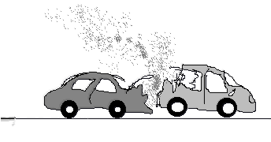

OS - Memory Storage and Management
1. Each process must have enough memory in which to execute, and
It can neither run into the memory space of another process,
Nor be run into by another process.

Slide 12
OS - Memory Storage and Management
1. The different types of memory in the system must be used properly so that each process can run most effectively.

Slide 13

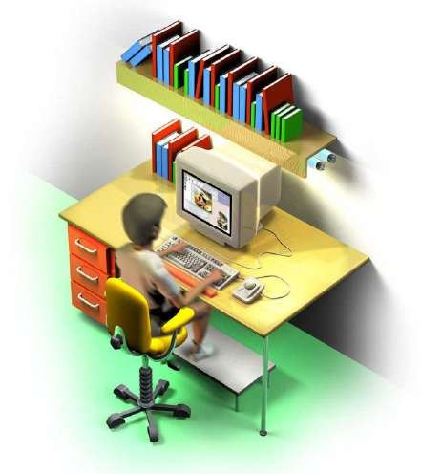
Cache Memory
Cache - A section of a computer's memory which temporarily retains recently accessed data in order to speed up repeated access to the same data.
It provides rapid access without having to wait for systems to load.

Slide 14
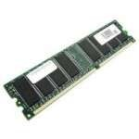
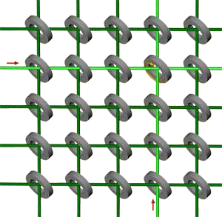
RAM Memory
Random access memory (RAM) is the best known form of computer memory.
  RAM is considered "random access" because you can access any memory cell directly if you know the row and column that intersect at that cell.

Slide 15
RAM Memory
The more RAM your computer has, the faster programs can function. The two main types are called DRAM and SRAM. SRAM is faster than DRAM, but, more expensive.
Remember, that if the power is turned off, then all data left in RAM, that has not been saved to the hard drive, is lost.

Slide 16
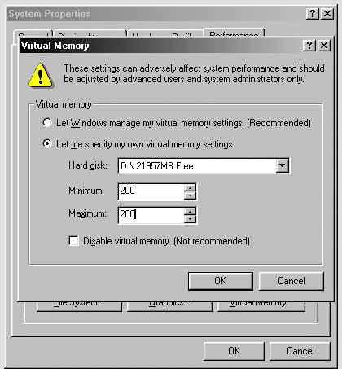
Virtual Memory
Virtual Memory – a method of using hard disk space to provide extra memory. It simulates additional RAM.
  In Windows, the amount of virtual memory available, equals the amount of free RAM plus the amount of disk space allocated to the swap file.

Slide 17
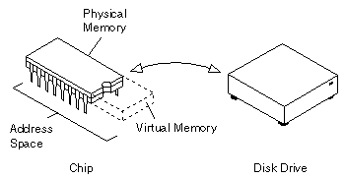
Virtual Memory – Swap File
A swap file is an area of your hard disk that is set aside for virtual memory. Swap files can be either temporary or permanent.

Slide 18


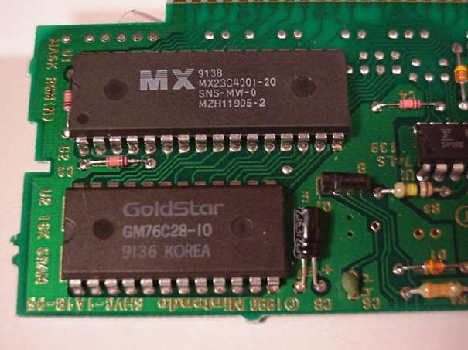
OS - Wake up call
When you turn on the power to a PC, the first program that runs is a set of instructions kept in the computer's read-only memory (ROM).

Slide 19

OS - Wake up Call
It checks to make sure everything is functioning properly.
It checks the CPU, memory, and basic input-output systems (BIOS) for errors.

Slide 20

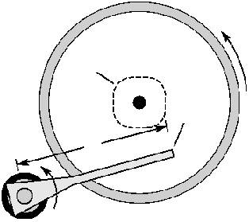

OS – Wake up Call
Once successful, the software will begin to activate the computer's disk drives.
It then finds the first piece of the operating system: the bootstrap loader.

Slide 21
OS - Booting the PC
The bootstrap loader is a small program that has a single function: It loads the operating system into memory and allows it to begin operation.

Slide 22
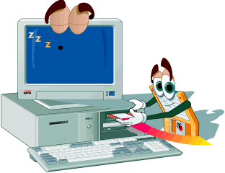
OS - Booting the PC
The bootstrap loader sets up the small driver programs that interface with and control the various hardware.
It sets up the divisions of
  memory
  user information, and
  applications.

Slide 23
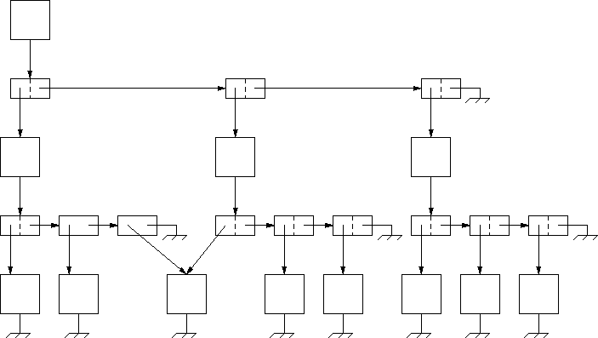

OS - Booting the PC
It establishes the data structures needed to communicate within and between the subsystems and applications of the computer.
Then it turns control of the computer over to the operating system.

