Slide 1

Sri Ganesh College of Arts and Science
Department of Computer science
SOFTWARE ENGINEERING
Speaker : Mr.A.PRAVEEN

Slide 2


Software Requirements
Microsoft Windows XP (Professional Ed.) / Vista / 7
Software tools will be available from the Internet or from the course Web site under demos as a choice of freeware or commercial tools
  Business and Application Modeling Tools
  Software Development Tools
  Workflow Management FrameworkS
11
Agenda
1
Instructor and Course Introduction
1
2
Software Engineering Fundamentals
2
3
Towards a Pattern-Driven SE Methodology
3
4
Summary and Conclusion
4
12

Slide 3
Agenda – Software Engineering Fundamentals
2 Software Engineering Fundamentals
Software Engineering Scope
Software Engineering Discipline
Software Development Challenges
Refining the Software Engineering Discipline
The Human Side of Software Development
Software Engineering Best Practices ala Rational Rational Unified Process
Introduction to Agile Software Engineering
2
13
What is Software? (1/2)
Software is:
instructions (computer programs) that when executed provide desired features, function, and performance;
data structures that enable the programs to adequately manipulate information;
documentation that describes the operation and use of the programs.
14

Slide 4
What is Software? (2/2)
Software is developed or engineered, it is not manufactured in the classical sense.
Software doesn't "wear out."
Although the industry is moving toward component- based construction, most software continues to be custom-built.
15
Wear vs. Deterioration
increased failure
rate due to side effects
Failure
rate
change
actual curve
idealized curve Time
16

Slide 5

Software Engineering
The economies of ALL developed nations are dependent on software
More and more systems are software-controlled
Software engineering is concerned with theories, methods and tools for professional software development
Software engineering expenditure represents a significant fraction of GNP in all developed countries
  GNP stands for Gross National Product. GNP per capita is the dollar value of a country’s final output of goods and services in a year, divided by its population. It reflects the average income of a country’s citizens.
17
Software Costs
Software costs often dominate system costs.
  The costs of software on a PC are often greater than the hardware cost
Software costs more to maintain than it does to develop
  For systems with a long life, maintenance costs may be several times development costs
Software engineering is concerned with cost- effective software development
18

Slide 6
Software Products
Generic products
  Stand-alone systems which are produced by a development organization and sold on the open market to any customer
Bespoke (customized) products
  Systems which are commissioned by a specific customer and developed specially by some contractor
Most software expenditure is on generic products but most development effort is on bespoke systems
19
Software Applications
System software
Application software
Engineering/scientific software
Embedded software
Product-line software
WebApps (Web applications)
AI software
20

Slide 7
Software—New Categories
Open world computing - pervasive, distributed computing
Ubiquitous computing - wireless networks
Netsourcing - the Web as a computing engine
Open source - ”free” source code open to the computing community (a blessing, but also a potential curse!)
Also …
» Data mining
» Grid computing
» Cognitive machines
» Software for nanotechnologies
21
Legacy Software
Why must it change?
software must be adapted to meet the needs of new computing environments or technology
software must be enhanced to implement new business requirements
software must be extended to make it interoperable with other more modern systems or databases
software must be re-architected to make it viable within a network environment
22

Slide 8

Software Product Attributes
Maintainability
  It should be possible for the software to evolve to meet changing requirements
Dependability
  The software should not cause physical or economic damage in the event of failure
Efficiency
  The software should not make wasteful use of system resources
Usability
  Software should have an appropriate user interface and documentation
23
Importance of Product Characteristics
The relative importance of these characteristics depends on the product and the environment in which it is to be used
In some cases, some attributes may dominate
  In safety-critical real-time systems, key attributes may be dependability and efficiency
Costs tend to rise exponentially if very high levels of any one attribute are required
24

Slide 9
Efficiency Costs
Cost
Efficiency
25
Characteristics of WebApps (1/2)
Network intensiveness. A WebApp resides on a network and must serve the needs of a diverse community of clients.
Concurrency. A large number of users may access the WebApp at one time.
Unpredictable load. The number of users of the WebApp may vary by orders of magnitude from day to day.
Performance. If a WebApp user must wait too long (for access, for server-side processing, for client-side formatting and display), he or she may decide to go elsewhere.
Availability. Although expectation of 100 percent availability is unreasonable, users of popular WebApps often demand access on a “24/7/365” basis.
Data driven. The primary function of many WebApps is to use hypermedia to present text, graphics, audio, and video content to the end-user.
Content sensitive. The quality and aesthetic nature of content remains an important determinant of the quality of a WebApp.
26

Slide 10
Characteristics of WebApps (2/2)
Continuous evolution. Unlike conventional application software that evolves over a series of planned, chronologically-spaced releases, Web applications evolve continuously
Immediacy. Although immediacy—the compelling need to get software to market quickly—is a characteristic of many application domains, WebApps often exhibit a time to market that can be a matter of a few days or weeks
Security. Because WebApps are available via network access, it is difficult, if not impossible, to limit the population of end-users who may access the application
Aesthetics. An undeniable part of the appeal of a WebApp is its look and feel
27
Summary of Sub-Section’s Key Points
Software engineering is concerned with the theories, methods and tools for developing, managing and evolving software products
Software products consist of programs and documentation
Product attributes include maintainability, dependability, efficiency and usability
28

Slide 11

Agenda – Software Engineering Fundamentals
2 Software Engineering Fundamentals
Software Engineering Scope Software Engineering Discipline
Software Development Challenges
Refining the Software Engineering Discipline The Human Side of Software Development
Software Engineering Best Practices ala Rational Rational Unified Process
Introduction to Agile Software Engineering
2
29
The Software Process
Structured set of activities required to develop a software system
  Specification
  Design
  Validation
  Evolution
Activities vary depending on the organization and the type of system being developed
Software process must be explicitly modeled if it is to be managed
30

Slide 12
Process Characteristics (1/2)
Understandability
  Is the process defined and understandable?
Visibility
  Is the process progress externally visible?
Supportability
  Can the process be supported by CASE tools?
Acceptability
  Is the process acceptable to those involved in it?
31
Process Characteristics (2/2)
Reliability
  Are process errors discovered before they result in product errors?
Robustness
  Can the process continue in spite of unexpected problems?
Maintainability
  Can the process evolve to meet changing organizational needs?
Rapidity
  How fast can the system be produced?
32

Slide 13
Engineering Process Model
Specification
  Set out the requirements and constraints on the system
Design
  Produce a paper model of the system
Manufacture
  Build the system
Test
  Check if the system meets the required specifications
Install
  Deliver the system to the customer and ensure it is operational
Maintain
  Repair faults in the system as they are discovered
33
Software Process Models Characteristics
Normally, specifications are incomplete/anomalous
Very blurred distinction between specification, design and manufacturing
No physical realization of the system for testing
Software does not wear out
  Maintenance does not mean component replacement
34

Slide 14





Generic Software Process Models
Waterfall model
  Separate and distinct phases of specification and development
Evolutionary development
  Specification and development are interleaved
Formal transformation
  A mathematical system model is formally transformed to an implementation
Reuse-based development
  The system is assembled from existing components
35
Waterfall Model
Requirements definition | System and software design | Implementation and unit testing | Integration and system testing | Operation and maintenance | 36

Slide 15









Waterfall Model Characteristics and Limitations
Phases:
  Requirements analysis and definition
  System and software design
  Implementation and unit testing
  Integration and system testing
  Operation and maintenance
The drawback of the waterfall model is the difficulty of accommodating change after the process is underway
37
Evolutionary Development
 | Concurrent
 | activities
 | Specification | Initial version
Outline description | Development | Intermediate versions
 | Validation | Final version
 |  |  | 38

Slide 16
Evolutionary Development Characteristics
Exploratory prototyping
  Objective is to work with customers and to evolve a final system from an initial outline specification
  Should start with well-understood requirements
Throw-away prototyping
  Objective is to understand the system requirements
  Should start with poorly understood requirements
39
Evolutionary Development Limitations
Problems
  Lack of process visibility
  Systems are often poorly structured
  Requires Special skills (e.g., languages for rapid prototyping) may be required
Applicability
  For small or medium-size interactive systems
  For parts of large systems (e.g. the user interface)
  For short-lifetime systems
40

Slide 17

Summary of Sub-Section’s Key Points
The software process consists of those activities involved in software development
The waterfall model considers each process activity as a discrete phase
Evolutionary development considers process activities as concurrent
41
Agenda – Software Engineering Fundamentals
2 Software Engineering Fundamentals
Software Engineering Scope Software Engineering Discipline
Software Development Challenges Refining the Software Engineering Discipline The Human Side of Software Development
Software Engineering Best Practices ala Rational
Rational Unified Process
Introduction to Agile Software Engineering
2
42

Slide 18
Inherent Risks
(http://www.ibm.com/developerworks/rational/library/1719.html)
Sponsorship
Budget
Culture
Business Understanding
Priorities
  Business changes
  Features
  Schedule slips
Methodology Misuse
Software Quality
43
Symptoms of Software Development Problems
User or business needs not met
Requirements churn
Modules don’t integrate
Hard to maintain
Late discovery of flaws
Poor quality of end-user experience
Poor performance under load
No coordinated team effort
Build-and-release issues
44

Slide 19

Trace Symptoms to Root Causes
Symptoms | Root Causes | Best Practices | 45
Needs not met Requirements churn Modules don’t fit Hard to maintain Late discovery Poor quality Poor performance Colliding developers Build-and-release | Insufficient requirements Ambiguous communications Brittle architectures Overwhelming complexity Undetected inconsistencies Poor testing Subjective assessment Waterfall development Uncontrolled change Insufficient automation | Develop Iteratively Manage Requirements Use Component Architectures Model Visually (e.g., UML) Continuously Verify Quality Manage Change
Risk Management
Perhaps the principal task of a manager is to minimize risk
The 'risk' inherent in an activity is a measure of the uncertainty of the outcome of that activity
High-risk activities cause schedule and cost overruns
Risk is related to the amount and quality of available information
  The less information, the higher the risk
46

Slide 20

Process Model Risk Problems
Waterfall
  High risk for new systems because of specification and design problems
  Low risk for well-understood developments using familiar technology
Prototyping
  Low risk for new applications because specification and program stay in step
  High risk because of lack of process visibility
Transformational
  High risk because of need for advanced technology and staff skills
47
Agenda – Software Engineering Fundamentals
2 Software Engineering Fundamentals
Software Engineering Scope Software Engineering Discipline Software Development Challenges
Refining the Software Engineering Discipline
The Human Side of Software Development Software Engineering Best Practices ala Rational Rational Unified Process
Introduction to Agile Software Engineering
2
48

Slide 21
Hybrid Process Models
Large systems are usually made up of several sub-systems
The same process model need not be used for all subsystems
Prototyping should be used for high- risk specifications
Waterfall model should be used for well-understood developments
49
Spiral Model of the Software Process
Determine ob jectiv es alternatives and
constraints
Ev aluate alternatives id entify, resolve risk s
Risk
analysis
Risk
analysis
Risk analys is
Opera-
Prototype 3 tional
Risk
Proto-
Prototyp e 2
protoype
REVIEW
analysis
type 1
Requirements plan Life-cycle plan
Concept o f Operation
Simulations, models, bench marks
S/W
requirements
Product design
Detailed design
Code
Development plan
Requirement valid ati on
Integration and test p lan
Design V& V
Accep tance
Unit test Integr ation
test
Develop, verify next-level p rod uct
Plan next p has e
Serv ice
test
50

Slide 22
Phases of the Spiral Model
Objective setting
  Specific objectives for the project phase are identified
Risk assessment and reduction
  Key risks are identified, analyzed and information is sought to reduce these risks
Development and validation
  An appropriate model is chosen for the next phase of development.
Planning
  The project is reviewed and plans drawn up for the next round of the spiral
51
Template for a Spiral Round
Quality Improvement Focus
  Objectives
  Constraints
  Alternatives
Risk Reduction Focus
  Risk Assessment
  Risk resolution
Plan-Do-Check-Act (PDCA) Approach
  Results
  Plans
  Commitment
52

Slide 23
Quality Improvement Focus
Objectives
  Significantly improve software quality
Constraints
  Within a three-year timescale
  Without large-scale capital investment
  Without radical change to company standards
Alternatives
  Reuse existing certified software
  Introduce formal specification and verification
  Invest in testing and validation tools
53
Risk Reduction Focus
Risk Assessment
  No cost effective quality improvement
  Possible quality improvements may increase costs excessively
  New methods might cause existing staff to leave
Risk resolution
  Literature survey
  Pilot project
  Survey of potential reusable components
  Assessment of available tool support
  Staff training and motivation seminars
54

Slide 24

PDCA Approach
Results
  Experience of formal methods is limited - very hard to quantify improvements
  Limited tool support available for company-wide standard development system
  Reusable components available but little support exists in terms of reusability tools
Plans
  Explore reuse option in more detail
  Develop prototype reuse support tools
  Explore component certification scheme
Commitment
  Fund further 18-month study phase
55
Template for a Spiral Round at Work - Catalogue Spiral (1/3)
Quality Improvement Focus
  Objectives
    Procure software component catalogue
  Constraints
    Within a year
Must support existing component types Total cost less than $100, 000
  Alternatives
    Buy existing information retrieval software
    Buy database and develop catalogue using database
    Develop special purpose catalogue
56

Slide 25
Template for a Spiral Round at Work - Catalogue Spiral (2/3)
Risks Reduction Focus
  Risks assessment
    May be impossible to procure within constraints
    Catalogue functionality may be inappropriate
  Risk resolution
    Develop prototype catalogue (using existing 4GL and an existing DBMS) to clarify requirements
    Commission consultants report on existing information retrieval system capabilities.
    Relax time constraint
57
Template for a Spiral Round at Work - Catalogue Spiral (3/3)
PDCA Approach
  Results
    Information retrieval systems are inflexible.
    Identified requirements cannot be met.
    Prototype using DBMS may be enhanced to complete system
    Special purpose catalogue development is not cost- effective
  Plans
    Develop catalogue using existing DBMS by enhancing prototype and improving user interface
  Commitment
    Fund further 12 month development
58

Slide 26
Spiral Model Flexibility
Hybrid models accommodated for different parts of a project:
  Well-understood systems
    Low technical risk
    Use Waterfall model as risk analysis phase is relatively cheap
  Stable requirements and formal specification with safety criticality
    Use formal transformation model
  High UI risk with incomplete specification
    Use Prototyping model
59
Spiral Model Advantages
Focuses attention on reuse options
Focuses attention on early error elimination
Puts quality objectives up front
Integrates development and maintenance
Provides a framework for hardware/software development
60

Slide 27
Spiral Model Limitations
Contractual development often specifies process model and deliverables in advance
Requires risk assessment expertise
Needs refinement for general use
61
Process Visibility as a Process Model Metric
Software systems are intangible so managers need documents to assess progress
However, this may cause problems
  Timing of progress deliverables may not match the time needed to complete an activity
  The need to produce documents places constraints on process iterations
  The time taken to review and approve documents is significant
Waterfall model is still the most widely used deliverable-based model
62

Slide 28
Sample Set of Waterfall Model Documents
Activity | Output documents
Requirements analysis | Feasibility study, Outline requirements
Requirements definition | Requirements document
System specification | Functional specification, Acceptance test plan Draft user manual
Architectural design | Architectural specification, System test plan
Interface design | Interface specification, Integration test plan
Detailed design | Design specification, Unit test plan
Coding | Program code
Unit testing | Unit test report
Module testing | Module test report
Integration testing | Integration test report, Final user manual
System testing | System test report
Acceptance testing | Final system plus documentation
63
Process Model Visibility
Process model | Process visibility
Waterfall model | Good visibility, each activity produces some deliverable
Evolutionary development | Poor visibility, uneconomic to produce documents during rapid iteration
Formal transformations | Good visibility, documents must be produced from each phase for the process to continue
Reuse-oriented development | Moderate visibility, it may be artificial to produce documents describing reuse and reusable components.
Spiral model | Good visibility, each segment and each ring of the spiral should produce some document.
64

Slide 29

Summary of Sub-Section’s Key Points
The spiral process model is risk-driven
Process visibility involves the creation of deliverables from activities
65
Agenda – Software Engineering Fundamentals
2 Software Engineering Fundamentals
Software Engineering Scope Software Engineering Discipline Software Development Challenges
Refining the Software Engineering Discipline The Human Side of Software Development
Software Engineering Best Practices ala Rational Rational Unified Process
Introduction to Agile Software Engineering
2
66

Slide 30
Professional Responsibility
Software engineers should not just be concerned with technical considerations. They have wider ethical, social and professional responsibilities
Not clear what is right or wrong about the following issues:
  Development of military systems
  Whistle blowing
  What is best for the software engineering profession
67
Ethical Issues
Confidentiality
Competence
Intellectual property rights
Computer misuse
68

Slide 31

Summary of Sub-Section’s Key Points
Software engineers have ethical, social and professional responsibilities
69
Agenda – Software Engineering Fundamentals
2 Software Engineering Fundamentals
Software Engineering Scope Software Engineering Discipline Software Development Challenges
Refining the Software Engineering Discipline The Human Side of Software Development
Software Engineering Best Practices ala Rational Rational Unified Process
Introduction to Agile Software Engineering
2
70

Slide 32

Section Outline
Identify Steps for Understanding and Solving Software Engineering Problems
Explain the IBM Rational “Six Best Practices”
71
Practice 1: Develop Iteratively
Best Practices
Process Made Practical
Develop Iteratively
Manage Requirements
Use Component Architectures
Model Visually (UML) Continuously Verify Quality Manage Change
72

Slide 33





Waterfall Development Characteristics
Delays confirmation of critical risk resolution
Measures progress by assessing work- products that are poor predictors of time-to- completion
Delays and aggregates integration and testing
Precludes early deployment
Frequently results in major unplanned iterations
Waterfall Process
Requirements analysis
Design
Code and unit test
Subsystem integration
System test
73
Iterative Development Produces Executable Releases
Initial Planning | Requirements Planning Management Environment Evaluation Each iteration results in an executable release | Analysis & Design Implementation Test Deployment | 74

Slide 34

Risk Profiles
Waterfall Risk Iterative Risk
Risk
Risk Reduction
Time
75
Practice 2: Manage Requirements
Best Practices
Process Made Practical
Develop Iteratively
Manage Requirements
Use Component Architectures
Model Visually (UML) Continuously Verify Quality Manage Change
76

Slide 35
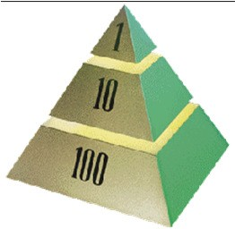
Requirements Management
Making sure you
  Solve the right problem
  Build the right system
By taking a systematic approach to
  eliciting
  organizing
  documenting
  managing
the changing requirements of a software application.
77
Aspects of Requirements Management
Analyze the Problem
Understand User Needs
Define the System
Manage Scope
Refine the System Definition
Build the Right System
78

Slide 36

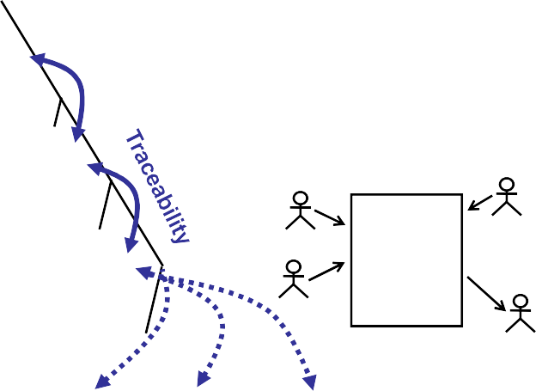

Map of the Territory
 | Problem | Problem Space | 79
Needs
Features |  | Solution Space
Use Cases and Software Requirements |  | The Product To Be Built
Test Procedures | Design | User Docs
Practice 3: Use Component Architectures
Best Practices
Process Made Practical
Develop Iteratively Manage Requirements
Use Component Architectures
Model Visually (UML) Continuously Verify Quality Manage Change
80

Slide 37

Resilient, Component-Based Architectures
Resilient
  Meets current and future requirements
  Improves extensibility
  Enables reuse
  Encapsulates system dependencies
Component-based
  Reuse or customize components
  Select from commercially-available components
  Evolve existing software incrementally
81
Purpose of a Component-Based Architecture
Basis for reuse
  Component reuse
  Architecture reuse
Basis for project management
  Planning
  Staffing
Component-based Architecture with layers
Delivery
Intellectual control
  Manage complexity
  Maintain integrity
Application- specific
Business- specific
Middleware
System- software
82

Slide 38

Practice 4: Model Visually (UML)
Best Practices
Process Made Practical
Develop Iteratively Manage Requirements
Use Component Architectures
Model Visually (UML)
Continuously Verify Quality Manage Change
83
Why Model Visually?
Capture structure and behavior
Show how system elements fit together
Keep design and implementation consistent
Hide or expose details as appropriate
Promote unambiguous communication
  UML: one language for all practitioners
84

Slide 39
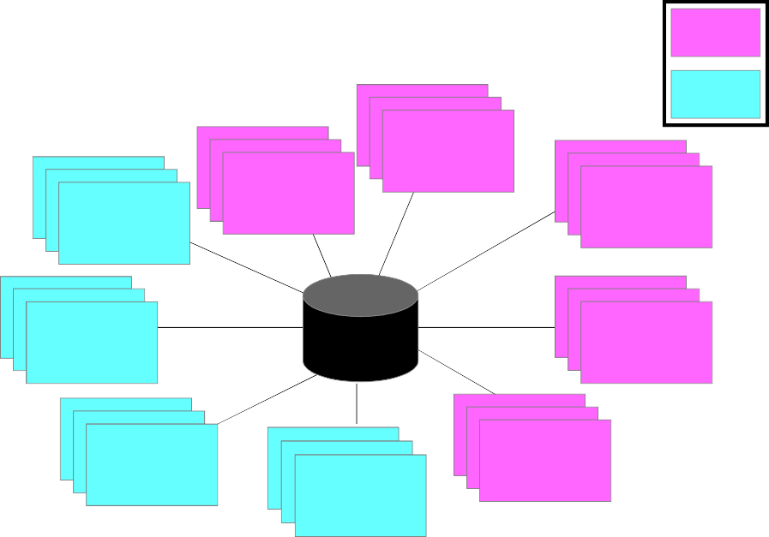
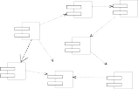


Visual Modeling with UML 1.X
Multiple views
Precise syntax and semantics
Static Diagrams
Dynamic Diagrams
Class Diagrams
Sequence Diagrams
Use-Case Diagrams
Object Diagrams
Collaboration Diagrams
Models
Component Diagrams
Statechart Diagrams
Activity Diagrams
Deployment Diagrams
85
Visual Modeling Using UML 1.X Diagrams
Use-case diagram
Class diagram
DocumentList
FileMgr
Statechart diagram
add f ile
Actor A
Use Case 1
Actor B
fetchDoc( ) sortByName( )
add( ) delete( )
Document
name : int docid : int numField : int
get( ) open( ) close( ) read( ) sortFileList( ) create( ) fillDocument( )
read() fill the code..
add f ile [ numberOf f ile==MAX ] / ^{Writing} f lag OFF
Use Case 2
FileList
fList
Openning
close f ile
Use Case 3
rep
add( ) delete( )
11
Reading
^{close f ile} Closing
Repository
File
Deployment
(from Persistence)
read( )
GrpFile
Collaboration 9: sortByName ( )
diagram 1: Doc view request ( ) L
2: fetchDoc( )
name : char * = 0
readDoc( ) readFile( )
read( )
open( )
create( ) fillFile( )
Repository
DocumentList
diagram
Window95 ^{Windows95}
mainWnd : MainWnd
gFile : GrpFile
FileManager
Document
¹®¼°ü¸®
Å¬¶óÀÌ¾ðÆ®.EXE
Windows95
user : Clerk
fileMgr : FileMgr
4: create ( ) 8: fillFile ( )
Windows NT
Solaris
¹®¼°ü¸® ¾ÖÇÃ¸´
7: readFile ( ) 5: readDoc ( )
ry
3: create ( )
6: fillDocument ( )
GraphicFile
File
FileList
Windows NT
¹®¼°ü¸® ¿£Áø.EXE
IBM
Mainframe
ÀÀ¿ë¼¹ö.EXE
Alpha UNIX
repository : Reposito
document : Document
Component diagram
µ¥ÀÌÅ¸º£ÀÌ½º¼¹ö
mainWnd
fileMgr : FileMgr
document :
gFile
repository
Æ¯ Á¤¹®¼¿¡ ´ëÇÑ º¸±â¸¦
»ç¿ëÀÚ°¡ ¿äÃ»ÇÑ´Ù.
user
1: Doc view request ( )
2: fetchDoc( )
3: create ( )
Document
Target System
4: create ( )
ÈÀÏ°ü¸®ÀÚ´Â ÀÐ¾î¿Â
¹®¼ÀÇ Á¤º¸¸¦ ÇØ´ç ¹®¼
°´Ã¼¿¡ ¼³Á¤À» ¿äÃ»ÇÑ´Ù.
5: readDoc ( )
6: fillDocument ( )
7: readFile ( )
Forward and Reverse Engineering
È¸é °´Ã¼´Â ÀÐ¾îµéÀÎ
°´Ã¼µé¿¡ ´ëÇØ ÀÌ¸§º°·Î
º¸¿©ÁØ´Ù.
9: sortByName ( )
8: fillFile ( )
Á¤·ÄÀ» ½ÃÄÑ È¸é¿¡
Sequence diagram
86

Slide 40
UML 1.X Notation Baseline
Diagram Name | Type | Phase
Use Case | Static* | Analysis
Class | Static | Analysis
Activity | Dynamic** | Analysis
State-Transition | Dynamic | Analysis
Event Trace (Interaction) | Dynamic | Design
Sequence | Dynamic | Design
Collaboration | Dynamic | Design
Package | Static | Delivery
Deployment | Dynamic | Delivery
*Static describes structural system properties
**Dynamic describes behavioral system properties.
87
UML 1.X Diagrams
UML 1.X defines twelve types of diagrams, divided into three categories
Four diagram types represent static application structure:
  Class Diagram
  Object Diagram
  Component Diagram
  Deployment Diagram
Five represent different aspects of dynamic behavior
  Use Case Diagram
  Sequence Diagram
  Activity Diagram
  Collaboration Diagram
  Statechart Diagram
Three represent ways to organize and manage your application modules
  Packages
  Subsystems
  Models
Source: http://www.omg.org/gettingstarted/what_is_uml.htm
88

Slide 41




UML 1.X Views
Approach
  UML 1.X defines five views that let you look at overall models from various angles
  Layering architectural principles is used to allocate pieces of functionality to subsystems
  Partitioning is used to group related pieces of functionality into packages within subsystems
Views and Related Diagrams
  Use Case View (application functionality)
    Use Case Diagram
  Logical View (static application structure)
    Class Diagram
    Object Diagram
  Process View (dynamic application behavior)
    Sequence Diagram
    Activity Diagram
    Collaboration Diagram
    Statechart Diagram
  Implementation View (application packaging)
    Component Diagram
  Deployment View (application delivery)
    Deployment Diagram
89
Need to Maintain Consistency and Coverage Across UML 1.X Views
Functional view
Architectural View
Play
DicePersist
HighScore
DiceSystem
Displayable
Dice Vizualization
Player
PersistKit
Observable
View HighScore
Consistency
Behavioral View
Randomizer
Observer
[ nocoffee ]
FindBeverage
[ nocola ]
Static View
Random system
[ found coffee]
[ foundcola]
Put Coffee in Filter AddWater toReservoir Get Cups Get Can of Cola
Coverage
d1: Die
JBDC Save/load the
Connection highscore
Put Filterin Machine
Player
(fromUseCaseView)
name:String
Rolls
Die faceValue:int=
roll()
game: Dice Game
1: play()
2:r1=roll()
Game Computer
Turn onMachine
score:int=0;
11 22
1
3:r2=roll()
SGBD computer
^coffeePot.TurnOn
play()
11
BrewCoffee
light goesout
11
Plays
11
Includes
Momo: Player
d2: Die
Play the game
File
S ystem
Maybe a Remote a file system
Pour Coffee DrinkBeverage
DiceGame
11 ¹¹
Scoring
11
HighScore
ca ncel
: DiceGame
1: play( )
: Playe r
2: roll( )
d1 : Die
d2 : Die
/ S tart gam e start
Ready to play Player ready
Quit
entry: get player name
3: roll( )
Cancel
play
roll dices[ turn<1 0 ]
[ turn>= 10 ]
In progress entry: turn++
90

Slide 42
New in UML 2.X (1/2) (http://www.omg.org/gettingstarted/what_is_uml.htm)
UML 2.X Profiles
  The new language goes well beyond the Classes and Objects well-modeled by UML 1.X to add the capability to represent not only behavioral models, but also architectural models, business process and rules, and other models used in many different parts of computing and even non-computing disciplines
Nested Classifiers
  Every model building block (e.g., classes, objects, components, behaviors such as activities and state machines) is a classifier
    A set of classes may be nested inside the component that manages them, or a behavior (such as a state machine) may be embedded inside the class or component that implements it
    Capability may be used to build up complex behaviors from simpler ones (i.e., the capability that defines the Interaction Overview Diagram)
    Can layer different levels of abstraction in multiple ways:
      For example, you can build a model of your Enterprise, and zoom in to embedded site views, and then to departmental views within the site, and then to applications within a department
      Alternatively, you can nest computational models within a business process model. OMG's Business Enterprise Integration Domain Task Force (BEI DTF) is currently working on several interesting new standards in business process and business rules
91
New in UML 2.X (2/2) (http://www.omg.org/gettingstarted/what_is_uml.htm)
Improved Behavioral Modeling
  In UML 1.X, the different behavioral models were independent, but in UML 2.0, they all derive from a fundamental definition of a behavior (except for the Use Case, which is subtly different but still participates in the new organization)
Improved relationship between Structural and Behavioral Models
  UML 2.0 makes it possible to designate that a behavior represented by (for example) a State Machine or Sequence Diagram is the behavior of a class or a component
Object Constraint Language (OCL) and Action Semantics
» During the upgrade process, several additions to the language were incorporated into it, including the Object Constraint Language (OCL) and Action Semantics.
92

Slide 43


Practice 5: Continuously Verify Quality
Best Practices
Process Made Practical
Develop Iteratively
Manage Requirements
Use Component Architectures
Model Visually (UML)
Continuously Verify Quality
Manage Change
93
Continuously Verify Software Quality
Software problems are
100 to 1000 times more costly to find and repair after
deployment
Cost to Repair Software
Cost of Lost Opportunities
Cost of Lost Customers
Cost
Inception
Elaboration
Construction
Transition
94

Slide 44



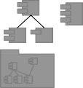
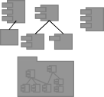







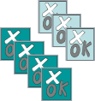
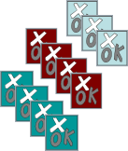
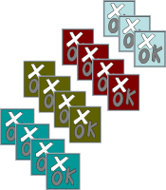
Test All Dimensions of Software Quality
Does my application respond acceptably?
Reliability
Verification of sustained application operation
Does my application do what’s required?
Functionality
Verification of each usage scenario
Does the system perform under production load?
Performance
Test performance under expected & worst-case load
95
Test Each Iteration
Iteration 1
Iteration 2
Iteration 3
Iteration 4
UML Model and
Implementation
Test Suite 1 Test Suite 2 Test Suite 3 Test Suite 4
Tests
96

Slide 45



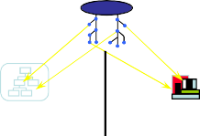






Practice 6: Manage Change
Best Practices
Process Made Practical
Develop Iteratively Manage Requirements
Use Component Architectures
Model Visually (UML) Continuously Verify Quality
Manage Change
97
What Do You Want to Control?
Changes to enable iterative development
Secure workspaces for each developer
Automated integration/build management
Parallel development
Workspace Management
Parallel Development
CM is more than just check-in and check-out
EPORT _{ALERT}
Build Management
Process Integration
98

Slide 46
Aspects of a Configuration Management (CM) System
Change Request Management
Configuration Status Reporting
Configuration Management (CM)
Change Tracking
Version Selection
Software Manufacturing
99
Unified Change Management
Management across the lifecycle
  System
  Project Management
Activity-Based Management
  Tasks
  Defects
  Enhancements
Progress Tracking
  Charts
  Reports
100

Slide 47


Best Practices Reinforce Each Other
Best Practices
Develop Iteratively
Manage Requirements
Ensures users involved as requirements evolve
Use Component Architectures
Model Visually (UML)
Validates architectural decisions early on
Addresses complexity of design/implementation incrementally
Continuously Verify Quality
Measures quality early and often
Manage Change
Evolves baselines incrementally
101
Agenda – Software Engineering Fundamentals
2 Software Engineering Fundamentals
Software Engineering Scope Software Engineering Discipline Software Development Challenges
Refining the Software Engineering Discipline The Human Side of Software Development
Software Engineering Best Practices ala Rational Rational Unified Process
Introduction to Agile Software Engineering
2
102

Slide 48
Section Outline
Present the IBM Rational Unified Process within the context of the Six Best Practices covered in the previous sub-section
103
Foundations of RUP
Implement Software Engineering Best Practices:
  Iterative Controlled Development
  Use Case Models for Business Requirements
  Component Architectures
  Risk Identification, Management & Mitigation
104

Slide 49


RUP Best Practices Implementation
Best Practices
Process Made Practical
Develop Iteratively Manage Requirements
Use Component Architectures Model Visually (UML) Continuously Verify Quality Manage Change
105
Achieving Best Practices
Iterative Approach
Guidance for activities and work products (artifacts)
Process focus on architecture
Use cases which drive design and implementation
Models which abstract the system
Requirements
Analysis & Design
Implementation
Test
Configuration & Change Management
106

Slide 50
A Team-Based Definition of Process
A process defines Who is doing What, When and How to reach a certain goal.
New or changed requirements
Software Engineering Process
New or changed system
107
Process Structure - Lifecycle Phases
Inception | Elaboration | Construction | Transition
time
The Rational Unified Process has four Phases:
» Inception - Define the scope of project
» Elaboration - Plan project, specify features, baseline architecture
» Construction - Build the product
» Transition - Transition the product into end user community
108

Slide 51
Phase Boundaries Mark Major Milestones
Inception | Elaboration | Construction | Transition
time
Lifecycle Objective Milestone
Lifecycle Architecture Milestone
Initial Operational Capability Milestone
Product Release
109
Iterations and Phases
Inception | Elaboration |  | Construction |  |  | Transition
Preliminary Iteration | Architect. Iteration | Architect. Iteration | Devel. Iteration | Devel. Iteration | Devel. Iteration | Transition Iteration | Transition Iteration
Minor Milestones: Releases
An iteration is a distinct sequence of activities based on an established plan and evaluation criteria, resulting in an executable release (internal or external)
110

Slide 52
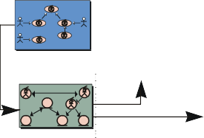

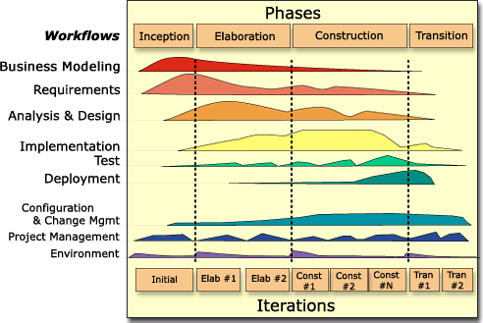

Workflows Produce Models
Core Process Workflows Models Realized By | Business Modeling | Requirements | Analysis & Design | Implemen- tation | Test Verified By OK OK Fail Test Model
 |  |  |  | Implemented
 | Business Use- | Use-Case | Realized By | By
 | Case Model | Model
 | B
 | B B B | Automated
 | Business Object Model | By | Design Model | Implementation Model
 |  |  |  |  |  | 111
Bringing It All Together: The Iterative Approach
Workflows group activities logically
In an iteration, you walk through all workflows
112

Slide 53
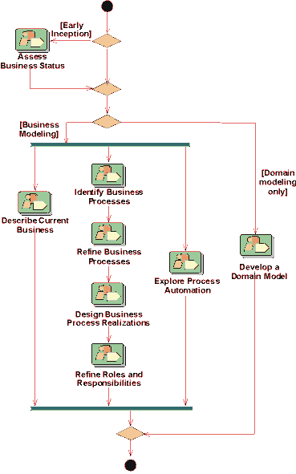
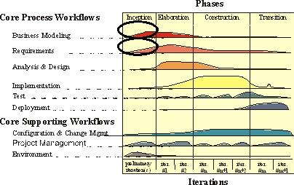
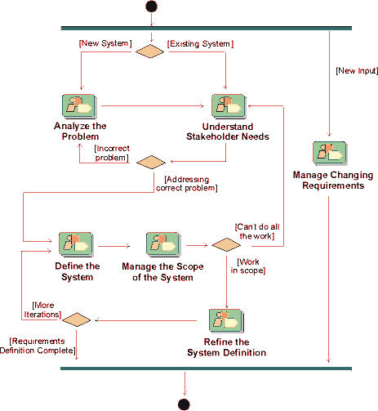


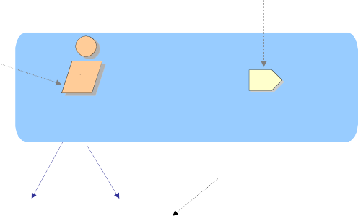



Workflows Guide Iterative Development
Business Modeling: Workflow Details
Requirements: Workflow Details
113
Notation
A role that may be played by an individual or a team in the development organization
A unit of work a role may be asked to perform
Activity
Role
Requirements Specifier
Detail a Use Case
responsible for
Artifact
A piece of information that is produced, modified, or used by a process
Use Case
Use-Case Package
114

Slide 54








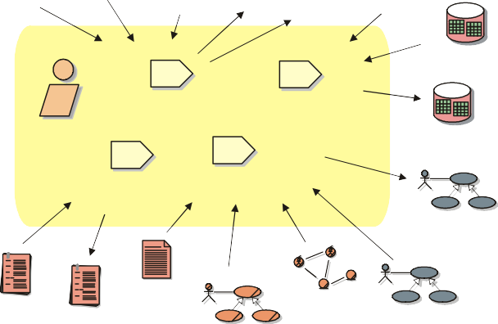
Roles Are Used for Resource Planning
Resource Paul Mary Joe Sylvia Stefan | Role Designer Requirements Specifier System Analyst Implementer Architect Each individual in the project is assigned to one or several roles | Activities Define Operations Detail a Use Case Find Actors and Use Cases Perform Unit Tests Identify Design Mechanisms | 115
Roles Perform Activities and Produce Artifacts
Example
Business Rules
Vision ^{Stakeholder Vision}
Requirements
Requirements: Workflow Detail
“Define the System”
Requests
_{(refined)} Supplementary Management
Specifications Plan
Requirements Attributes
Develop Vision
Manage Dependencies
System Analyst
Requirements Attributes (refined)
Capture a Common Vocabulary
Find Actors and Use Cases
Use-Case Model
(refined)
Glossary
Glossary
Use-Case Modeling Guidelines
Business
^{Object Model} Use-Case Model
Use Case
(outlined)
(refined)
Business Use-Case Model
116

Slide 55
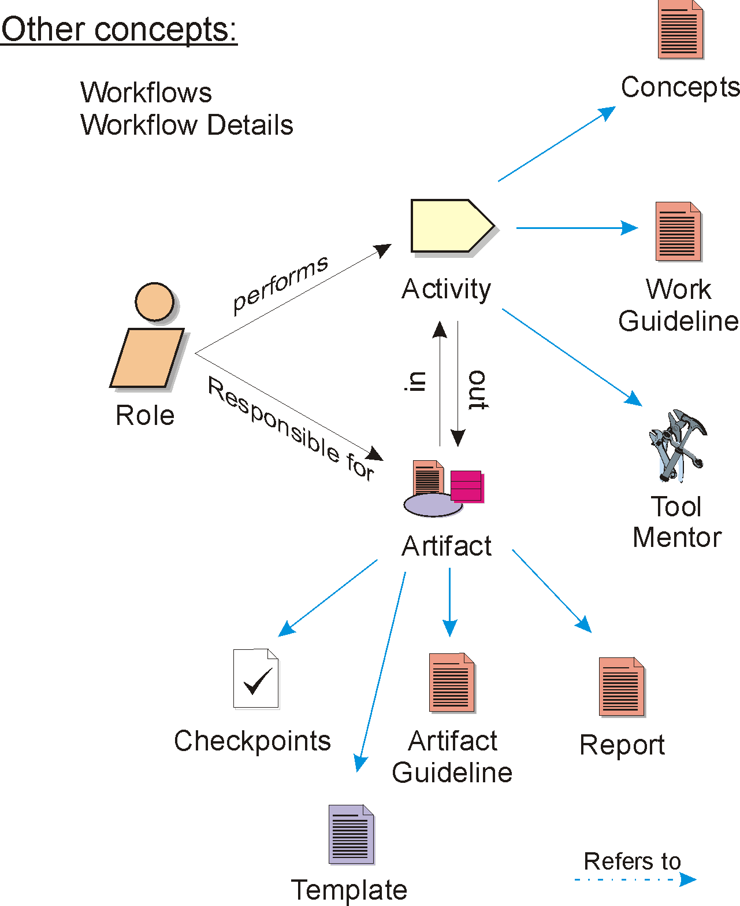
Overview of Rational Unified Process Concepts
117
Summary: Best Practices of Software Engineering
Best Practices guide software engineering by addressing root causes
Best Practices reinforce each other
Process guides a team on what to do, how to do it, and when to do it
The Rational Unified Process is a means of achieving Best Practices
118

Slide 56
Sample RUP Artifacts Definition
Artifacts | Definitions
Investment Concept Statement Business Case | Outlines the project’s purpose, scope, costs, benefits and risks of the investment and is used by business sponsors and stakeholders to make an informed decision
Vision | Defines the stakeholders view of the product to be developed, contains an outline of the envisioned core requirements, defines the boundary and primary features of the system and is used as the basis for more detailed technical requirements
Stakeholders Requests | Captures all requests made on the project from stakeholders
Technology Governance Questionnaire | Assesses the impact of all development projects introducing significant architectural or high- level design changes
Use Case Specifications | Defines the functional requirements for the system with use case diagrams
Supplementary Specifications | Defines the nonfunctional requirements of the system
Software Architecture Document | Provides a comprehensive architectural overview of the system, using a number of different architectural views to depict different aspects of the system – use case view, logical view, process view, deployment view, implementation view and data view (as needed)
User Acceptance Test Plan | Documents a plan to be used to direct user acceptance testing and ensures that all of the detailed business requirements defined in Inception are tested completely
System Test Plan | Outlines and communicates the objectives of the testing effort to gain acceptance and approval from the stakeholders
Corporate Report Card | Provides measurement and explanation of variances between actual and expected project performance and informs management of project issues (High Risk, High Impact)
Issues List | Entails the documentation, review, resolution, and follow-up of project issues
Risk List | Details a list of known and open risks to the project, sorted in decreasing order of importance and associated with specific mitigation strategies or contingency plans
Project Plan / Iteration Plan | Details the specific tasks that must be completed by each team member in order to complete a project
Phase Assessment Review | Establishes criteria for determining whether or not a project is ready to move from one phase to the next phase
119
Sample RUP Core Artifacts
Phase | S | M | L | Artifact | Owner
Inception |  |  |  | Investment Concept Statement | Business Sponsor ^{(A)} Business Project Manager
Inception |  |  |  | Business Case | Business Sponsor ^{(A)} Business Project Manager
Inception | L ight |  |  | Vision | Business Lead ^{(A)} Technology Project Manager
Inception | Vision |  |  | Stakeholder Requests | Business Lead
Inception | L ight |  |  | Delegated Governance Questionnaire | Technology Project Manager
Elaboration |  |  |  | Use Case Specifications | Business Lead ^{(A)} Technology Project Manager
Elaboration | Vision |  |  | Supplementary Specifications | Business Lead ^{(A)} Technology Project Manager
Elaboration |  |  |  | Software Architecture Document | Technology Project Manager Architect
Construction |  |  |  | User Acceptance Test Plan | Business Project Manager
Construction |  |  |  | System Test Plan | Project Manager
Ongoing |  |  |  | Issues List | Project Manager
Ongoing |  |  |  | Risk List | Project Manager
Ongoing |  |  |  | Project Plan / Iteration Plan | Project Manager
Ongoing | Light |  |  | Phase Assessment Review | Project Manager
Ongoing |  |  |  | Corporate Report Card | Business Project Manag^{A}e⁼r^{Approver}
120

Slide 57
Sample Key Roles/Owners of RUP Artifacts
 | Key Role | Definition
 | Business Sponsor | Establishes the project funding and periodically review the spending progress against the Investment Opportunity expectations. They consistently champion the project and associated changes, as well as communicate project progress to Corporate leaders.
 | Business Lead | Provides project leadership and overall business perspective. This role is responsible for managing the project risk and working with the team to ensure appropriate communication of risk mitigation. Represents the team to stakeholders and management and influences the strategic and tactical business decisions pertaining to the project product. This role’s overall goal is to ensure the business expectations are achieved on time and on budget.
 | Business Project Manager | Allocates resources, shapes priorities, coordinates interactions with customers and users, and generally keeps the project team focused on the right goal. The project manager also establishes a set of practices that ensure the integrity and quality of project artifacts. In addition, the Business Project Manager plans and conducts the formal review of the use- case model. Leads and coordinates requirements elicitation and use-case modeling by outlining the system's functionality and delimiting the system; for example, establishing what actors and use cases exist and how they interact. In addition, this role details the specification of a part of the organization by describing the workflow of one or several business use cases.
 | Technology Project Manager | Allocates resources, shapes priorities, coordinates interactions with customers and users, and generally keeps the project team focused on the right goal. The technology project manager also establishes a set of practices that ensure the integrity and quality of project artifacts.
 | Architect | Leads and coordinates technical activities and artifacts throughout the project. The software architect establishes the overall structure for each architectural view: the decomposition of the view, the grouping of elements, and the interfaces between these major groupings. Therefore, in contrast to the other roles, the software architect's view is one of breadth as opposed to one of depth. ₁₂₁
Summary of Sub-Section’s Key Points
RUP focuses on:
  Iterative Controlled Development
  Use Case Models for Business Requirements
  Component Architecture
  Risk Identification, Management &Mitigation
122

Slide 58

Agenda – Software Engineering Fundamentals
2 Software Engineering Fundamentals
Software Engineering Scope
So tware nginee ing Disc pline Software Development Challenges
Refining the Software Engineering Discipline The Human Side of Software Development
Software Engineering Best Practices ala Rational Rational Unified Process
Introduction to Agile Software Engineering
2
123
Agile Software Engineering
Agility
  “Ability to create and respond to change in order to profit in a turbulent business environment”
Agile Values
  Individual and interactions vs. processes and tools
  Working software vs. comprehensive documentation
  Customer collaboration vs. contract negotiation
  Responding to change vs. following a plan
124

Slide 59
Agile Software Development Ecosystems
Agile Software Development Ecosystems (ASDEs) vs. Traditional Software Development Methodologies
  “Chaordic” perspective
    Product goals are achievable but they are not predictable
    Processes can aid consistency but they are not repeatable
  Collaborative values and principles
  Barely sufficient methodology
Agilists are proponents of ASDEs
125
Agenda
1
Instructor and Course Introduction
1
2
Software Engineering Fundamentals
2
3
Towards a Pattern-Driven SE Methodology
3
4
Summary and Conclusion
4
126

Slide 60
Section Objectives
Describe the limitations of legacy and best practice SDLC methodologies
Suggest the improved approach that is covered in the course
Discuss the approach to follow for the class project
127
Limitations of Legacy SE Methodologies
Focused on software solutions development
Driven by processes
  Not driven by architecture and/or best practices altogether (other than initially)
Focus is on scope, time, cost, and quality
  customer input sparsely considered
Metaphor:
  “an algorithm without a centralized data structure to operate on”
128

Slide 61
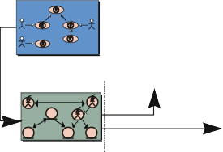
Limitations of RUP Approach
Focused on software solutions development
Driven by best practices
  Driven by workflows (and tools)
Focus is on scope, time, and cost
  Customer assesses quality and drive change
  Deliver quality software on-time & on-budget
    By enforcing a best practice process that manages change
    By following a PDCA approach were individuals play various roles in the overall process
Gap between Architecture-Driven approach and Use-Case Driven Modeling
  A “top-down” architectural approach
129
Illustrating the RUP “Gap”
Core Process Workflows
Business Modeling
Requirements
Analysis & Design
Implemen- tation
Test
Models
Implemented Verified By
Realized By ^{By}
^{Realized} Business Use- ^{By} Case Model
Use-Case Model
B
B B B
Automated
By Design Model
OK OK
Fail
Business Object Model
Implementation Model
Test Model
Going from business requirements to use cases requires non-trivial input that is hard/impossible to predict
130

Slide 62
Limitations of ASDE Approaches
Focused on software solutions development
Driven by best practices
  Driven by collaboration between individuals
    Interactions: customer/project team & intra-project team
  Driven by change
Focus is on quality (test-driven), time, and cost
  Customer drives the scope
  Deliver optimal quality software on-time & on-budget
    By limiting the scope to facilitate change
    By follow an MOB approach were individuals assume full leadership
Architectural re-factoring becomes a nightmare
  A “bottom-up architectural approach”
131
Agile Pattern-Driven Architecture (PDA) Approach
Focused on business solutions development
» SDLC stands for “(Business) Solution Development LifeCycle”
Seed the Architecture-Driven approach so it does not operate top-down or bottom-up
» Integrate the Architecture-Driven approach into standard and business specific architecture-driven workflows
  e.g., AKDAR, GDM, SBAM, PEM, LSS (BPM pattern), CBM (SOA pattern)
» Use an agile workflow-driven approach rather than rigid processes
» Use architecture-driven approach from business strategy all the way down to product maintenance
» Subject individuals to ongoing transformation processes
Flexible RUP-like or ASDE-like focus and introduces problem pattern set as an additional variable
Need to deal with individuals reaction to the constant need to adapt to change
» Build conducive environments (e.g., game-metaphor, etc.)
132

Slide 63
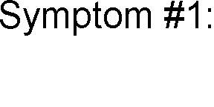
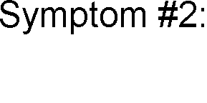


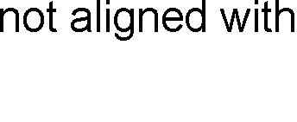
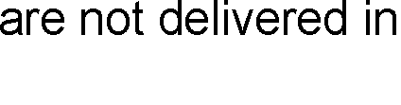
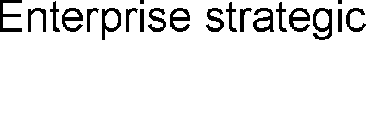


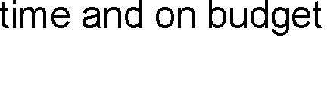


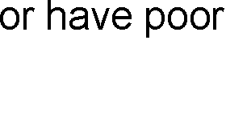



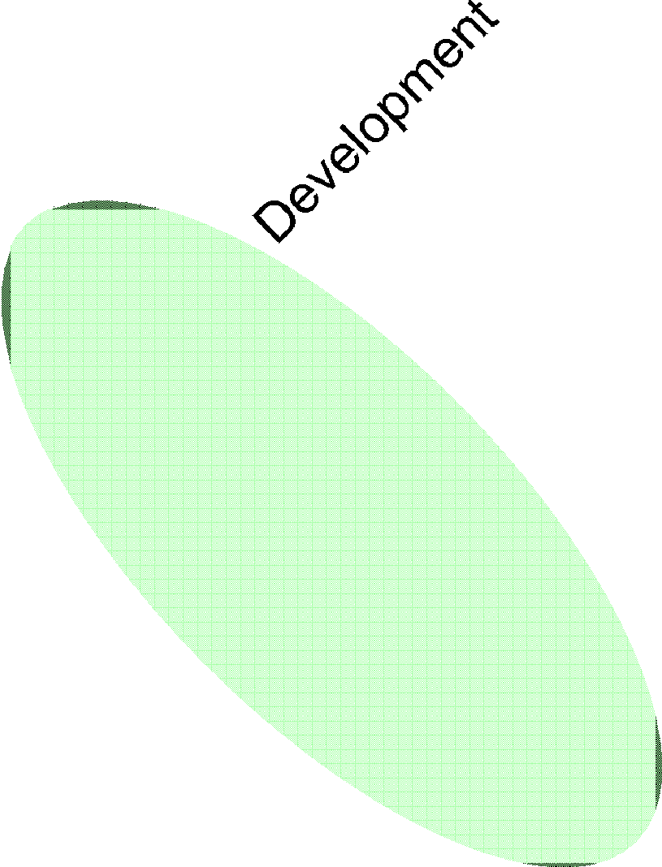

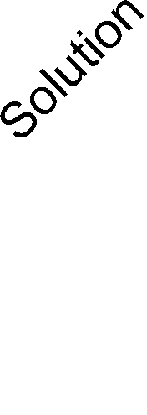







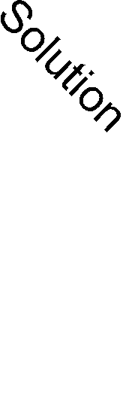
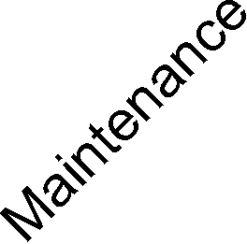

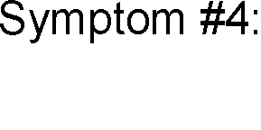
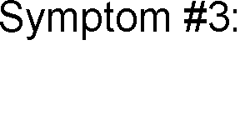







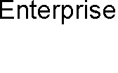


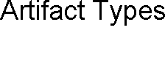








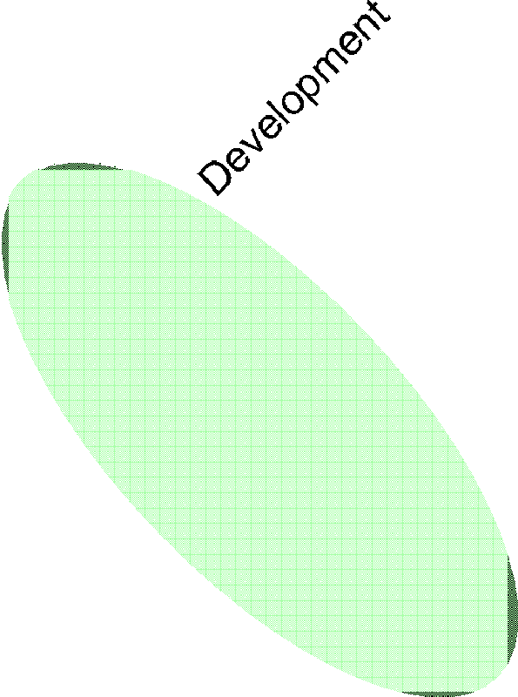



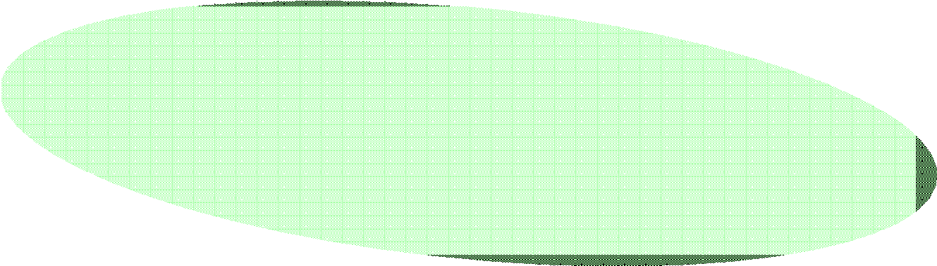







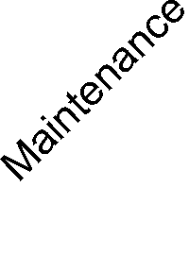









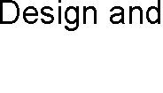



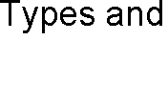

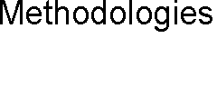
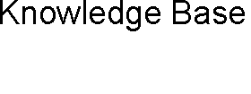
Enterprise Strategy and Business Solutions Alignment Problem
133
PDA Solution: Enterprise Architecture Management
“Focusing on Business Model Improvements while Maintaining Enterprise Alignment”
134

Slide 64
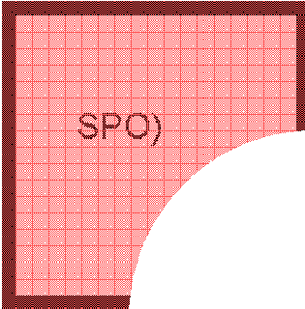
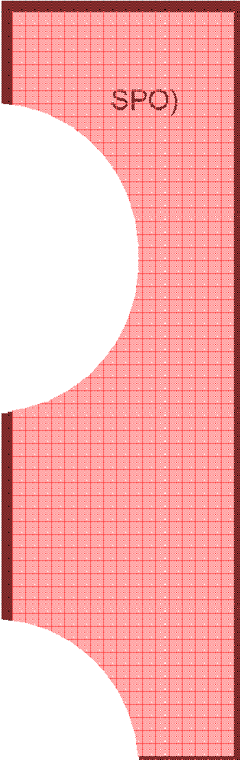

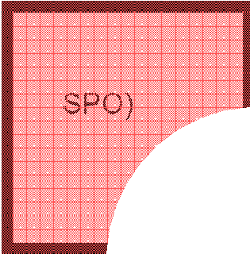
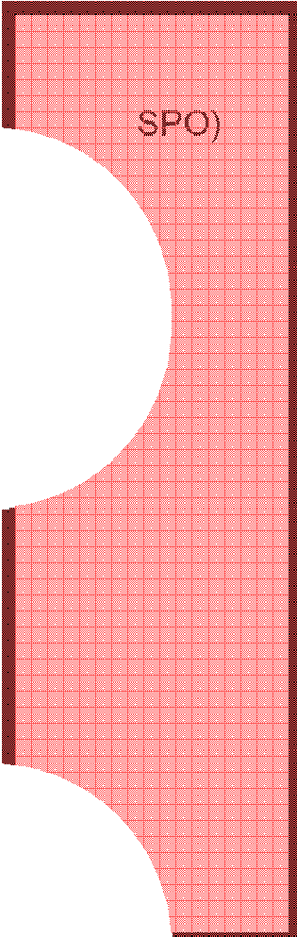





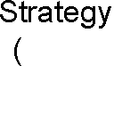
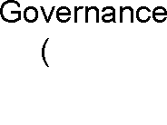


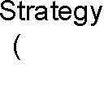
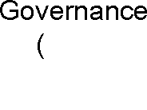


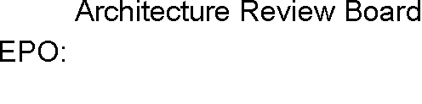























































































































































































Strategy Enablement Process Patterns and Artifact Types
“Enabler #1”
135
Strategy Enablement Process Patterns Detailed
A Process Pattern Leads to a Methodology Once Specific Activities are Chosen to Implement a Vision
136

Slide 65





















































































































Strategy Enablement Artifact Types Detailed
Traceable Artifacts
137
Extensible Framework and Best Practices Knowledge Base
“Enablers #2 and #3 (Sample)” – EAMF Framework Summary of Capabilities
Extension of the TOGAF Industry Standard
  http://www.opengroup.org/togaf/
Differentiators:
  Business Pattern Oriented Architecture (POA) orientation
    Extensible methodology based on business solution patterns
    Extensible knowledge foundation based on best practices and ongoing strategies and business solution development
  Artifact Traceability Focus
  Agile Activity-Driven Approach
    Solution Development Lifecycle agnostic
  Solution-Driven Approach
  Tool Agnostic Approach
138

Slide 66


































































































































Strategy Enablement From a Tools Perspective
Enabler #4 (Sample): EAMF Framework Implementation
139
Incremental Iterative Enterprise Transformation Methodology
“Enabler #5”
140

Slide 67


































































Strategy Enablement At Work
Enterprise business model goal is to sustain double digit annual growth and align all business units with that goal
1
Enterprise Strategy (SPO)
Enterprise Governance (SPO)
3
Business unit X consults with the SPO to identify:
Their current maturity level with respect to the high-level vision
Business Unit Specific alignment goals
Alignment Elicitation Methodology
SPO conducts a high-level goal decomposition, consults with the ARB, matches the business domain forces with the forces that drive best practice business reference architectures, and identifies a high-level vision:
e.g., SOA + BPM + BRM + BAM
Enterprise
Requirements
& Architectural Models
4
With the help of the SPO and the EAM infrastructure, alignment tenets are identified by applying goal patterns and best practices, and the applicable alignment elicitation methodology is identified
2
Gated execution of multiple projects starts: Projects that are not aligned with the Enterprise strategy breach gate 1
Projects that pass through gate 1 are funded SPO updates the roadmap every six months to account for changes in strategic directions
7
Project Strategy (EPO)
Business unit X applies the alignment elicitation methodology to identify their maturity level (i.e., common denominator) with respect to the high-level vision and a set of alignment projects/opportunities
5
SPO, ARB, and Business unit X prioritize the projects and elevate a subset of them into the 4-year project roadmap and select an appropriate alignment execution methodology (ARB inputs is key to identify constraints imposed by existing infrastructure)
Alignment Execution Methodology is applied to individual projects starting with requirements engineering activities conducted by project BAs:
Gate 2 review occurs at the end of the requirements definition phase (aka.
Inception phase)
On selected project a 3-months timeline is imposed on the delivery of a CPD prior to Gate 2 review
Project Requirements
8
Requirements Engineering (PT)
Architecture Integration (SPO & ARB)
6
Business Architecture (PT)
Application Architecture (PT)
10
While the business architecture is still being refined, Alignment Execution Methodology activities are conducted on the Application and Information Architecture fronts (business architecture is “deployed” incrementally and iteratively on top of the application/ information architecture)
Alignment Execution Methodology moves onto requirements model engineering activities and business architecture analysis and design conducted by project Business Architects in collaboration with application/ information/technology architects (requirements model is shared between the various group and is the central point of focus for collaboration)
Project Requirements & Architectural Models
9
(PT)
Information Architecture
(PT)
Technology Architecture
While the business/application/information architectures are still being refined,
¹¹ Alignment Execution Methodology activities are conducted on the Technology
Architecture front (application/information architecture is “deployed” incrementally and iteratively on top of the technology architecture
141
Enterprise Architecture Management
EAMF Activities Integrate Seamlessly with the Company X Project Lifecycle
142

Slide 68






























































Enterprise Architecture Management
Integration with the Company X Project Lifecycle all
143
Agenda
1
Instructor and Course Introduction
1
2
Software Engineering Fundamentals
2
3
Towards a Pattern-Driven SE Methodology
3
4
Summary and Conclusion
4
144

Slide 69
Course Assignments
Individual Assignments
  Reports based on case studies / class presentations
Project-Related Assignments
  All assignments (other than the individual assessments) will correspond to milestones in the team project.
  As the course progresses, students will be applying various methodologies to a project of their choice. The project and related software system should relate to a real-world scenario chosen by each team. The project will consist of inter-related deliverables which are due on a (bi-) weekly basis.
  There will be only one submission per team per deliverable and all teams must demonstrate their projects to the course instructor.
  A sample project description and additional details will be available under handouts on the course Web site
145
Team Project
Project Logistics
  Teams will pick their own projects, within certain constraints: for instance, all projects should involve multiple distributed subsystems (e.g., web- based electronic services projects including client, application server, and database tiers). Students will need to come up to speed on whatever programming languages and/or software technologies they choose for their projects - which will not necessarily be covered in class.
  Students will be required to form themselves into "pairs" of exactly two (2) members each; if there is an odd number of students in the class, then one
    team of three (3) members will be permitted. There may not be any "pairs" of only one member! The instructor and TA(s) will then assist the pairs in forming "teams", ideally each consisting of two (2) "pairs", possibly three (3) pairs if necessary due to enrollment, but students are encouraged to form their own 2-pair teams in advance. If some students drop the course, any remaining pair or team members may be arbitrarily reassigned to other pairs/teams at the discretion of the instructor (but are strongly encouraged to reform pairs/teams on their own). Students will develop and test their project code together with the other member of their programming pair.
146

Slide 70
Team Project Approach - Overall
Document Transformation methodology driven approach
» Strategy Alignment Elicitation
  Equivalent to strategic planning
    i.e., planning at the level of a project set
» Strategy Alignment Execution
  Equivalent to project planning + SDLC
    i.e., planning a the level of individual projects + project implementation
Build a methodology Wiki & partially implement the enablers
Apply transformation methodology approach to a sample problem domain for which a business solution must be found
Final product is a wiki/report that focuses on
» Methodology / methodology implementation / sample business-driven problem solution
147
Team Project Approach – Initial Step
Document sample problem domain and business-driven problem of interest
» Problem description
» High-level specification details
» High-level implementation details
» Proposed high-level timeline
148

Slide 71

Assignments & Readings
Readings
» Slides and Handouts posted on the course web site
» Textbook: Chapter 1 & Part One-Chapter 2
Assignment #1
» Team Project proposal (format TBD in class)
» Presentation topic proposal (format TBD in class)
Project Frameworks Setup (ongoing)
» As per reference provided on the course Web site
149
Next Session: Software Development Lifecycles (SDLCs)
Software Engineering Detailed
Process Models
Agile Development
Software Engineering Knowledge
Roles and Types of Standards
  ISO 12207: Life Cycle Standard
  IEEE Standards for Software Engineering Processes and Specifications
Summary and Conclusion
  Readings
  Assignment #1
  Course Project
150

Slide 72

Any Questions?
151

