Slide 1
8051 Microcontroller and Interfacing
Prepared By
Mr.K.Ganesan,
Assistant Professor
Department of Electronics and Communication
Sri Ganesh College of Arts & Science,
Salem - 636014

Slide 2
Microcontroller
A microcontroller is a compact integrated circuit designed to govern a specific operation in an embedded system. A typical microcontroller includes a processor, memory and input/output (I/O) peripherals on a single chip.

Slide 3
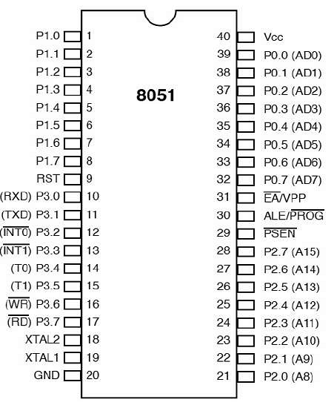
8051 Pin Diagram

Slide 4
Pin diagram
Pins 1 to 8 − These pins are known as Port 1. This port doesn’t serve any other functions. It is internally pulled up, bi-directional I/O port.
Pin 9 − It is a RESET pin, which is used to reset the microcontroller to its initial values.
Pins 10 to 17 − These pins are known as Port 3. This port serves some functions like interrupts, timer input, control signals, serial communication signals RxD and TxD, etc.
Pins 18 & 19 − These pins are used for interfacing an external crystal to get the system clock.
Pin 20 − This pin provides the power supply to the circuit.
Pins 21 to 28 − These pins are known as Port 2. It serves as I/O port. Higher order address bus signals are also multiplexed using this port.
Pin 29 − This is PSEN pin which stands for Program Store Enable. It is used to read a signal from the external program memory.
Pin 30 − This is EA pin which stands for External Access input. It is used to enable/disable the external memory interfacing.
Pin 31 − This is ALE pin which stands for Address Latch Enable. It is used to demultiplex the address-data signal of port.
Pins 32 to 39 − These pins are known as Port 0. It serves as I/O port. Lower order address and data bus signals are multiplexed using this port.
Pin 40 − This pin is used to provide power supply to the circuit.

Slide 5
8051 Architecture

Slide 6
8051 Architecture
8051 micro controller is an 8 bit controller. Figure 1.1 shows the architecture diagram of 8051.
The 8051 microcontroller has the following features:
4 Kb of ROM.
128b of RAM (including SFRs) satisfies the user’s basic needs.
4 ports, each having 8 input/ouput lines, total of 32 input/output lines are present which are sufficient to make all necessary connections to peripheral environment.
It has Accumulator, general purpose registers and special purpose registers and
It has ALU which does all kind of arithmetic and logical operations.

Slide 7
ALU:
• It is 8 bit unit
• It performs arithmetic operation as addition, subtraction, multiplication, division, increment and decrement.
• It performs logical operations like AND, OR and EX-OR. It manipulates 8 bit and 16 bit data
• It calculates address of jump locations in relative branch instruction.
• It performs compare, rotate and compliment operations
• 8051 micro controller contains 34 general purpose registers or working registers

Slide 8
Accumulator(A-reg):
It is 8 bit register
It is bit and byte accessible
Result of arithmetic & logic operations performed by ALU is accumulated by this register.
Therefore it is called accumulator register
It is used to store 8 bit data and to hold one of operand of ALU units during arithmetical and logical operations
Most of the instructions are carried out on accumulator data.

Slide 9
B-register
It is special 8 bit math register. It is bit and byte accessible.
It is used in conjunction with A register as I/P operand for ALU. It is used as general purpose register to store 8 bit data.

Slide 10
Program counter (PC):
The Program Counter (PC) is a 2-byte address which tells the 8051 where the next instruction to execute is found in memory.
It is used to hold 16 bit address of internal RAM, external RAM or external ROM locations.
It is important to note that PC isn’t always incremented by one and never decremented.

Slide 11
Data pointer register (DTPR):
It is a 16-bit register used to hold address of external or internal RAM where data is stored or result is to be stored.
It is used to store 16 bit data.
Each register can be used as general purpose register to store 8 bit data and can also be used as memory location.
DPTR does not have single internal address.
It functions as Base register in base relative addressing mode and in-direct jump.

Slide 12
Stack pointer (SP):
It is 8-bit register. It is byte addressable.
Its address is 81H.
It is used to hold the internal RAM memory location addresses which are used as stack memory.
When the data is to be placed on stack by push instruction, the content of stack pointer is incremented by 1, and when data is retrieved from stack, content of stack of stack pointer is decremented by 1.

Slide 13
Special function Registers(SFR):
The 8051 microcontroller has 11 SFR divided in 4 groups:
Timer/Counter register
8051 microcontroller has 2-16 bit Timer/counter registers called Timer-reg-T0 And Timer/counter Reg-T1.
Each register is 16 bit register divide into lower and higher byte register
These register are used to hold initial no. of count.
All of the 4 register are byte addressable.

Slide 14
Timer control register
8051 microcontroller has two 8-bit timer control register i.e. TMOD and TCON register.
TMOD Register:
It is 8-bit register. Its address is 89H.
It is byte addressable.
It used to select mode and control operation of time by writing control word.
TCON register:
It is 8-bit register. Its address is 88H. It is byte addressable.
Its MSB 4- bit are used to control operation of timer/ counter and LSB 4-bit are used for external interrupt control.

Slide 15
Serial data register:
8051 micro controller has 2 serial data register viz. SBUF and SCON.
Serial buffer register (SBUF):
It is 8-bit register.
It is byte addressable .
Its address is 99H.
It is used to hold data which is to be transferred serially.

Slide 16
Serial control register (SCON):
It is 8-bit register.
It is bit/byte addressable. Its address is 98H.
The 8-bit loaded into this register controls the operation of serial communication.

Slide 17
Interrupt register:
8051 µ C has 2 8-bit interrupt register.
Interrupt enable register (IE): It is 8-bit register.
It is bit/byte addressable.
Its address is A8H.
It is used to enable and disable function of interrupt.
Interrupt priority register (IP):
It is 8-bit register.
It is bit/byte addressable.
Its address is B8H.
It is used to select low or high level priority of each individual interrupts.

Slide 18
Power control register (PCON):
It is 8-bit register.
It is byte addressable . Its address is 87H.
Its bits are used to control mode of power saving circuit, either idle or power down mode and
also one bit is used to modify baud rate of serial communication.

Slide 19
Program Status Word

Slide 20
PSW
It is 8 bit register.
Its address is D0H and It is bit and byte accessible.
It has 4 conditional flags or math flags which sets or resets according to condition of result.
It has 3 control flags, by setting or resetting bit required operation or function can be achieved.

Slide 21
FLAG:
Carry Flag(CY): During addition and subtraction any carry or borrow is generated then
carry flag is set otherwise carry flag resets.
It is used in arithmetic, logical, jump, rotate and Boolean operations.
Auxiliary carry flag(AC): If during addition and subtraction any carry or borrow is generated from lower 4 bit to higher 4 bit then AC sets else it resets.
It is used in BCD arithmetic operations.

Slide 22
FLAG:
Overflow flag(OV): If in signed arithmetic operations result exceeds more than 7 bit than
OV flag sets else resets.
It is used in signed arithmetic operations only.
Parity flag(P): If in result, even no. Of ones "1" are present than it is called even parity and parity flag sets. In result odd no. Of ones "1"are present than it is called odd parity and parity flag resets.

Slide 23
FLAG:
CONTROL FLAGS:
FO: It is user defined flag. The user defines the function of this flag. The user can set test and clear this flag through software.
RS1 and RS0: These flags are used to select bank of register by resetting those flags

Slide 24
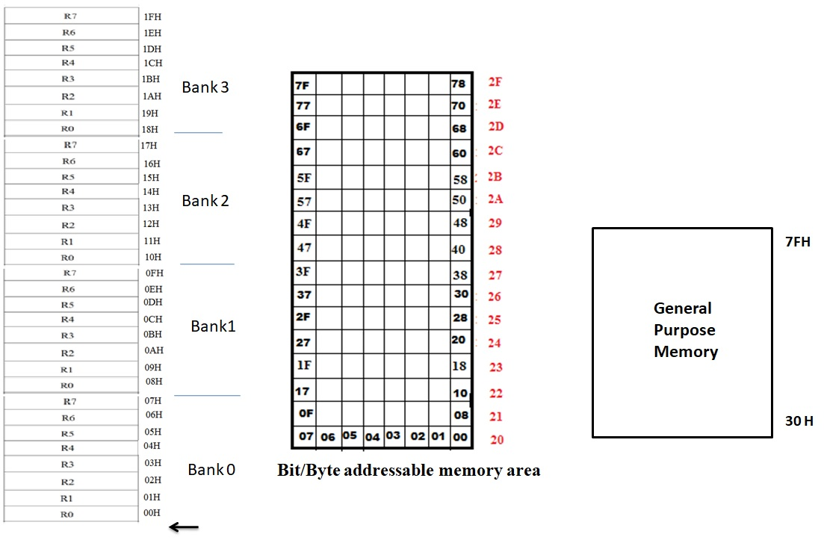
Internal Memory

Slide 25
Memory Organization
The 8051 has two types of memory and these are Program Memory and Data Memory.
Program Memory (ROM) is used to permanently save the program being executed, while Data Memory (RAM) is used for temporarily storing data and intermediate results created and used during the operation of the microcontroller.
Depending on the model in use 8051 microcontroller family in general have at most a few KB of ROM and 128 or 256 bytes of RAM is used.
All 8051 microcontrollers have a 16-bit addressing bus and are capable of addressing 64 kB memory.

Slide 26
8051 Instructions Set
The instructions of 8051 can be broadly classified under the following headings.
• Data transfer instructions
• Arithmetic instructions
• Logical instructions
• Branch instructions
• Subroutine instructions
• Bit manipulation instructions

Slide 27
ADDRESSING MODES
Various methods of accessing the data are called addressing modes. 8051
addressing modes are classified as follows.
Immediate AddressingMode
Register AddressingMode
Direct AddressingMode
Register IndirectAddressing Mode
Indexed AddressingMode
Implied AddressingMode

Slide 28
Thank You

