Slide 1
MOBILE COMMUNICATION
Prepared By
Mr.A.MANIKANDAN,
Head Of The Department
Department of Electronics and Communication
Sri Ganesh College of Arts & Science,
Salem - 636014

Slide 2
Basic Components
  Cellular Mobile Phone:
  A light-weight hand-held set which is an outcome of the marriage of Graham Bell’s Plain Old Telephone Technology [1876] and Marconi’s Radio Technology [1894] [although a very late delivery but very cute]
  Base Station: A Low Power Transmitter, other Radio Equipment [Transceivers] plus a small Tower
  Mobile Switching Center [MSC] /Mobile Telephone Switching Office[MTSO]
    An Interface between Base Stations and the PSTN
    Controls all the Base Stations in the Region and Processes User ID and other Call Parameters
    A typical MSC can handle up to 100,000 Mobiles, and 5000 Simultaneous Calls
    Handles Handoff Requests, Call Initiation Requests, and all Billing & System Maintenance Functions

Slide 3
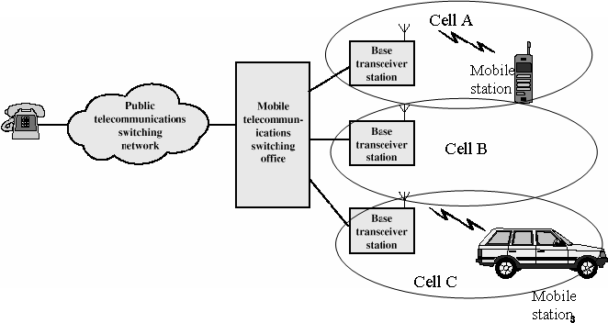

Slide 4
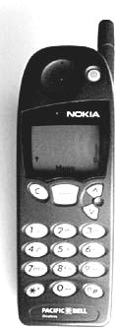
Cordless Telephone System
To Connect a Fixed Base Station to a Portable Cordless Handset
Early Systems (1980s) have very limited range of few tens of meters [within a House Premises]
Modern Systems [PACS, DECT, PHS, PCS] can provide a limited range & mobility within Urban Centers
Cordless Handset
PSTN
Fixed Base Station

Slide 5
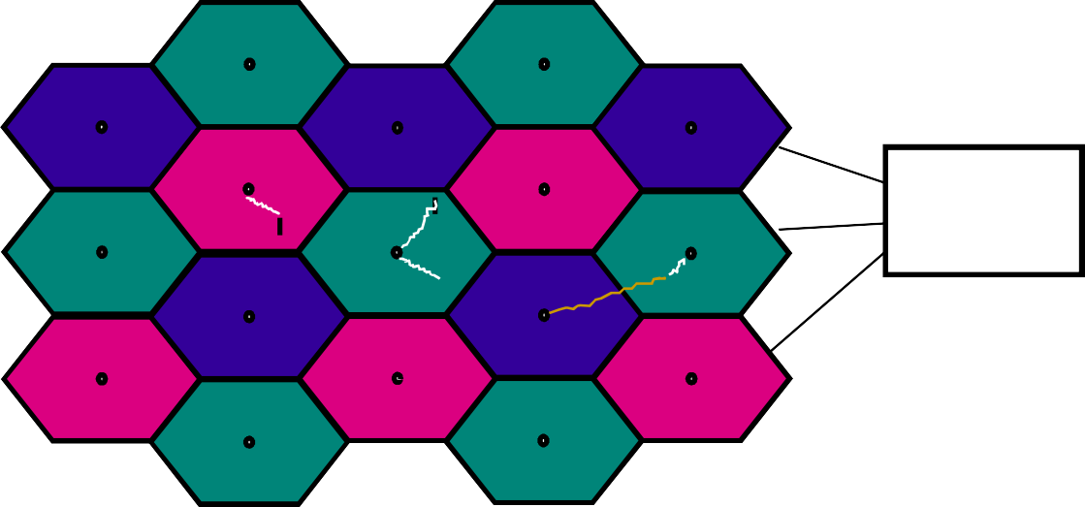
Cellular Systems: Reuse channels to maximize capacity
Geographic region divided into cells
Frequencies/timeslots/codes reused at spatially-separated locations.
Co-channel interference between same color cells.
Base stations/MTSOs coordinate handoff and control functions
Shrinking cell size increases capacity, as well as networking burden
BASE STATION
MTSO

Slide 6
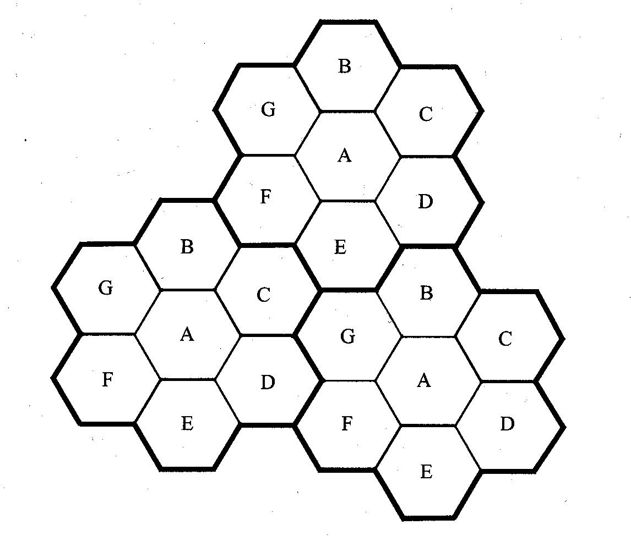
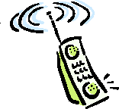
Introduction to Cellular Systems
Solves the problem of spectral congestion and user capacity.
Offer very high capacity in a limited spectrum without major technological changes.
Reuse of radio channel in different cells.
Enable a fix number of channels to serve an arbitrarily large number of users by reusing the channel throughout the coverage region.

Slide 7
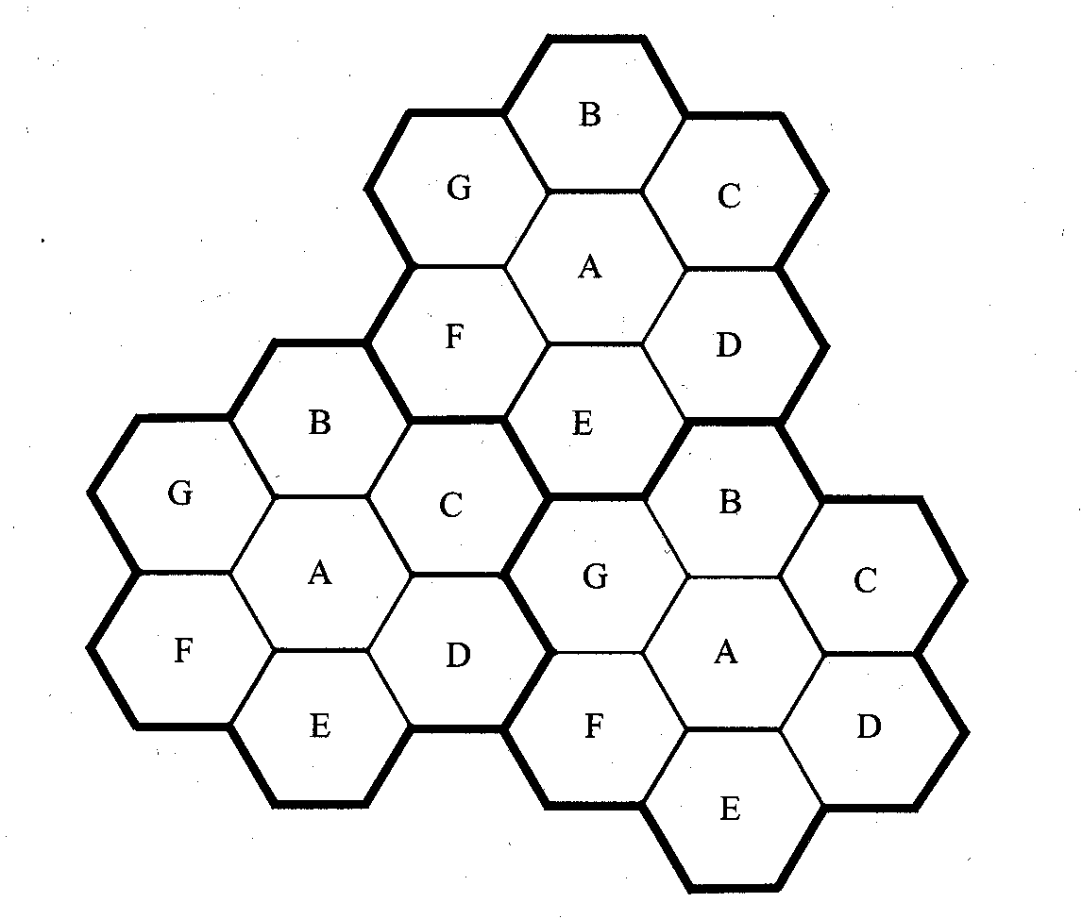
Frequency Reuse
Each cellular base station is allocated a group of radio channels within a small geographic area called a cell.
Neighboring cells are assigned different channel groups.
By limiting the coverage area to within the boundary of the cell, the channel groups may be reused to cover different cells.
Keep interference levels within tolerable limits.
Frequency reuse or frequency planning
  seven groups of channel from A to G
  footprint of a cell - actual radio coverage
  omni-directional antenna v.s. directional antenna

Slide 8
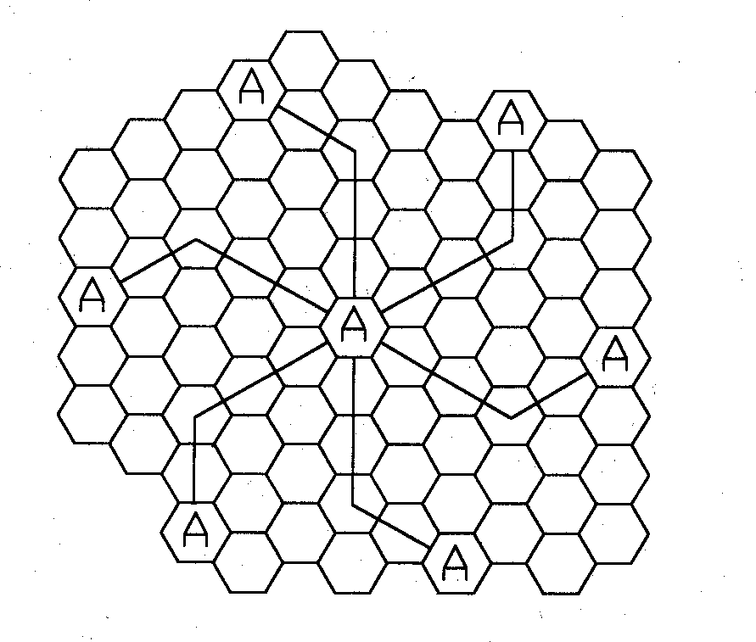
Hexagonal geometry has
  exactly six equidistance neighbors
  the lines joining the centers of any cell and each of its neighbors are separated by multiples of 60 degrees.
Only certain cluster sizes and cell layout are possible.
The number of cells per cluster, N, can only have values which satisfy
N = i² + ij + j²
Co-channel neighbors of a particular cell, ex, i=3 and j=2.

Slide 9
Channel Assignment Strategies
Frequency reuse scheme
  increases capacity
  minimize interference
Channel assignment strategy
  fixed channel assignment
  dynamic channel assignment
Fixed channel assignment
  each cell is allocated a predetermined set of voice channel
  any new call attempt can only be served by the unused channels
  the call will be blocked if all channels in that cell are occupied
Dynamic channel assignment
  channels are not allocated to cells permanently.
  allocate channels based on request.
  reduce the likelihood of blocking, increase capacity.

Slide 10
Handoff Strategies
When a mobile moves into a different cell while a conversation is in progress, the MSC automatically transfers the call to a new channel belonging to the new base station.
Handoff operation
  identifying a new base station
  re-allocating the voice and control channels with the new base station.
Handoff Threshold
  Minimum usable signal for acceptable voice quality (-90dBm to -100dBm)
  Handoff margin Δ = P_{r ,handoff} − P_{r ,minimum usa}c_{bl}a_{e}nnot be too large or too small.
  If Δ is too large, unnecessary handoffs burden the MSC
  If Δ is too small, there may be insufficient time to complete handoff before a call is lost.

Slide 11
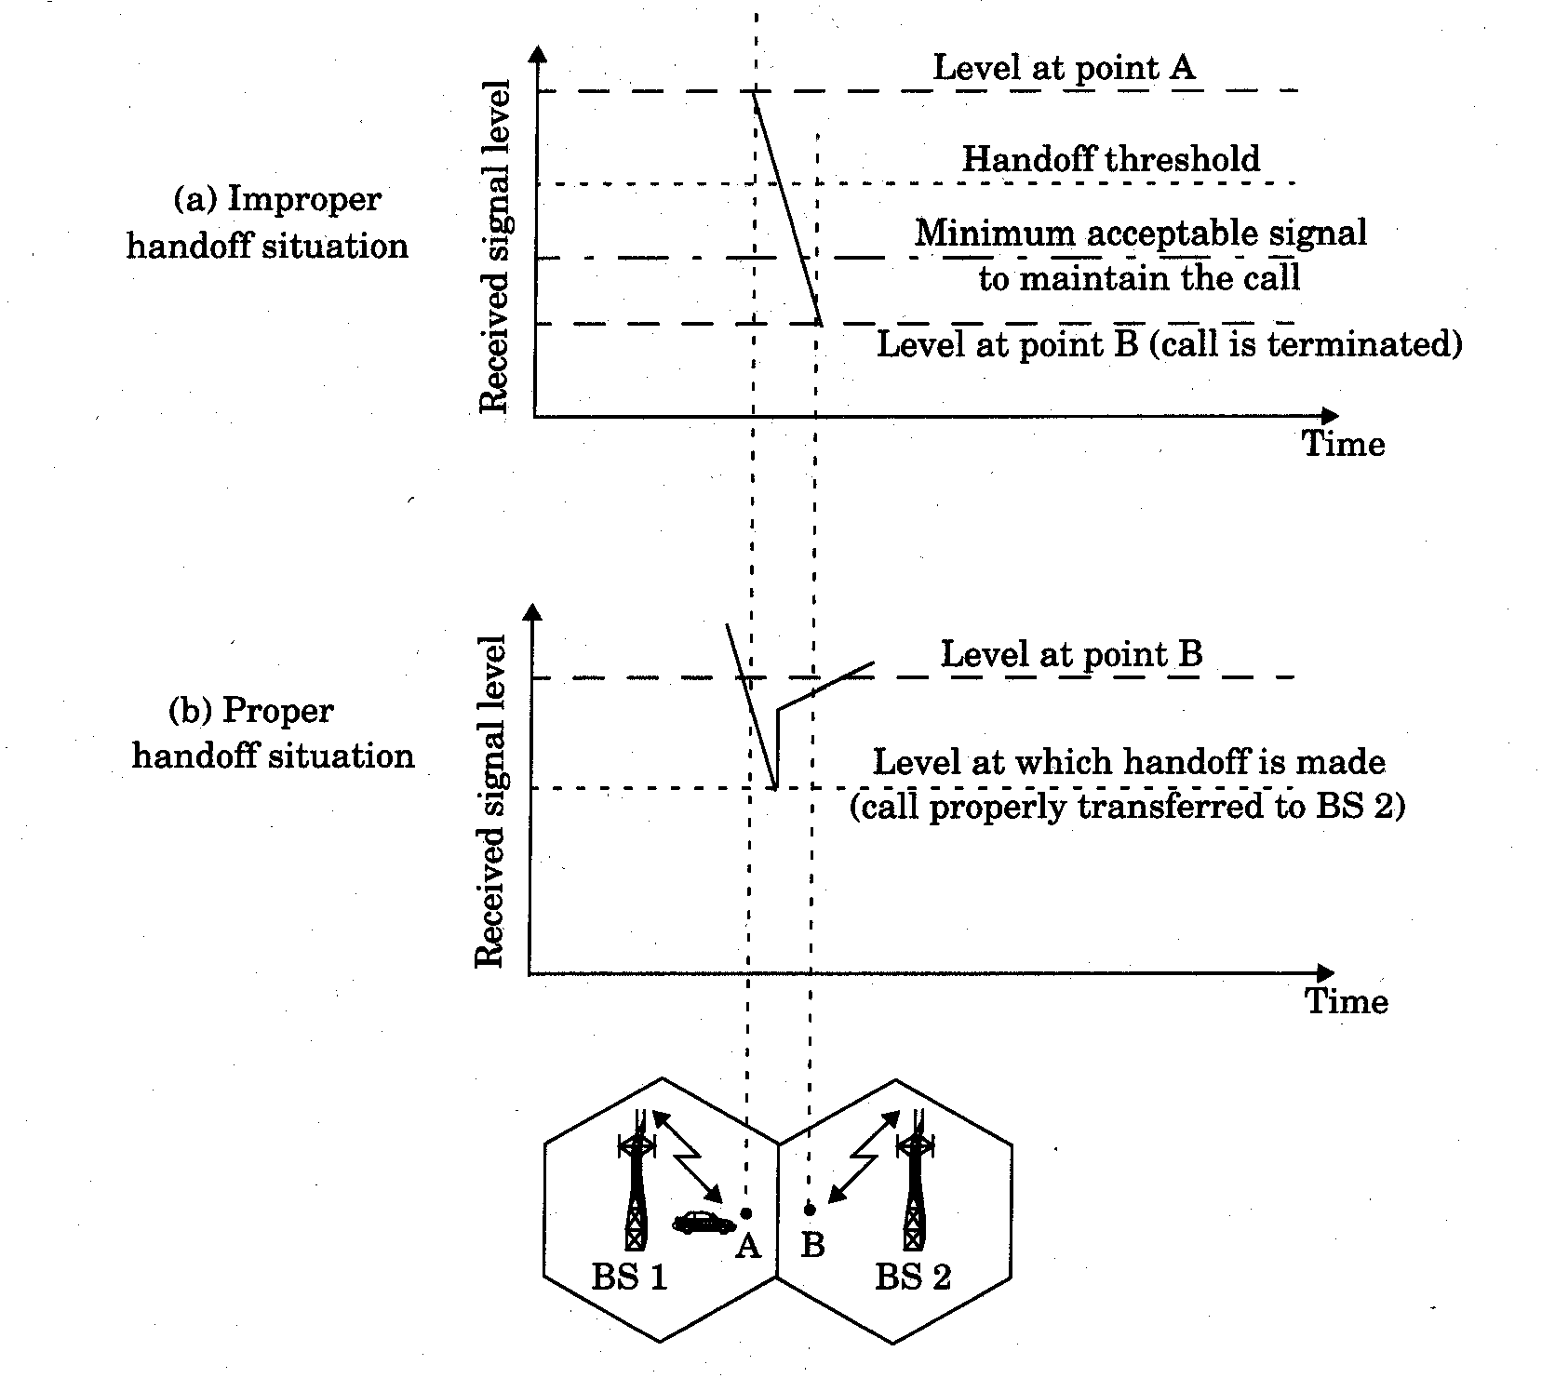

Slide 12
Handoff must ensure that the drop in the measured signal is not due to momentary fading and that the mobile is actually moving away from the serving base station.
Running average measurement of signal strength should be optimized so that unnecessary handoffs are avoided.
  Depends on the speed at which the vehicle is moving.
  Steep short term average -> the hand off should be made quickly
  The speed can be estimated from the statistics of the received short-term fading signal at the base station
Dwell time: the time over which a call may be maintained within a cell without handoff.
Dwell time depends on
  propagation
  interference
  distance
  speed

Slide 13
Handoff measurement
  In first generation analog cellular systems, signal strength measurements are made by the base station and supervised by the MSC.
  In second generation systems (TDMA), handoff decisions are mobile assisted, called mobile assisted handoff (MAHO)
Intersystem handoff: If a mobile moves from one cellular system to a different cellular system controlled by a different MSC.
Handoff requests is much important than handling a new call.

Slide 14
Practical Handoff Consideration
Different type of users
  High speed users need frequent handoff during a call.
  Low speed users may never need a handoff during a call.
Microcells to provide capacity, the MSC can become burdened if high speed users are constantly being passed between very small cells.
Minimize handoff intervention
  handle the simultaneous traffic of high speed and low speed users.
Large and small cells can be located at a single location (umbrella cell)
  different antenna height
  different power level
Cell dragging problem: pedestrian users provide a very strong signal to the base station
  The user may travel deep within a neighboring cell

Slide 15
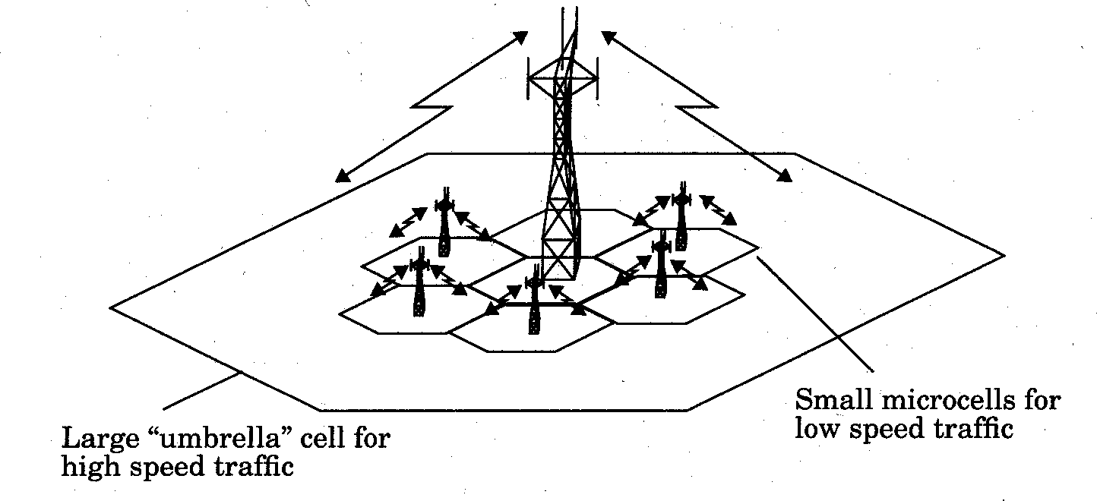

Slide 16
Handoff for first generation analog cellular systems
  10 secs handoff time
  Δ is in the order of 6 dB to 12 dB
Handoff for second generation cellular systems, e.g., GSM
  1 to 2 seconds handoff time
  mobile assists handoff
  Δ is in the order of 0 dB to 6 dB
  Handoff decisions based on signal strength, co-channel interference, and adjacent channel interference.
IS-95 CDMA spread spectrum cellular system
  Mobiles share the channel in every cell.
  No physical change of channel during handoff
  MSC decides the base station with the best receiving signal as the service station
•
34

Slide 17
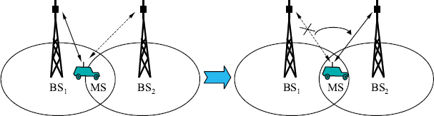
Types of Handoffs:
Hard handoff: “break before make” connection
Intra and inter-cell handoffs
Hard Handoff between the MS and BSs

Slide 18
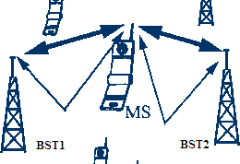
Cont.
Soft handoff: “make-before-break” connection.
Mobile directed handoff.
Multiways and softer handoffs
Soft Handoff between MS and BSTs

Slide 19
Handoff Prioritization:
Two basic methods of handoff prioritization are :
Guard Channels
Queuing of Handoff

Slide 20
Interference and System Capacity
Sources of interference
  another mobile in the same cell
  a call in progress in the neighboring cell
  other base stations operating in the same frequency band
  noncellular system leaks energy into the cellular frequency band
Two major cellular interference
  co-channel interference
  adjacent channel interference

Slide 21
Co-channel Interference and System Capacity
Frequency reuse - there are several cells that use the same set of frequencies
  co-channel cells
  co-channel interference
To reduce co-channel interference, co-channel cell must be separated by a minimum distance.
When the size of the cell is approximately the same
  co-channel interference is independent of the transmitted power
  co-channel interference is a function of
    R: Radius of the cell
    D: distance to the center of the nearest co-channel cell
Increasing the ratio Q=D/R, the interference is reduced.
Q is called the co-channel reuse ratio

Slide 22
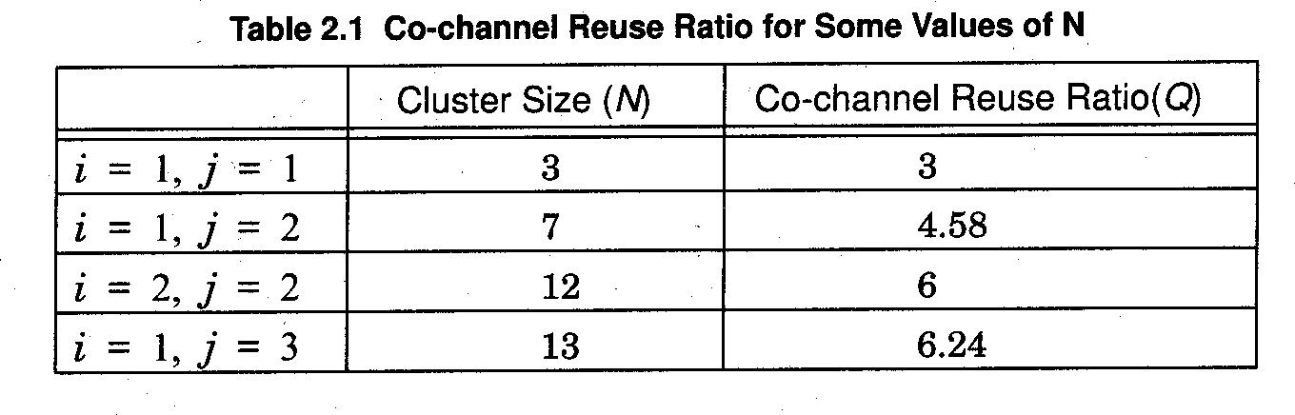
For a hexagonal geometry
Q = ^{D} = 3N
R
A small value of Q provides large capacity
A large value of Q improves the transmission quality - smaller level of co-channel interference
A tradeoff must be made between these two objectives

Slide 23

Let i₀ be the number of co-channel interfering cells. The signal-to- interference ratio (SIR) for a mobile receiver can be expressed as
S ₌ S
I
i₀
∑ ^{I}i
i=1
S: the desired signal power
I_{i}: interference power caused by the ith interfering co-channel cell base station
The average received power at a distance d from the transmitting antenna is approximated by
⎛ d ⎞^{− n}
close-in reference point
d₀
P_{r} = P₀ ⎜ ⎟
d
⎝ 0 ⎠
or
⎛ d ⎞
P :measued power
P (dBm) = P (dBm) − 10n log⎜
⎟
0
TX
r 0
d
⎝ 0 ⎠
n is the path loss exponent which ranges between 2 and 4.

Slide 24
When the transmission power of each base station is equal, SIR for a mobile can be approximated as
S ₌
_{R}− n
I
i₀
₎−n
∑ i
(D
i=1
Consider only the first layer of interfering cells
S (D / R)^{n} ( 3N )^{n}
= =
I
i₀ = 6
i
i
0 0
Example: AMPS requires that SIR be greater than 18dB
  N should be at least 6.49 for n=4.
  Minimum cluster size is 7

Slide 25
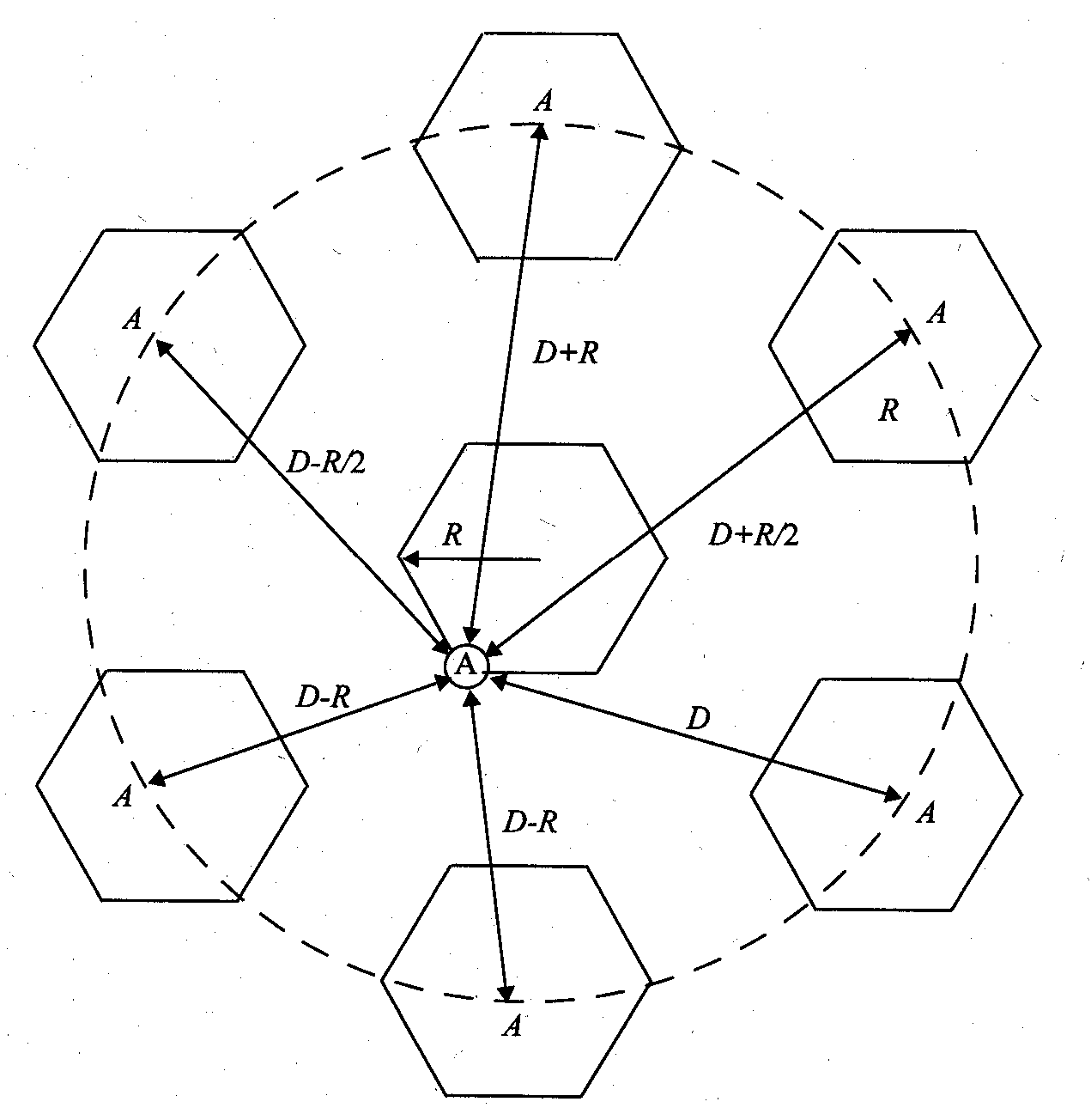
For hexagonal geometry with 7-cell cluster, with the mobile unit being at the cell boundary, the signal-to-interference ratio for the worst case can be approximated as
S ₌ R
I 2(D − R)⁻⁴ + (D − R / 2)⁻⁴ + (D + R / 2)⁻⁴ + (D + R)⁻⁴ + D⁻⁴
−4

Slide 26


Adjacent Channel Interference
Adjacent channel interference: interference from adjacent in frequency to the desired signal.
  Imperfect receiver filters allow nearby frequencies to leak into the passband
  Performance degrade seriously due to near-far effect.
receiving filter response
signal on adjacent channel
signal on adjacent channel
desired signal
FILTER
interference
interference
desired signal

Slide 27
Adjacent channel interference can be minimized through careful filtering and channel assignment.
Keep the frequency separation between each channel in a given cell as large as possible
A channel separation greater than six is needed to bring the adjacent channel interference to an acceptable level.
Ensure each mobile transmits the smallest power necessary to maintain a good quality link on the reverse channel
  long battery life
  increase SIR
  solve the near-far problem

Slide 28
Trunking and Grade of Service
A means for providing access to users on demand from available pool of channels.
With trunking, a small number of channels can accommodate large number of random users.
Telephone companies use trunking theory to determine number of circuits required.
Trunking theory is about how a population can be handled by a limited number of servers.

Slide 29
Terminology:
Traffic intensity is measured in Erlangs:
One Erlang: traffic in a channel completely occupied. 0.5 Erlang: channel occupied 30 minutes in an hour.
Grade of Service (GOS): probability that a call is blocked (or delayed).
Set-Up Time: time to allocate a channel.
Blocked Call: Call that cannot be completed at time of request due to congestion. Also referred to as Lost Call.
Holding Time: (H) average duration of typical call.
Load: Traffic intensity across the whole system.
Request Rate: (λ) average number of call requests per unit time.

Slide 30
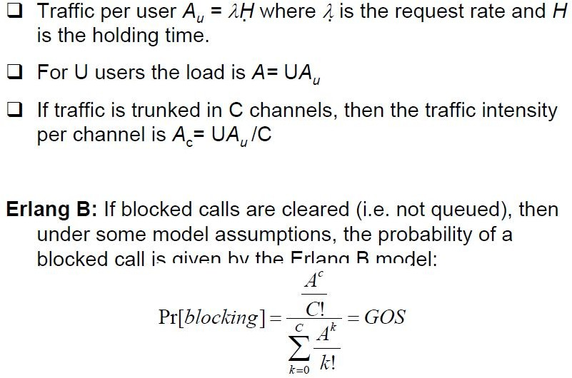
Traffic Measurement (Erlangs)

Slide 31
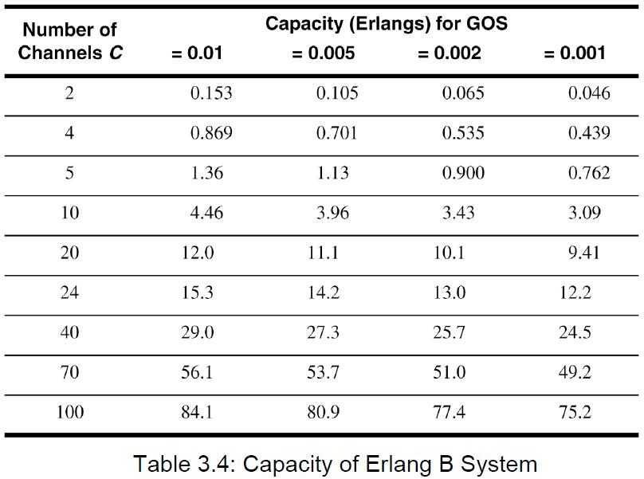

Slide 32
Improving Capacity in Cellular Systems
Methods for improving capacity in cellular systems
  Cell Splitting: subdividing a congested cell into smaller cells.
  Sectoring: directional antennas to control the interference and frequency reuse.
  Coverage zone : Distributing the coverage of a cell and extends the cell boundary to hard-to-reach place.

Slide 33
Cell Splitting
Cell Splitting is the process of subdividing the congested cell into smaller cells (microcells),Each with its own base station and a corresponding reduction in antenna height and transmitter power.
Cell Splitting increases the capacity since it increases the number of times the channels are reused.

Slide 34
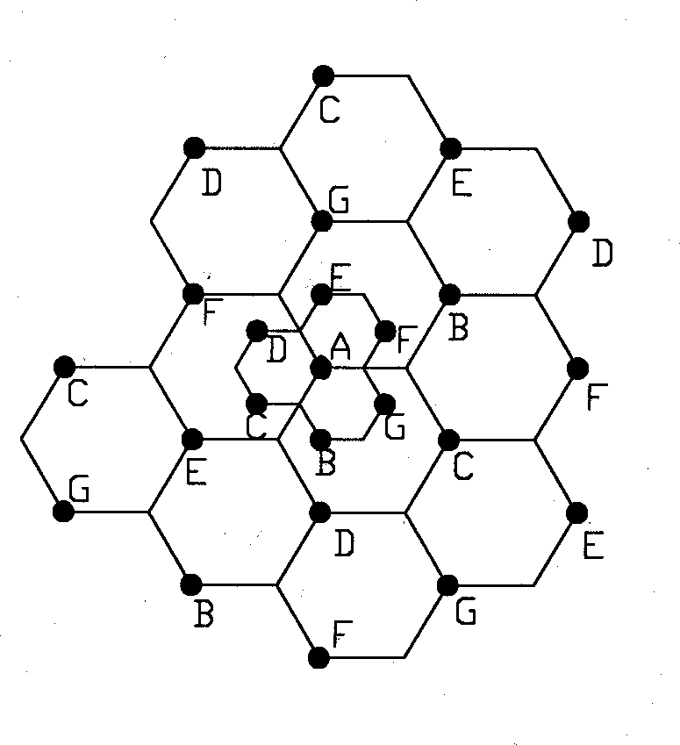
Cell Splitting
Split congested cell into smaller cells.
  Preserve frequency reuse plan.
  Reduce transmission power.
Reduce R to R/2
microcell

Slide 35
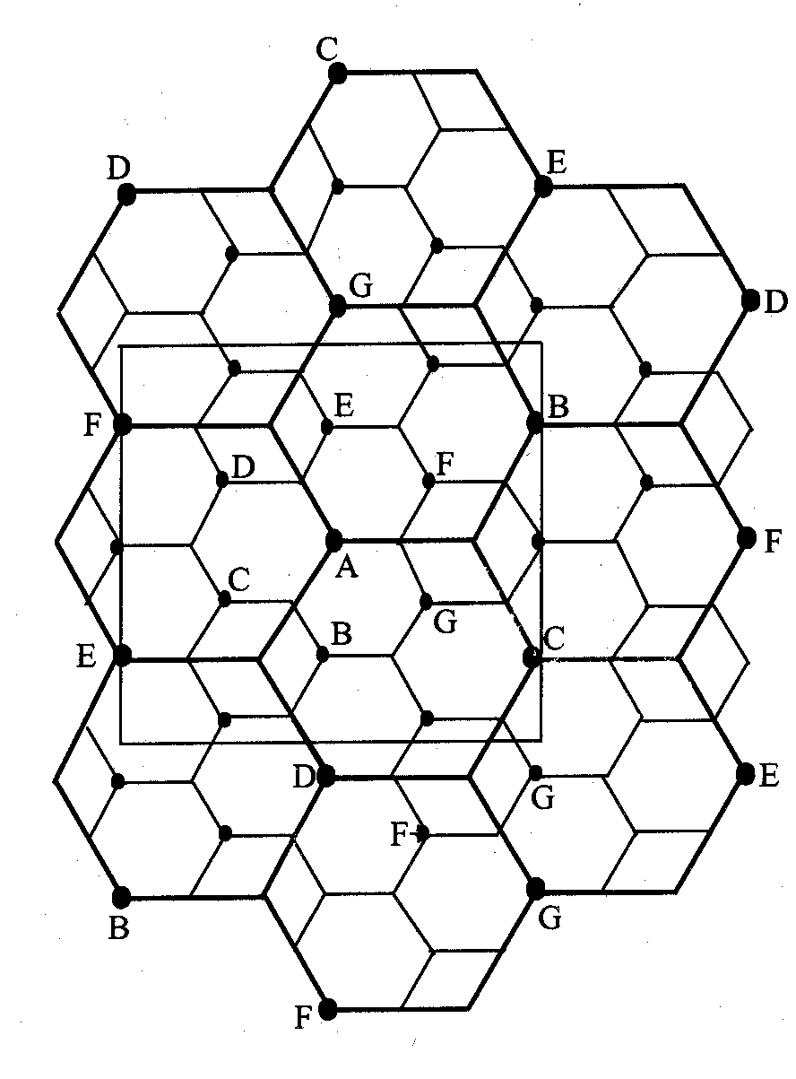
Illustration of cell splitting within a 3 km by 3 km square

Slide 36
Transmission power reduction from P_{t1} to
Examining the receiving power at the new and old cell boundary
^{P}t 2
P [at old cell boundary] ∝ P R^{− n} r t1
P [at new cell boundary] ∝ P (R / 2)^{− n} r t 2
If we take n = 4 and set the received power equal to each other
P
₌ ^{P}t1
t 2
16
The transmit power must be reduced by 12 dB in order to fill in the original coverage area.
Problem: if only part of the cells are splited
– Different cell sizes will exist simultaneously
Handoff issues - high speed and low speed traffic can be simultaneously accommodated

Slide 37
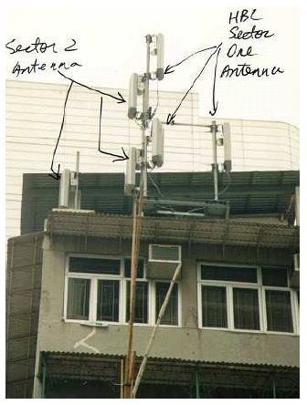
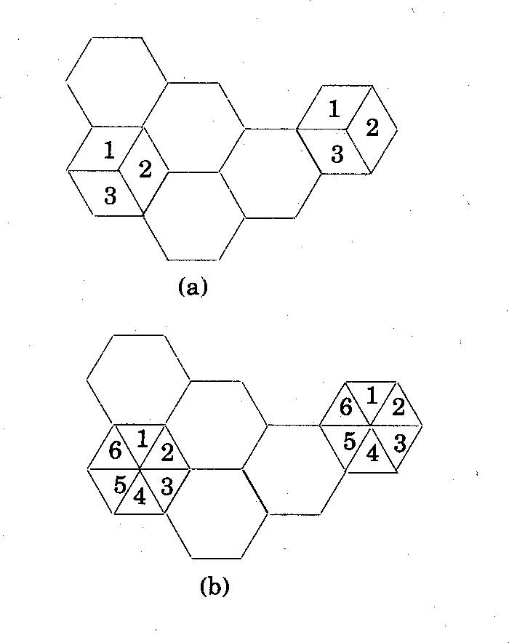
Sectoring
Decrease the co-channel interference and keep the cell radius R
unchanged
  Replacing single omni-directional antenna by several directional antennas
  Radiating within a specified sector

Slide 38
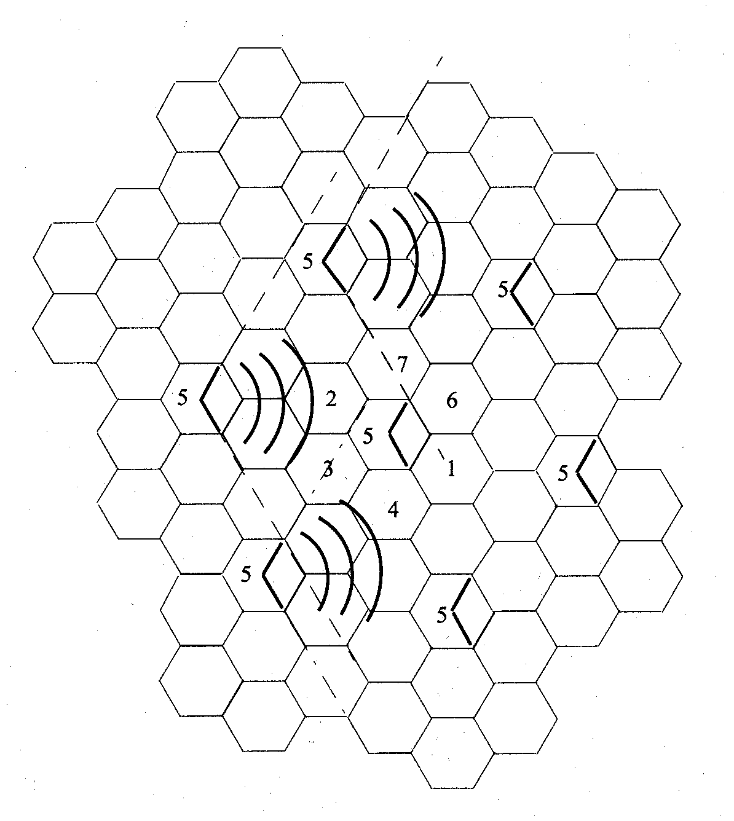
Interference Reduction
position of the
mobile
interference cells

Slide 39
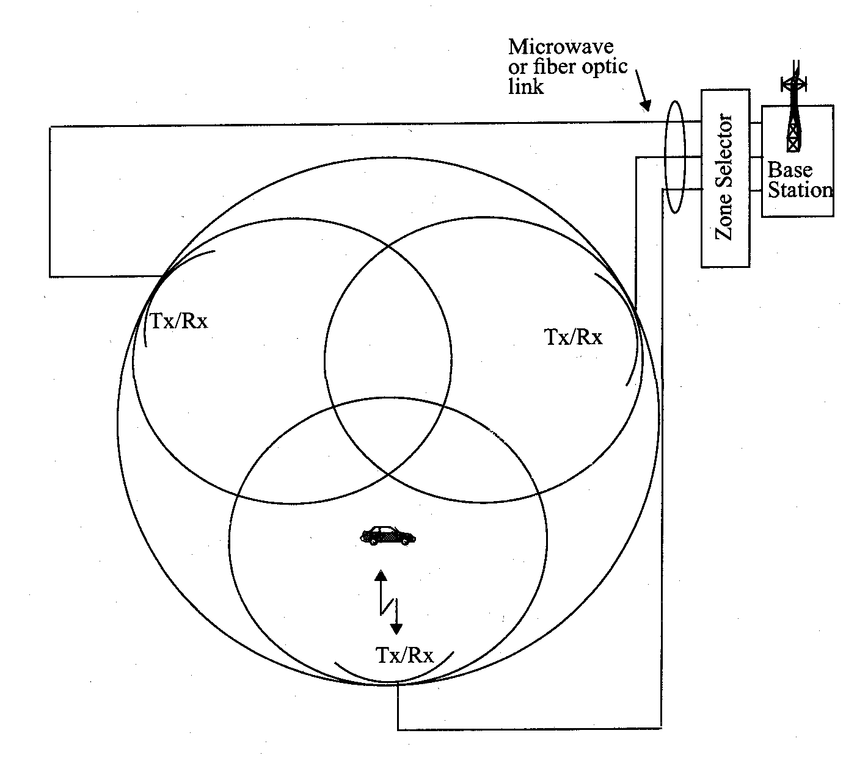
Microcell Zone Concept
Antennas are placed at the outer edges of the cell
Any channel may be assigned to any zone by the base station
Mobile is served by the zone with the strongest signal.
Handoff within a cell
  No channel re- assignment
  Switch the channel to a different zone site
Reduce interference
  Low power transmitters are employed

Slide 40
Multiple Access Techniques for Wireless Communication:
Many users can access the at same time, share a finite amount of radio spectrum with high performance duplexing generally required frequency domain time domain. They accessing techniques are,
FDMA
TDMA
SDMA
PDMA

Slide 41
Frequency division multiple access FDMA
One phone circuit per channel
Idle time causes wasting of resources
Simultaneously and continuously transmitting
Usually implemented in narrowband systems
For example: in AMPS is a FDMA bandwidth of 30 kHz implemented

Slide 42
Time Division Multiple Access
Time slots
One user per slot
Buffer and burst method
Noncontinuous transmission
Digital data
Digital modulation

Slide 43
Features of TDMA
A single carrier frequency for several users
Transmission in bursts
Low battery consumption
Handoff process much simpler
FDD : switch instead of duplexer
Very high transmission rate
High synchronization overhead
Guard slots necessary

Slide 44
Space Division Multiple Access
Controls radiated energy for each user in space
using spot beam antennas
base station tracks user when moving
cover areas with same frequency:
TDMA or CDMA systems
cover areas with same frequency:
FDMA systems

Slide 45
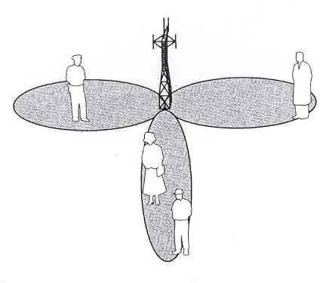
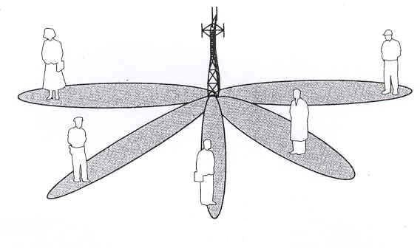
Space Division Multiple Access
primitive applications are antennas”
“Sectorized
In future adaptive antennas simultaneously steer energy in the direction of many users at once

Slide 46
. Mobile Radio Propagation
RF channels are random – do not offer easy analysis
difficult to model – typically done statistically for a specific system
Introduction to Radio Wave Propagation: diverse mechanisms
of electromagnetic (EM) wave propagation generally attributed to
diffraction
reflection
scattering
non-line of sight (NLOS – obstructed) paths rely on reflections
obstacles cause diffraction
multi-path: EM waves travel on different paths to a destination – interaction of paths causes fades at specific locations

Slide 47
traditional Propagation Models focus on
transmit model - average received signal strength at given distance
receive model - variability in signal strength near a given location
  Large Scale Propagation Models: predict mean signal strength for TX-RX pair with arbitrary separation
    useful for estimating coverage area of a transmitter
    characterizes signal strength over large distances (10²-10³ m)
    predict local average signal strength that decreases with distance

Slide 48
(2) Small Scale or Fading Models: characterize rapid fluctuations of received signal over
short distances (few λ) or
short durations (few seconds)
with mobility over short distances
instantaneous signal strength fluctuates
received signal = sum of many components from different directions
phases are random → sum of contributions varies widely
received signal may fluctuate 30-40 dB by moving a fraction of λ

Slide 49
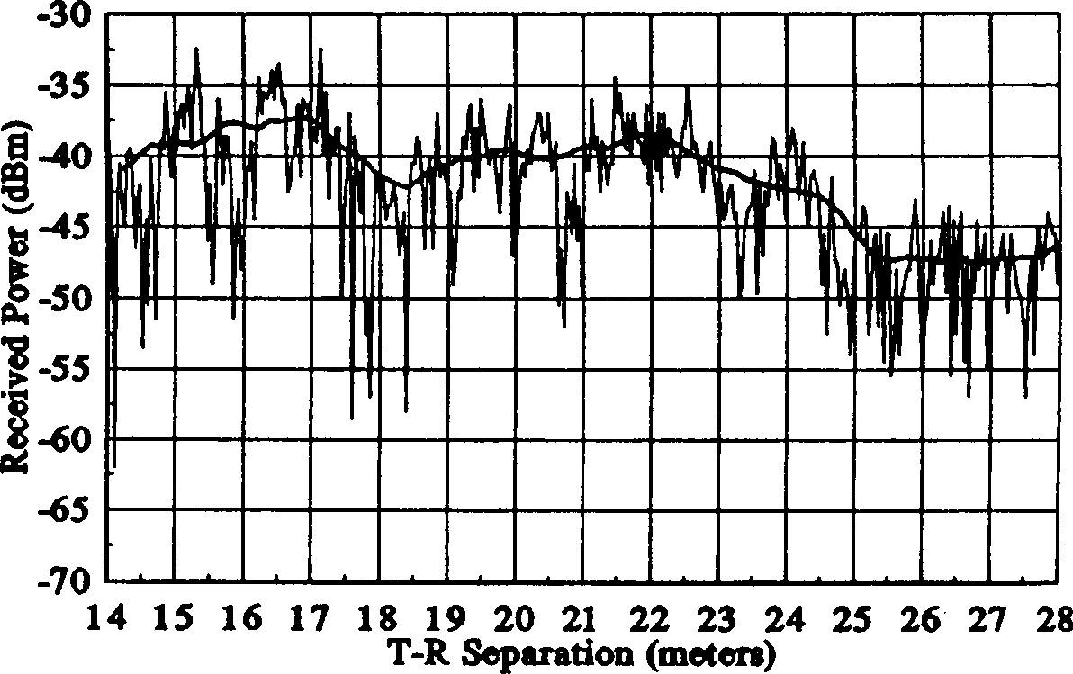
Large-scale small-scale propagation

Slide 50
Reflection
Perfect conductors reflect with no attenuation
  Like light to the mirror
Dielectrics reflect a fraction of incident energy
  “Grazing angles” reflect max*
  Steep angles transmit max*
– Like light to the water
Reflection induces 180°
θ
θ
phase shift
r
θ
t
– Why? See yourself in the mirror

Slide 51
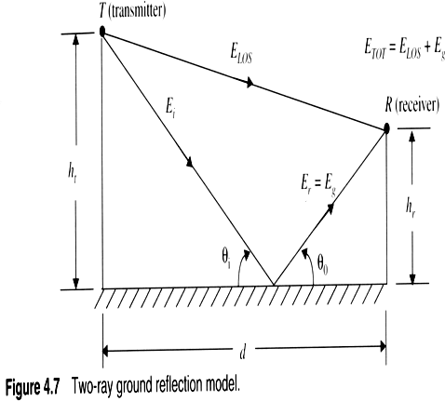
Classical 2-ray ground bounce model
One line of sight and one ground bound

Slide 52
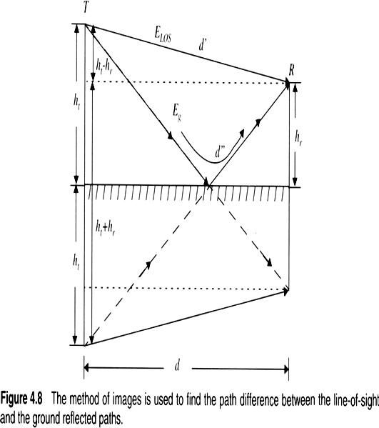
Method of image

Slide 53
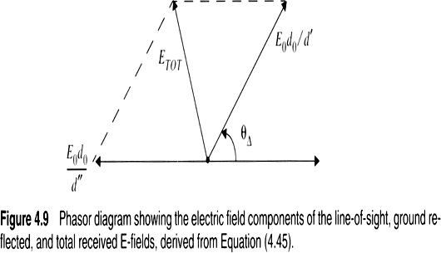
Vector addition of 2 rays

Slide 54
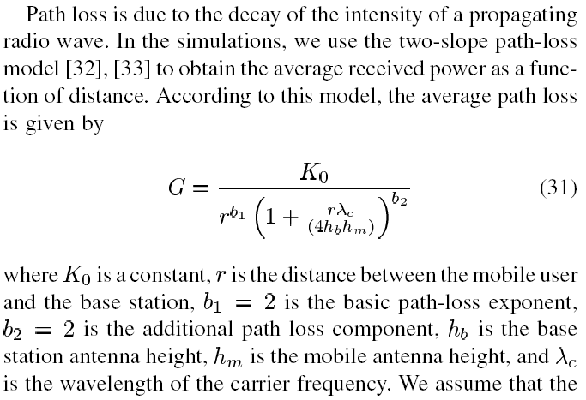
Simplified model
_{h}2_{h}2
P_{r} = P_{t} G_{t} G_{r} ^{t r}
_{d} 4
• Far field simplified model
• Example 2.2
84

Slide 55
Diffraction
Diffraction occurs when waves hit the edge of an obstacle
  “Secondary” waves propagated into the shadowed region
  Water wave example
  Diffraction is caused by the propagation of secondary wavelets into a shadowed region.
  Excess path length results in a phase shift
  The field strength of a diffracted wave in the shadowed region is the vector sum of the electric field components of all the secondary wavelets in the space around the obstacle.
  Huygen’s principle: all points on a wavefront can be considered as point sources for the production of secondary wavelets, and that these wavelets combine to produce a new wavefront in the direction of propagation.

Slide 56
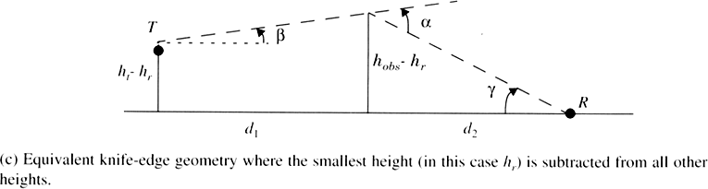
Diffraction geometry
Fresnel-Kirchoff distraction parameters,

Slide 57
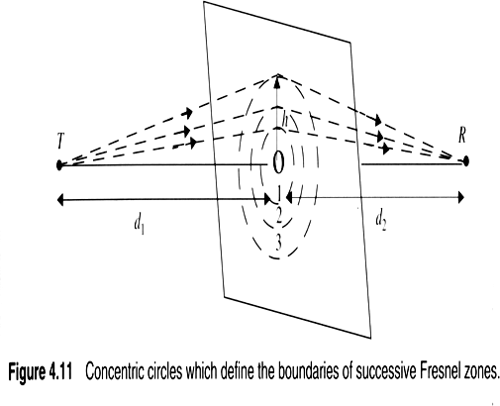
Fresnel Screens
Fresnel zones relate phase shifts to the positions of obstacles
A rule of thumb used for line-of-sight
microwave links 55% of the first Fresnel zone is
kept clear.

Slide 58
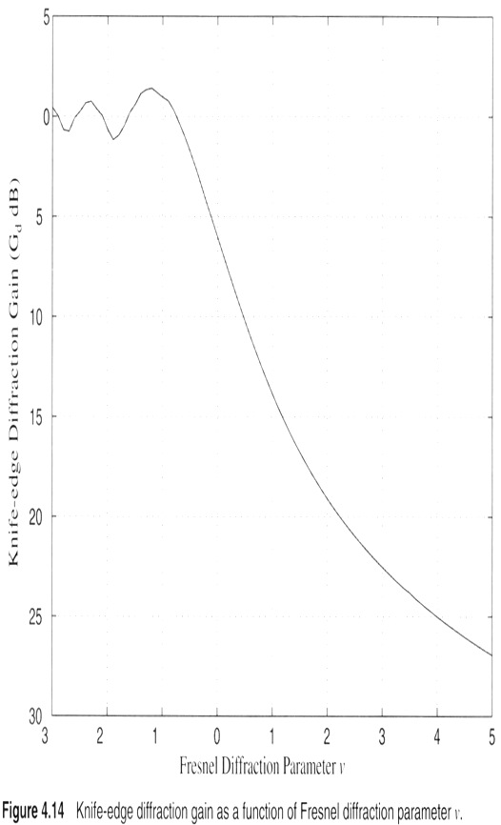
Knife-edge diffraction loss
Gain

Slide 59
Scattering
Rough surfaces
  Lamp posts and trees, scatter all directions
  Critical height for bumps is f(λ,incident angle),
  Smooth if its minimum to maximum protuberance h is less than critical height.
  Scattering loss factor modeled with Gaussian distribution,
Nearby metal objects (street signs, etc.)
  Usually modeled statistically
Large distant objects
  Analytical model: Radar Cross Section (RCS)
  Bistatic radar equation,

Slide 60
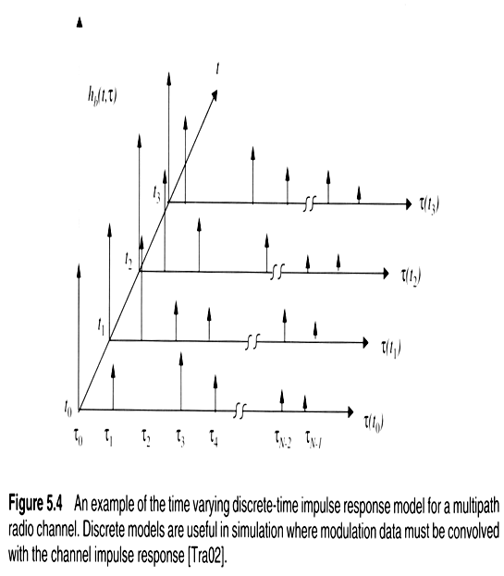
Impulse Response Model of a Time Variant Multipath Channel

Slide 61
3.2 Free Space Propagation Model
used to predict signal strength for LOS path
satellites
LOS uwave
power decay ∝ d ^{–n} (d = separation)
Subsections
Friis Equation
Radiated Power
Path Loss
Far Field Region

Slide 62
⎛ G G λ² ⎞ P
(1) Friis free space equation: receive power at antenna separated by distance d from transmitter
P_{r}(d) =
⎜ t r ⎟ t
(3.1)
⎜
2
⎟
2
(4π ) L d
⎝ ⎠
P_{r} & P_{t} = received & transmitted power
G_{t} & G_{r} = gain of transmit & receive antenna
λ = wavelength
d = separation
L = system losses (line attenuation, filters, antenna)
- not from propagation
- practically, L ≥ 1, if L = 1 → ideal system with no losses
power decays by d ² → decay rate = 20dB/decade

Slide 63
Antenna Gain
4π _{A}
G =
_{λ}2
(3.2)
e
A_{e} = effective area of absorption– related to antenna size
Antenna Efficiency η = A_{e}/A
A = antenna’s physical area (cross sectional)
  for parabolic antenna η ≈ 45% - 50%
  for horn antenna η ≈ 50% - 80%

Slide 64



(2) Radiated Power
Isotropic Radiator: ideal antenna (used as a reference antenna)
radiates power with unit gain uniformly in all directions
surface area of a sphere = 4πd ²
_{λ}2
4π
Effective Area of isotropic antennae given by A =
iso
_{⎛ λ}2
⎞⎛
1
⎞
_{λ}2
Isotropic Received Power P_{R} =
⎜ ⎟
⎝
⎜
⎟
P
⁼ (4πd )²
P_{T}
4π
⎠⎝
4πd
2
⎠
T
d = transmitter-receiver separation
P (4πd )²
_{λ}2
Isotropic free space path loss L_{p} =
T ₌
P
R
f ² relationship with antenna size results from dependence of A_{iso} on λ

Slide 65

Directional Radiation
practical antennas have gain or directivity that is a function of
θ = azimuth: look angle of the antenna in the horizontal plane
ϕ = elevation: look angle of the antenna above the horizontal plane
ϕ
Let Φ = power flux desnity
θ
transmit antenna gain is given by:
Φ in the direction of (θ, ϕ)
Φ of isotropic antenna
G (θ, ϕ) =
T
receive antenna gain is given by:
A_{e} in the direction of (θ, ϕ) A_{e} of isotropic antenna
G (θ, ϕ) =
R

Slide 66
Principal Of Reciprocity:
signal transmission over a radio path is reciprocal
the locations of TX & RX can be interchanged without changing transmission characteristics
signals suffers exact same effects over a path in either direction in a consistent order → implies that G_{T}(θ, ϕ) = G_{R}(θ, ϕ)
thus maximum antenna gain in either direction is given by
A_{e =} 4π _{Ae}
G =
_{λ}2
^{A}iso

Slide 67
EIRP: effective isotropic radiated power
represents maximum radiated power available from a transmitter
measured in the direction of maximum antenna gain as compared to isotropic radiator
EIRP = P_{t}G_{iso} (3.4)
ERP: effective radiated power - often used in practice
  denotes maximum radiated power compared to ½ wave dipole antenna
  dipole antenna gain = 1.64 (2.15dB) > isotropic antenna
  thus EIRP will be 2.15dB smaller than ERP for same system
^{ERP = P}t^{G}dipole

Slide 68
1. Outdoor Propagation Models
  1.1 Longley-Rice Model
  1.2 Okumura Model
  1.3. Hata Model
  1.4. PCS Extension to Hata Model
  1.5. Walfisch and Bertoni Model

Slide 69
Outdoor Propagation Models
Propagation over irregular terrain.
The propagation models available for predicting signal strength vary very widely in their capacity, approach, and accuracy.

Slide 70
Longley-Rice Model
also referred to as the ITS irregular terrain model
frequency range from 40 MHz to 100 GHz
Two version:
point-to-point using terrain profile.
area mode estimate the path-specific parameters

Slide 71
Okumura Model
Frequency range from150 MHz to 1920 MHz
BS-MS distance of 1 km to 100 km.
BS antenna heights ranging from 30 m 1000 m.
L₅₀ (dB) = L _{f} + A_{mu} ( f , d ) − G(h_{te} ) − G(h_{re} ) − G_{AREA}
L_{f} is the free space propagation loss,
A_{mu} is the median attenuation relative to free space,
G(t_{te} ) is the base station antenna height gain factor, G(t_{re} ) is the mobile antenna height gain factor,
G_{AREA} is the gain due to the type of environment.

Slide 72
Hata Model
Frequency range from150 MHz to 1500 MHz
BS-MS distance of 1 km to 100 km.
BS antenna heights ranging from 30 m 200 m.
L₅₀ (urban)(dB) = 69.55 + 26.16 log f_{c} −13.82 log h_{te} − a(h_{re} ) + (44.9 − 6.55 log h_{te} )log d
f_{c} is the frequency (in MHz) from 150 MHz to 1500 MHz,
h_{te} is the effective transmitter antenna height (in meters)
h_{re} is the effective receiver (mobile) antenna height (1..10 m)
d is the T-R separation distance (in km),
a(h_{re} ) is the correction factor for effective mobile antenna height (large city, small to medium size city, suburban, open rural)

Slide 73
PCS Extension to Hata Model
Frequency range from1500 MHz to 2000 MHz
BS-MS distance of 1 km to 20 km.
BS antenna heights ranging from 30 m 200 m.
L₅₀ (urban) = 46.3 + 33.9 log f _{c} − 13.82 log h_{te} − a(h_{re} ) + (44.9 − 6.55 log h_{te} )log d + C_{M}
f_{c} is the frequency (in MHz) from 1500 MHz to 2000 MHz,
h_{te} is the effective transmitter antenna height (in meters)
h_{re} is the effective receiver (mobile) antenna height (1..10 m)
d is the T-R separation distance (in km),
a(h_{re} ) is the correction factor for effective mobile antenna height (large city, small to medium size city, suburban, open rural)
C_{M} 0 dB for medium sized city and suburban areas,
3 dB for metropolitan centers

Slide 74
Walfisch and Bertoni Model
considered the impact of the rooftops and building height by using diffraction to predict average signal strength at street level
α
Δ_{H}
hb
H
hm
d
w
b

Slide 75
Indoor Propagation Models
The distances covered are much smaller
The variability of the environment is much greater
Key variables: layout of the building, construction materials, building type, where the antenna mounted, …etc.
In general, indoor channels may be classified either as LOS or OBS with varying degree of clutter
The losses between floors of a building are determined by the external dimensions and materials of the building, as well as the type of construction used to create the floors and the external surroundings.
Floor attenuation factor (FAF)

Slide 76
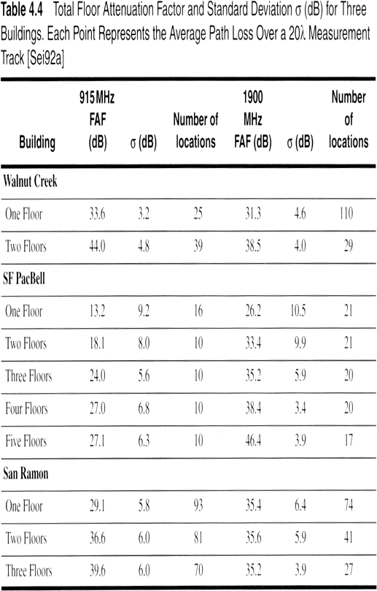
Partition losses between floors

Slide 77
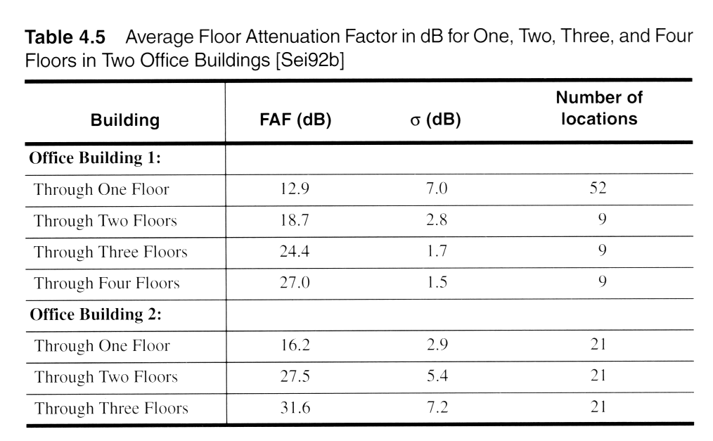
Partition losses between floors

Slide 78
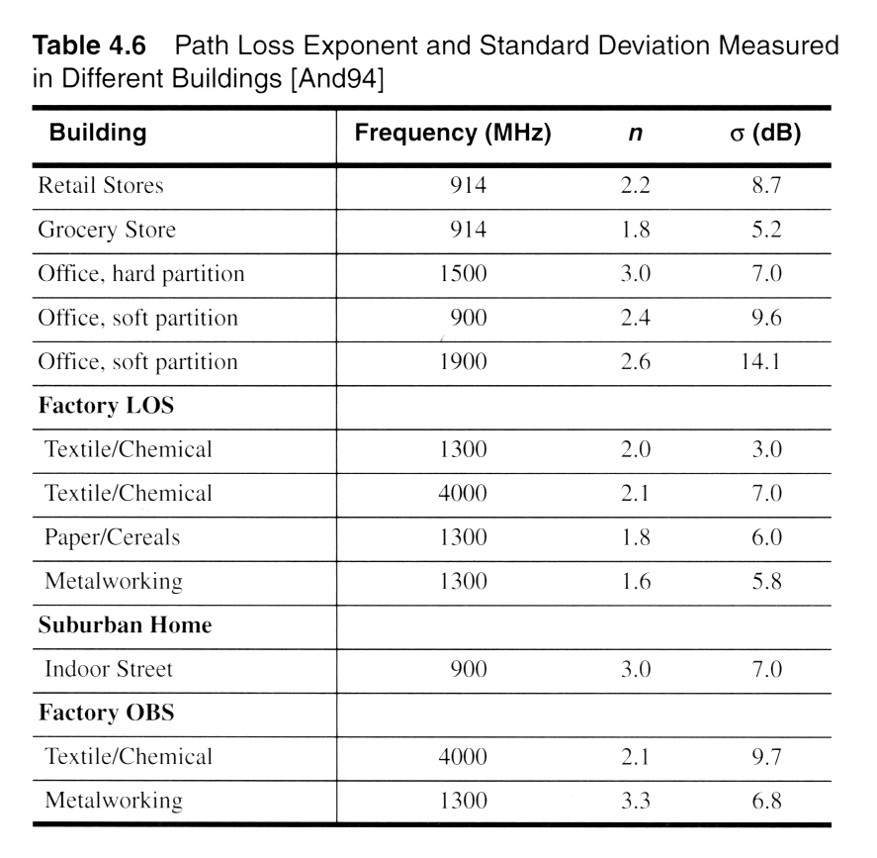
Log-distance Path Loss Model
The exponent n depends on the surroundings and building type
– X_{σ} is the variable in dB having a standard deviation σ.
PL (d ) = PL (d₀ )+ 10n log(d / d ₀ )+ X_{σ}

Slide 79
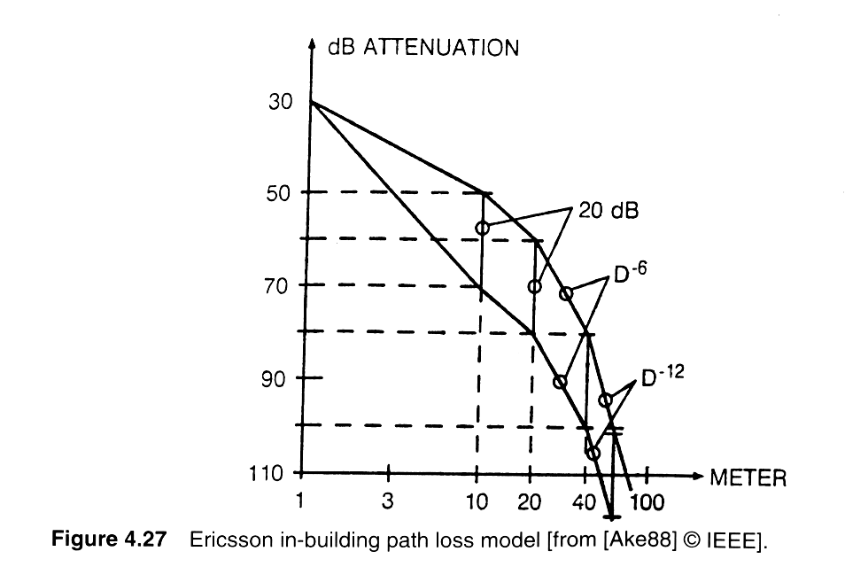
Ericsson Multiple Breakpoint Model

Slide 80
Attenuation Factor Model
FAF represents a floor attenuation factor for a specified number of building floors.
PAF represents the partition attenuation factor for a specific obstruction encountered
by a ray drawn between the transmitter and
P_{re}L_{c}(_{e}d_{iv})_{e}=_{r i}P_{n}L₃(₋d_{D0} ) +10n_{SF} log(d / d₀ ) + FAF + ∑ PAF
_{P}α_{L}is_{(d}th₎e₌at_{P}te_{L}n₍u_{d}ati₎o₊n₁c₀o_{n}nsta_{l}n_{og}t ₍fo_{d}r/t_{d}he₎c+h∑anPnAelF
with units of dB⁰per me^{M}te^{F}r.
0
PL (d ) = PL (d ₀ )+ 10 log(d / d ₀ )+ αd + FAF + ∑ PAF

Slide 81
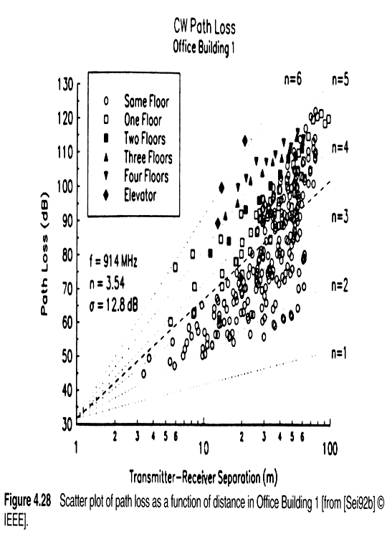
Measured indoor path loss

Slide 82
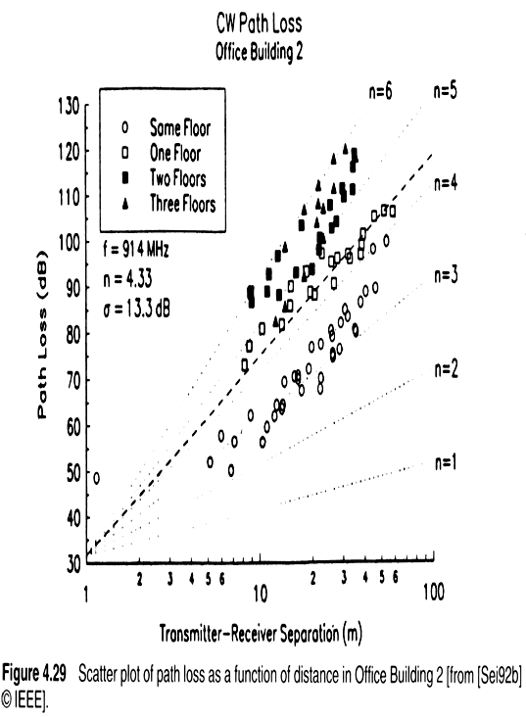
Measured indoor path loss

Slide 83
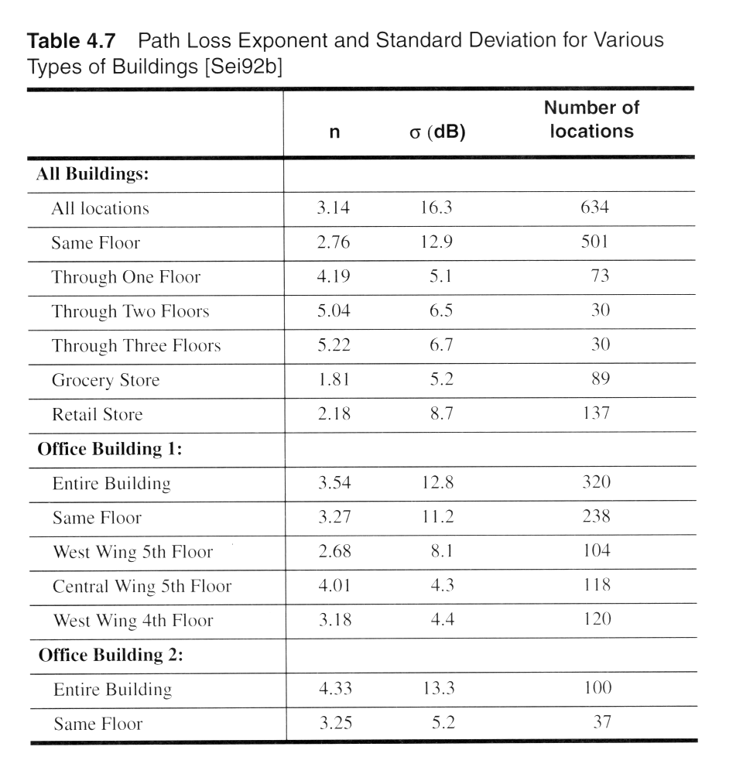
Measured indoor path loss

Slide 84
Parameters of Mobile Multipath Channels
Time Dispersion Parameters
  Grossly quantifies the multipath channel
  Determined from Power Delay Profile
  Parameters include
    Mean Access Delay
    RMS Delay Spread
    Excess Delay Spread (X dB)
Coherence Bandwidth
Doppler Spread and Coherence Time

Slide 85
Measuring PDPs
Power Delay Profiles
  Are measured by channel sounding techniques
  Plots of relative received power as a function of excess delay
  They are found by averaging intantenous power delay measurements over a local area
    Local area: no greater than 6m outdoor
    Local area: no greater than 2m indoor
» Samples taken at λ/4 meters approximately
» For 450MHz – 6 GHz frequency range.

Slide 86
Timer Dispersion Parameters
Determined from a power delay profile.
∑ ªk^{τ}k
2
τ = ^{k}
∑ ªk
2
k
∑ P(τ_{k} )(τ_{k} )
k
∑ P(τ_{k} )
k
Mean excess delay( ):_{τ}
=
σ = τ ² − (τ )²
τ
Rms delay spread (σ_{τ}):
∑ ∑
2 2
2
a τ
P(τ )(τ )
k k
k k
_{τ} 2 ₌ k ₌ k
∑ k
∑ P(τ )
a
2
k
k
k

Slide 87
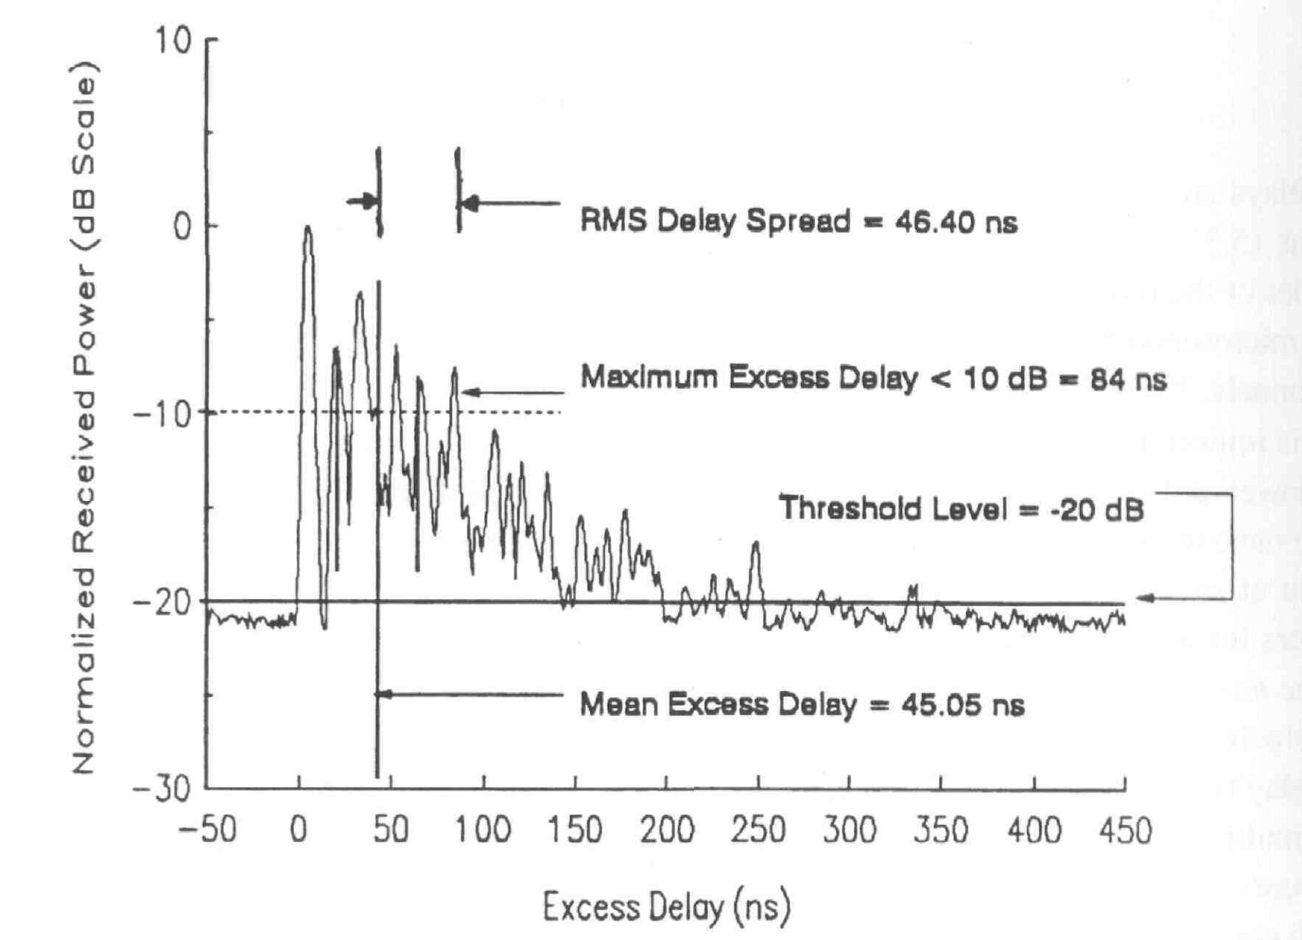
RMS Delay Spread
117

Slide 88
Coherence Bandwidth (B_{C})
Range of frequencies over which the channel can be considered flat (i.e. channel passes all spectral components with equal gain and linear phase).
– It is a definition that depends on RMS Delay Spread.
Two sinusoids with frequency separation greater than B_{c} are affected quite differently by the channel.
f₁
f₂
Multipath Channel
Receiver
Frequency Separation: |f₁-f₂|
118

Slide 89
Coherence Bandwidth
Frequency correlation between two sinusoids: 0 <= C_{r1, r2} <= 1.
If we define Coherence Bandwidth (B_{C}) as the range of frequencies over which the frequency correlation is above 0.9, then
1
50σ
B =
σ is rms delay spread.
C
If we define Coherence Bandwidth as the range of frequencies over which the frequency correlation is above 0.5, then
B = ¹
^{C} 5σ
This is called 50% coherence bandwidth.

Slide 90
Coherence Time
Delay spread and Coherence bandwidth describe the time dispersive nature of the channel in a local area.
  They don’t offer information about the time varying nature of the channel caused by relative motion of transmitter and receiver.
Doppler Spread and Coherence time are parameters which describe the time varying nature of the channel in a small-scale region.

Slide 91
Doppler Spread
Measure of spectral broadening caused by motion
We know how to compute Doppler shift: f_{d}
Doppler spread, B_{D}, is defined as the maximum Doppler shift: f_{m} = v/λ
If the baseband signal bandwidth is much greater than B_{D} then effect of Doppler spread is negligible at the receiver.

Slide 92
Coherence Time
Coherence time is the time duration over which the channel impulse response is essentially invariant.
If the symbol period of the baseband signal (reciprocal of the baseband signal bandwidth) is greater the coherence time, than the signal will distort, since channel will change during the transmission of the signal .
T_{S}
Coherence time (T_{C}) is defined as:
T ≈
1
C
f
m
T_{C}
f₁
f₂
t₁
Δt=t₂ - t₁
t₂

Slide 93
Coherence Time
₉ ₌ 0.423
Coherence time is also defined as:
T ≈
C
16πf ²
f
m
m
Coherence time definition implies that two signals arriving with a time separation greater than T_{C} are affected differently by the channel.

Slide 94
Types o^{S}f^{m}Sªm^{ll-sc}a^{al}l^{e}l-^{F}s^{ad}c^{in}a^{g}le Fading
(Based on Multipath Tİme Delay Spread)
Flat Fading
Frequency Selective Fading
BW Signal < BW of Channel
Delay Spread < Symbol Period
BW Signal > Bw of Channel
Delay Spread > Symbol Period
Small-scale Fading
(Based on Doppler Spread)
Slow Fading
Fast Fading
1. Low Doppler Spread
1. High Doppler Spread
2. Coherence Time < Symbol Peri²o.d^{Coherence Time > Symbol P}
3. Channel variations faster than b³a.s^{C}eb^{han}d^{nel variations smaller th}
signal variations
signal variations

Slide 95
Flat Fading
Occurs when the amplitude of the received signal changes with time
  For example according to Rayleigh Distribution
Occurs when symbol period of the transmitted signal is much larger than the Delay Spread of the channel
– Bandwidth of the applied signal is narrow.
May cause deep fades.
– Increase the transmit power to combat this situation.

Slide 96
Flat Fading
s(t)
r(t)
h(t,τ)
τ << T_{S}
0
T_{S}
0 τ
0
T_{S}+τ
Occurs when:
B_{S} << B_{C}
and T_{S} >> σ_{τ}
B_{C}: Coherence bandwidth B_{S}: Signal bandwidth
T_{S}: Symbol period
σ_{τ}: Delay Spread

Slide 97
Frequency Selective Fading
Occurs when channel multipath delay spread is greater than the symbol period.
  Symbols face time dispersion
  Channel induces Intersymbol Interference (ISI)
Bandwidth of the signal s(t) is wider than the channel impulse response.

Slide 98
Frequency Selective Fading
s(t)
r(t)
h(t,τ)
τ >> T_{S}
0
T_{S}
0
τ
0 T_{S}
T_{S}+τ
Causes distortion of the received baseband signal
Causes Inter-Symbol Interference (ISI)
Occurs when: B_{S} > B_{C}
and T_{S} < σ_{τ}
As a rule of thumb:
T_{S} < σ_{τ}

Slide 99
Fast Fading
Due to Doppler Spread
  Rate of change of the channel characteristics is larger than the
Rate of change of the transmitted signal
  The channel changes during a symbol period.
  The channel changes because of receiver motion.
  Coherence time of the channel is smaller than the symbol period of the transmitter signal
Occurs when: B_{S} < B_{D}
and T_{S} > T_{C}
B_{S}: Bandwidth of the signal B_{D}: Doppler Spread
T_{S}: Symbol Period
T_{C}: Coherence Bandwidth

Slide 100
Slow Fading
Due to Doppler Spread
  Rate of change of the channel characteristics is much smaller than the
Rate of change of the transmitted signal
Occurs when:
B_{S} >> B_{D}
and T_{S} << T_{C}
B_{S}: Bandwidth of the signal B_{D}: Doppler Spread
T_{S}: Symbol Period
T_{C}: Coherence Bandwidth

Slide 101
Different Types of Fading
T_{S}
Flat Slow Fading
Flat Fast Fading
Symbol Period of Transmitting Signal
σ_{τ}
Frequency Selective Slow Fading
Frequency Selective Fast Fading
T_{C}
T_{S}
Transmitted Symbol Period
With Respect To SYMBOL PERIOD

Slide 102
Antennas: simple dipoles
Real antennas are not isotropic radiators but, e.g., dipoles with lengths λ/4 on car roofs or λ/2 as Hertzian dipole
➔ shape of antenna proportional to wavelength
λ/4
λ/2
Example: Radiation pattern of a simple Hertzian dipole
y y z
simple dipole
x
z
x
side view (xy-plane) side view (yz-plane) top view (xz-plane)
Gain: maximum power in the direction of the main lobe compared to the power of an isotropic radiator (with the same average power)

Slide 103
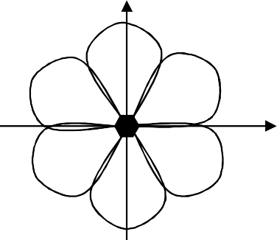
Antennas: Directed and Sectorized
Often used for microwave connections or base stations for mobile phones (e.g., radio coverage of a valley)
y
y
z
directed antenna
x
z
x
side view (xy-plane)
side view (yz-plane)
top view (xz-plane)
z
z
sectorized antenna
x
x
top view, 3 sector
top view, 6 sector

Slide 104
Modulation Techniques
Modulation can be done by varying the
  Amplitude
  Phase, or
  Frequency of a high frequency carrier in accordance with the amplitude of the message signal.
Demodulation is the inverse operation: extracting the baseband message from the carrier so that it may be processed at the receiver.

Slide 105
Analog/Digital Modulation
Analog Modulation
  The input is continues signal
  Used in first generation mobile radio systems such as AMPS in USA.
Digital Modulation
  The input is time sequence of symbols or pulses.
  Are used in current and future mobile radio systems

Slide 106
Goal of Modulation Techniques
Modulation is difficult task given the hostile mobile radio channels
  Small-scale fading and multipath conditions.
The goal of a modulation scheme is:
  Transport the message signal through the radio channel with best possible quality
  Occupy least amount of radio (RF) spectrum.

Slide 107
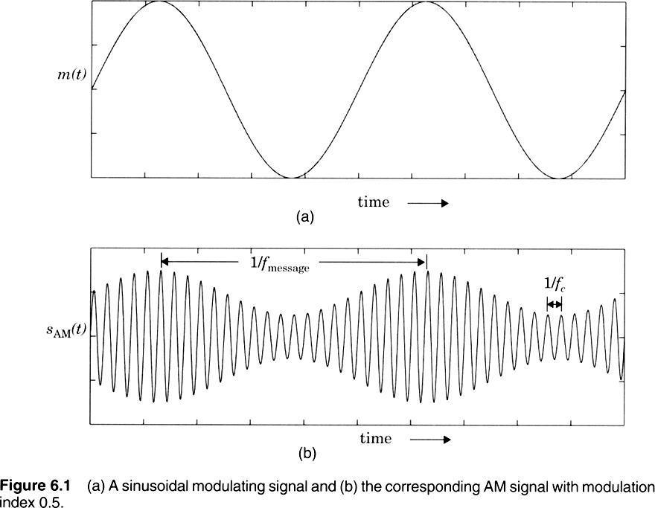
Amplitude Modulation

Slide 108
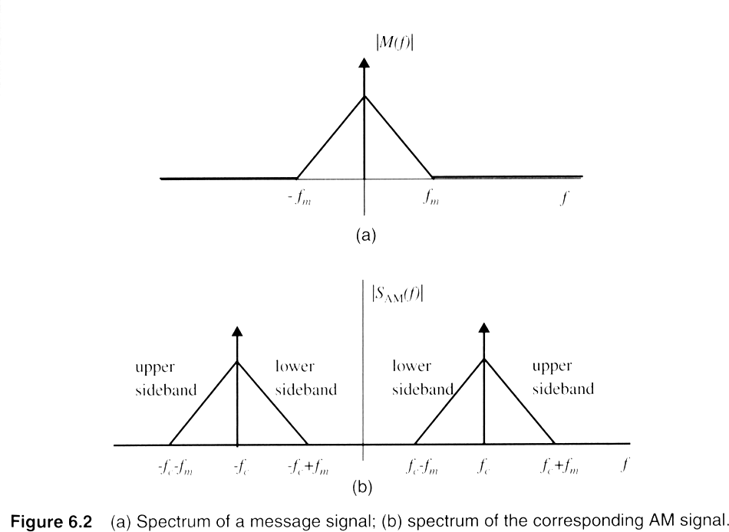
Double Sideband Spectrum

Slide 109
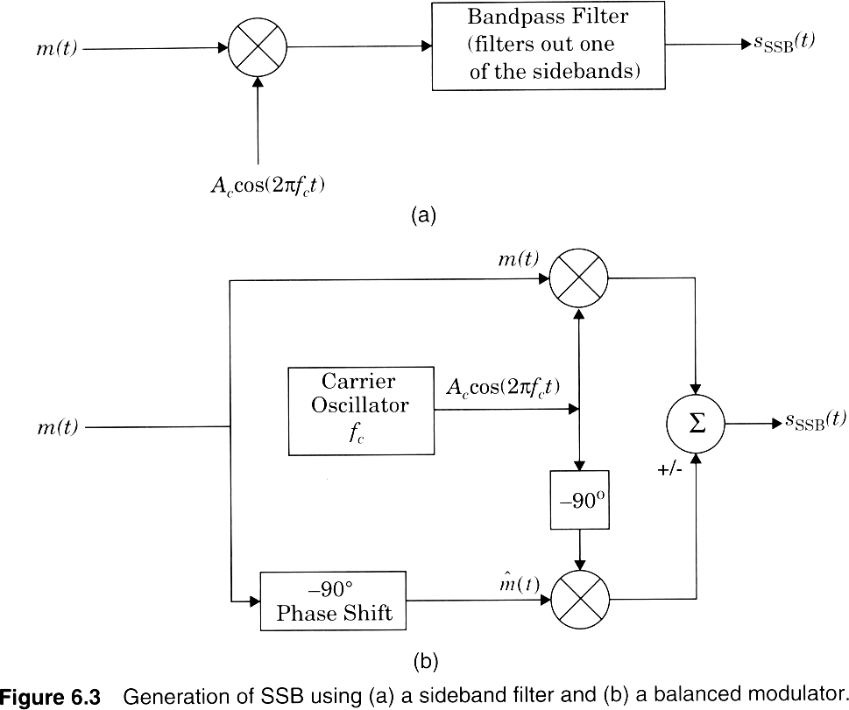
SSB Modulators

Slide 110
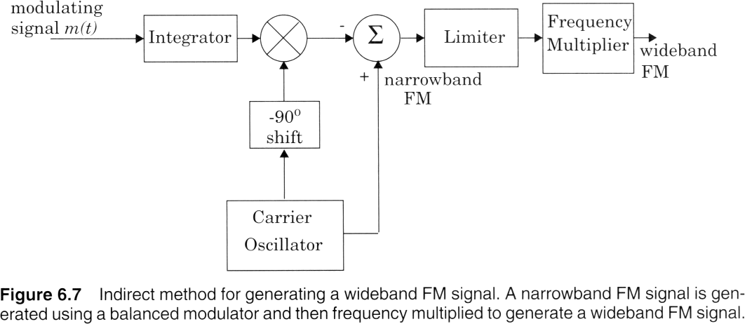
Wideband FM generation

Slide 111
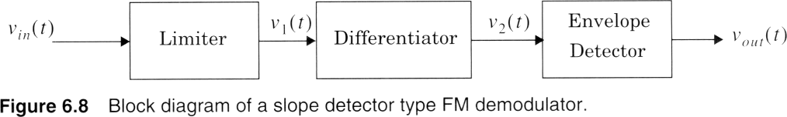
Slope Detector for FM

Slide 112
Digital Modulation
The input is discrete signals
  Time sequence of pulses or symbols
Offers many advantages
  Robustness to channel impairments
  Easier multiplexing of variuous sources of information: voice, data, video.
  Can accommodate digital error-control codes
  Enables encryption of the transferred signals
    More secure link

Slide 113
Factors that Influence Choice of Digital Modulation Techniques
A desired modulation scheme
  Provides low bit-error rates at low SNRs
    Power efficiency
  Performs well in multipath and fading conditions
  Occupies minimum RF channel bandwidth
    Bandwidth efficiency
  Is easy and cost-effective to implement
Depending on the demands of a particular system or application, tradeoffs are made when selecting a digital modulation scheme.

Slide 114
Power Efficiency of Modulation
Power efficiency is the ability of the modulation technique to preserve fidelity of the message at low power levels.
Usually in order to obtain good fidelity, the signal power needs to be increased.
  Tradeoff between fidelity and signal power
  Power efficiency describes how efficient this tradeoff is made
Power Efficiency :η = ^{⎡ Eb} required at the receiver input for certain PER⎤
p ⎢ ⎥
⎣ ^{N}0 ⎦
Eb: signal energy per bit
N0: noise power spectral density
PER: probability of error
145

Slide 115
Bandwidth Efficiency of Modulation
Ability of a modulation scheme to accommodate data within a limited bandwidth.
Bandwidth efficiency reflect how efficiently the allocated bandwidth is utilized
R
Bandwidth Efficiency :η_{B} = _{B} bps/Hz
R: the data rate (bps)
B: bandwidth occupied by the modulated RF signal
146

Slide 116
Linear Modulation Techniques
Classify digital modulation techniques as:
  Linear
    The amplitude of the transmitted signal varies linearly with the modulating digital signal, m(t).
    They usually do not have constant envelope.
    More spectral efficient.
    Poor power efficiency
    Example: QPSK.
  Non-linear
147

Slide 117

Binary Phase Shift Keying
Use alternative sine wave phase to encode bits
  Phases are separated by 180 degrees.
  Simple to implement, inefficient use of bandwidth.
  Very robust, used extensively in satellite communication.
s₁ (t) = A_{c} cos(2πf_{c} + θ_{c} )
s₂ (t) = A_{c} cos(2πf_{c} +θ_{c} + π )
Q
binary 1
binary 0
0
State
1
State
117

Slide 118
BPSK Example
1
1
0
1
0
1
Data
Carrier
Carrier+ π
BPSK waveform
118

Slide 119


Quadrature Phase Shift Keying
Multilevel Modulation Technique: 2 bits per symbol
More spectrally efficient, more complex receiver.
Two times more bandwidth efficient than BPSK
Q
01 State
11 State
00 State
10 State
Phase of Carrier: π/4, 2π/4, 5π/4, 7π/4
119

Slide 120
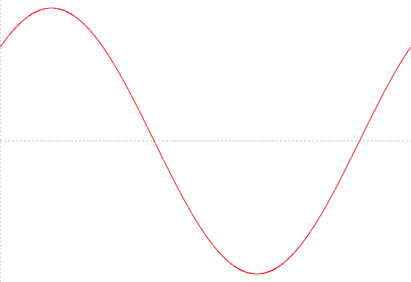
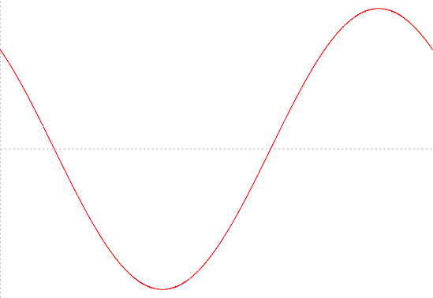
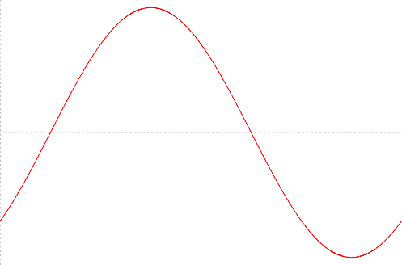
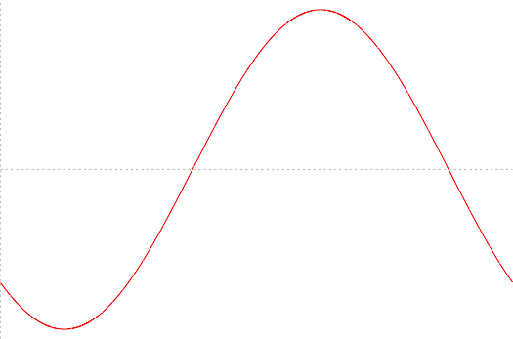
4 different waveforms
cos+sin
-cos+sin
.5
1
.5
0
.5
-1
.5₀
.5
1
0.5
0
0.5
-1
1.5₀
11
.5
1
.5
0
.5
-1
.5₀
01
0.2 0.4 0.6 0.8 1
0.2 0.4 0.6 0.8 1
10
cos-sin
.5
1
0.5
0
0.5
-1
1.5₀
00
-cos-sin
0.2 0.4 0.6 0.8 1
0.2 0.4 0.6 0.8 1
120

Slide 121
Constant Envelope Modulation
Amplitude of the carrier is constant, regardless of the variation in the modulating signal
  Better immunity to fluctuations due to fading.
  Better random noise immunity
  Power efficient
They occupy larger bandwidth
152

Slide 122
Frequency Shift Keying (FSK)
The frequency of the carrier is changed according to the message state (high
(1) or low (0)).
s₁ (t) = A cos(2πf_{c} + 2πΔf )t 0 ≤ t ≤ T_{b} (bit = 1)
s₂ (t) = A cos(2πf_{c} − 2πΔf )t 0 ≤ t ≤ T_{b} (bit = 0)
Continues FSK
s(t) = A cos(2πf_{c} +θ (t))
t
s(t) = A cos(2πf_{c}t + 2πk _{f ∫} m(x)dx)
−∞
Integral of m(x) is continues.
122

Slide 123
FSK Example
Data
1
1
0
1
FSK
Signal
123

Slide 124

BPSK constellation

Slide 125

Virtue of pulse shaping

Slide 126

BPSK Coherent demodulator

Slide 127
Equalization,Diversity and Channel coding
Three techniques are used to improve Rx signal quality and lower BER:
  Equalization
  Diversity
  Channel Coding
    Used independently or together
    We will consider Diversity and Channel Coding

Slide 128
III. Diversity Techniques
Diversity : Primary goal is to reduce depth & duration of small-scale fades
  Spatial or antenna diversity → most common
    Use multiple Rx antennas in mobile or base station
    Why would this be helpful?
    Even small antenna separation (∝ λ ) changes phase of signal → constructive /destructive nature is changed
  Other diversity types → polarization, frequency,
& time

Slide 129
Exploits random behavior of MRC
  Goal is to make use of several independent (uncorrelated) received signal paths
  Why is this necessary?
Select path with best SNR or combine multiple paths → improve overall SNR performance

Slide 130
Microscopic diversity → combat small-scale
fading
  Most widely used
  Use multiple antennas separated in space
    At a mobile, signals are independent if separation > λ / 2
    But it is not practical to have a mobile with multiple
antennas separated by λ / 2 (7.5 cm apart at 2 GHz)
    Can have multiple receiving antennas at base stations, but must be separated on the order of ten wavelengths (1 to 5 meters).

Slide 131
Since reflections occur near receiver, independent signals spread out a lot before they reach the base station.
a typical antenna configuration for 120 degree sectoring.
For each sector, a transmit antenna is in the center, with two diversity receiving antennas on each side.
If one radio path undergoes a deep fade, another independent path may have a strong signal.
By having more than one path one select from, both the instantaneous and average SNRs at the receiver may be improved

Slide 132
Spatial or Antenna Diversity → 4 basic types
  M independent branches
  Variable gain & phase at each branch → G∠ θ
  Each branch has same average SNR:
SNR = Γ = ^{Eb}
N₀
SNR = γ , the pdf of
– Instantaneous
γ _{i}
i
1
−γ_{i}
p(γ _{i} ) = _{Γ} e ^{Γ} γ _{i} ≥ 0
(6.155)
γ
∫
0
γ
∫
0
1
Γ
−γ_{i}
−γ
Γ
Pr γ
[ ]
≤ γ =
p(γ )dγ =
e dγ
= 1− e
Γ
i
i
i
i
132

Slide 133
– The probability that all M independent diversity branches Rx signal which are simultaneously less than some specific SNR threshold γ
Pr[γ ,...γ ≤ γ ] = (1− e^{−γ / Γ} )^{M} = P (γ )
1 M M
Pr[γ
]
−γ / Γ M
γ = 1− P (
γ ) = 1− (1− e )
i M
– The pdf of γ:
d M
dγ Γ
( )
M −1
p (γ ) =
P (γ ) =
−γ Γ
−γ Γ
1− e e
M
M
– Average SNR improvement offered by selection diversity
∞ ∞
γ = γ p
0
( )
M −1
∫ ∫
(γ )dγ = Γ Mx 1− e
− x
e dx, x = γ Γ
− x
M
_{γ = ∑}M
0
1
Γ
k =1 k
133

Slide 134

1) Selection Diversity → simple & cheap
Rx selects branch with highest instantaneous SNR
  new selection made at a time that is the reciprocal of the fading rate
  this will cause the system to stay with the current signal until it is likely the signal has faded
SNR improvement :
  γ is new avg. SNR
  Γ : avg. SNR in each branch
134

Slide 135


Slide 136

2) Scanning Diversity
scan each antenna until a signal is found that is above predetermined threshold
if signal drops below threshold → rescan
o
ti
nly one Rx is required (since only receiving one signal a
me), so less costly → still need multiple antennas
t a

Slide 137
3) Maximal Ratio Diversity
signal amplitudes are weighted according to each
SNR
summed in-phase
most complex of all types
a complicated mechanism, but modern DSP makes this more practical → especially in the base station Rx where battery power to perform computations is not an issue

Slide 138
r_{M} = ∑G_{i} r_{i}
The resulting signal envelop applied to detector:
M
i=1
Total noise power:
M
N = N
∑
i=1
G
2
T
i
SNR applied to detector:
_{r} 2
γ _{M}
₌ M
2N_{T}
138

Slide 139

– The voltage signals γ _{i} from each of the M diversity branches are co-phased to provide coherent voltage addition and are individually weighted to provide optimal SNR
( r_{M}is maximized when
G_{i} = r_{i} /)N
– The SNR out of the diversity combiner is the sum of the SNRs in each branch.
139

Slide 140


– The probability that γ _{M}less than some specific
SNR threshold γ
140

Slide 141
gives optimal SNR improvement :
  Γ_{i}: avg. SNR of each individual branch
  Γ_{i} = Γ if the avg. SNR is the same for each branch
M M
γ _{M} = ∑γ_{i} =∑Γ_{i} =M Γ
i=1 i=1
141

Slide 142


Slide 143
4) Equal Gain Diversity
combine multiple signals into one
G = 1, but the phase is adjusted for each received signal so that
  The signal from each branch are co-phased
  vectors add in-phase
better performance than selection diversity

Slide 144
IV. Time Diversity
Time Diversity → transmit repeatedly the
information at different time spacings
  Time spacing > coherence time (coherence time is the time over which a fading signal can be considered to have similar characteristics)
  So signals can be considered independent
  Main disadvantage is that BW efficiency is significantly worsened – signal is transmitted more than once
    BW must ↑ to obtain the same R_{d} (data rate)

Slide 145
RAKE Receiver
Powerful form of time diversity available in spread spectrum (DS) systems →
CDMA
Signal is only transmitted once
Propagation delays in the MRC provide multiple copies of Tx signals delayed in time
Attempts to collect the time-shifted versions of the original signal by providing a separate correlation receiver for each of the multipath signals.
Each correlation receiver may be adjusted in time delay, so that a microprocessor controller can cause different correlation receivers to search in different time windows for significant multipath.
The range of time delays that a particular correlator can search is called a search window.

Slide 146
If time delay between multiple signals > chip period of spreading sequence (Tc) →
multipath signals can be considered uncorrelated (independent)
  In a basic system, these delayed signals only appear as noise, since they are delayed by more than a chip duration. And ignored.
  Multiplying by the chip code results in noise because of the time shift.
  But this can also be used to our advantage, by shifting the chip sequence to receive that delayed signal separately from the other signals.

Slide 147

The RAKE Rx is a time diversity Rx that collects time-shifted versions of the original Tx signal

Slide 148
Cont.
M branches or “fingers” = # of correlation Rx’s
Separately detect the M strongest signals
Weighted sum computed from M branches
  Faded signal → low weight
  Strong signal → high weight
  Overcomes fading of a signal in a single branch

Slide 149
In indoor environments:
The delay between multipath components is usually large, the low autocorrelation properties of a CDMA spreading sequence can assure that multipath components will appear nearly uncorrelated with each other.
RAKE receiver in IS-95 CDMA has been found to perform poorly
Since the multipath delay spreads in indoor channels
much smaller than an IS-95 chip duration (≈ 800 ns).
In such cases, a rake will not work since multipath is unresolveable
Rayleigh flat-fading typically occurs within a single chip period.
(≈100 ns) are

Slide 150

Channel Coding :
Error control coding ,detect, and often received in error
correct, symbols which are
The channel encoder separates or segments the incoming bit stream into equal length blocks of L binary digits and maps each L-bit message block into an N-bit code word where N > L
There are M=2^{L} messages and 2^{L} code words of length N bits
The channel decoder has the task of detecting that there has been a bit error and • (if possible) correcting the bit error

Slide 151

ARQ (Automatic-Repeat-Request ) If the channel decoder performs error detection then errors can be detected and a feedback channel from the channel decoder to the channel encoder can be used to control the retransmission of the code word until the code word is received without detectable errors.
There are two major ARQ techniques stop and wait continuous ARQ
FEC (Forward Error Correction) If the channel decoder performs error correction then errors are not only detected but the bits in error can be identified and corrected (by bit inversion)

Slide 152
There are two major ARQ techniques.
Stop and wait, in which each block of data is positively, or negatively, acknowledged by the receiving terminal as being error free before the next data block is transmitted,
Continuous ARQ, in which blocks of data continue to be transmitted without waiting for each previous block to be acknowledged

Slide 153
Companding for ‘narrow-band’ speech
‘Narrow-band’ speech is what we hear over telephones.
Normally band-limited from 300 Hz to about 3500 Hz.
May be sampled at 8 kHz.
8-bits per sample not sufficient for good ‘narrow-band’ speech encoding with uniform quantisation.
Problem lies with setting a suitable quantisation step-size ◻.
One solution is to use instantaneous companding.
Step-size adjusted according to amplitude of sample.
For larger amplitudes, larger step-sizes used as illustrated next.
‘Instantaneous’ because step-size changes from sample to sample.

Slide 154
Multiple Access Techniques for Wireless Communication:
Many users can access the at same time, share a finite amount of radio spectrum with high performance duplexing generally required frequency domain time domain. They accessing techniques are,
FDMA
TDMA
SDMA
PDMA

Slide 155
Introduction
many users at same time
share a finite amount of radio spectrum
high performance
duplexing generally required
frequency domain
time domain

Slide 156
Frequency division duplexing (FDD)
two bands of frequencies for every user
forward band
reverse band
duplexer needed
frequency seperation between forward band and reverse band is constant
reverse channel forward channel frequency seperation
f

Slide 157
Time division duplexing (TDD)
uses time for forward and reverse link
multiple users share a single radio channel
forward time slot
reverse time slot
no duplexer is required
reverse channel forward channel
time seperation
t

Slide 158
Multiple Access Techniques
Frequency division multiple access (FDMA)
Time division multiple access (TDMA)
Code division multiple access (CDMA)
Space division multiple access (SDMA)
grouped as:
narrowband systems
wideband systems

Slide 159
Narrowband systems
large number of narrowband channels
usually FDD
Narrowband FDMA
Narrowband TDMA
FDMA/FDD
FDMA/TDD
TDMA/FDD
TDMA/TDD

Slide 160
Logical separation FDMA/FDD
forward channel
user 1
reverse channel
...
f
forward channel
user n
reverse channel
t

Slide 161
Logical separation FDMA/TDD
user 1
forward channel
reverse channel
...
f
user n
forward channel
reverse channel
t

Slide 162
Logical separation TDMA/FDD
forward channel
forward channel
user 1
...
user n
f
reverse channel
reverse channel
t

Slide 163
Logical separation TDMA/TDD
user 1
user n
forward channel
reverse channel
...
forward channel
reverse channel
f
t

Slide 164
Wideband systems
large number of transmitters on one channel
TDMA techniques
CDMA techniques
FDD or TDD multiplexing techniques
TDMA/FDD
TDMA/TDD
CDMA/FDD
CDMA/TDD

Slide 165
Logical separation CDMA/FDD
user 1
forward channel
reverse channel
...
code
user n
forward channel
reverse channel
f

Slide 166
Logical separation CDMA/TDD
user 1
forward channel
reverse channel
...
code
user n
forward channel
reverse channel
t

Slide 167
Multiple Access Techniques in use
Multiple Access
Technique
Cellular System
Advanced Mobile Phone System (AMPS) Global System for Mobile (GSM)
US Digital Cellular (USDC)
FDMA/FDD TDMA/FDD TDMA/FDD
Digital European Cordless Telephone (DECT) FDMA/TDD
US Narrowband Spread Spectrum (IS-95) CDMA/FDD

Slide 168
Frequency division multiple access FDMA
One phone circuit per channel
Idle time causes wasting of resources
Simultaneously and continuously transmitting
Usually implemented in narrowband systems
For example: in AMPS is a FDMA bandwidth of 30 kHz implemented

Slide 169
FDMA compared to TDMA
Fewer bits for synchronization
Fewer bits for framing
Higher cell site system costs
Higher costs for duplexer used in base station and subscriber units
FDMA requires RF filtering to minimize adjacent channel interference

Slide 170
Nonlinear Effects in FDMA
Many channels - same antenna
For maximum power efficiency operate near saturation
Near saturation power amplifiers are nonlinear
Nonlinearities causes signal spreading
Intermodulation frequencies

Slide 171
Nonlinear Effects in FDMA
IM are undesired harmonics
Interference with other channels in the FDMA system
Decreases user C/I - decreases performance
Interference outside the mobile radio band: adjacent-channel interference
RF filters needed - higher costs

Slide 172
Number of channels in a FDMA system
Bt - Bguard
N=
Bc
N … number of channels
Bt … total spectrum allocation
Bguard … guard band
Bc … channel bandwidth

Slide 173
Time Division Multiple Access
Time slots
One user per slot
Buffer and burst method
Noncontinuous transmission
Digital data
Digital modulation

Slide 174
Repeating Frame Structure
One TDMA Frame Preamble Information Message
Trail Bits
Slot 1
Slot 2
Slot 3
…
Slot N
Trail Bits
Sync. Bits
Information Data
Guard Bits
The frame is cyclically repeated over time.

Slide 175
Features of TDMA
A single carrier frequency for several users
Transmission in bursts
Low battery consumption
Handoff process much simpler
FDD : switch instead of duplexer
Very high transmission rate
High synchronization overhead
Guard slots necessary

Slide 176
Number of channels in a TDMA system
m*(Btot - 2*Bguard) Bc
N=
N … number of channels
m … number of TDMA users per radio channel
Btot … total spectrum allocation
Bguard … Guard Band
Bc … channel bandwidth

Slide 177
Example: Global System for Mobile (GSM)
TDMA/FDD
forward link at Btot = 25 MHz
radio channels of Bc = 200 kHz
if m = 8 speech channels supported, and
if no guard band is assumed :
8*25E6
200E3
N=
= 1000 simultaneous users

Slide 178
Efficiency of TDMA
Percentage of transmitted data that contain information
Frame efficiency ηf
Usually end user efficiency < ηf ,
Because of source and channel coding

Slide 179
Repeating Frame Structure
One TDMA Frame Preamble Information Message
Trail Bits
Slot 1
Slot 2
Slot 3
…
Slot N
Trail Bits
Sync. Bits
Information Data
Guard Bits
The frame is cyclically repeated over time.

Slide 180
Efficiency of TDMA
bOH = Nr*br + Nt*bp + Nt*bg + Nr*bg
bOH … number of overhead bits
Nr … number of reference bursts per frame
br … reference bits per reference burst
Nt … number of traffic bursts per frame
bp … overhead bits per preamble in each slot
bg … equivalent bits in each guard time
intervall

Slide 181
Efficiency of TDMA
bT = Tf * R
bT … total number of bits per frame
Tf … frame duration
R … channel bit rate

Slide 182
Efficiency of TDMA
ηf = (1-bOH/bT)*100%
ηf … frame efficiency
bOH … number of overhead bits per frame
bT … total number of bits per frame

Slide 183
Space Division Multiple Access
Controls radiated energy for each user in space
using spot beam antennas
base station tracks user when moving
cover areas with same frequency:
TDMA or CDMA systems
cover areas with same frequency:
FDMA systems

Slide 184
Space Division Multiple Access
primitive applications are antennas”
“Sectorized
In future adaptive antennas simultaneously steer energy in the direction of many users at once

Slide 185
Reverse link problems
General problem
Different propagation path from user to base
Dynamic control of transmitting power from each user to the base station required
Limits by battery consumption of subscriber units
Possible solution is a filter for each user

Slide 186
Solution by SDMA systems
Adaptive antennas promise to mitigate reverse link problems
Limiting case of infinitesimal beamwidth
Limiting case of infinitely fast track ability
Thereby unique channel that is free from interference
All user communicate at same time using the same channel

Slide 187
Disadvantage of SDMA
Perfect adaptive antenna system:
Compromise needed
infinitely large antenna needed

Slide 188

SDMA and PDMA in satellites
INTELSAT IVA
SDMA dual-beam receive antenna
Simultaneously access from two different regions of the earth

Slide 189

SDMA and PDMA in satellites
COMSTAR 1
PDMA
separate antennas
simultaneously access from same region

Slide 190

SDMA and PDMA in satellites
INTELSAT V
PDMA and SDMA
Two hemispheric coverage by SDMA
Two smaller beam zones by PDMA
Orthogonal polarization

Slide 191
Capacity of Cellular Systems
Channel capacity: maximum number of users in a fixed frequency band
Radio capacity : value for spectrum efficiency
Reverse channel interference
Forward channel interference
How determine the radio capacity?

Slide 192
Co-Channel Reuse Ratio Q
Q=D/R
Q … co-channel reuse ratio
D … distance between two co-channel cells
R … cell radius

Slide 193

Forward channel interference
cluster size of 4
D0 … distance serving station to user
DK … distance co-channel base station to user

Slide 194
Cellular Wireless Network Evolution
First Generation: Analog
  AMPS: Advance Mobile Phone Systems
  Residential cordless phones
Second Generation: Digital
  IS-54: North American Standard - TDMA
  IS-95: CDMA (Qualcomm)
  GSM: Pan-European Digital Cellular
  DECT: Digital European Cordless Telephone

Slide 195
Cellular Evolution (cont)
Third Generation: T/CDMA
combines the functions of: cellular, cordless, wireless LANs, paging etc.
supports multimedia services (data, voice, video, image)
a progression of integrated, high performance systems:
GPRS (for GSM)
EDGE (for GSM)
1xRTT (for CDMA)
UMTS

Slide 196


Slide 197

Invented by Bell Labs; installed In US in 1982; in Europe as TACS

Slide 198

AMPS (Advance Mobile Phone System):
B
FDMA (Frequency Div
Multiple Access): one frequency per user channel
B
G
C
G
C
A
A
F
D
F
D
E
E
B
G
C
Frequency Reuse: Frequencies are not reused in a group of 7 adjacent cells
A
F
D
E
In each cell, 57 channels each for A-side and B -side carrier respectively; about 800 channels total (across the entire
AMPS system)

Slide 199

Advanced Mobile Phone System
Frequencies are not reused in adjacent cells.
To add more users, smaller cells can be used.

Slide 200
Channel Categories
The channels are divided into four categories:
Control (base to mobile) to manage the system
Paging (base to mobile) to alert users to calls for them
Access (bidirectional) for call setup and channel assignment
Data (bidirectional) for voice, fax, or data

Slide 201
Handoff
Handoff: Transfer of a mobile from one cell to another
Each base station constantly monitors the received power from each mobile.
When power drops below given threshold, base station asks neighbor station (with stronger received power) to pick up the mobile, on a new channel.
In APMS the handoff process takes about 300 msec.
Hard handoff: user must switch from one frequency to another (noticeable disruption)
Soft Handoff (available only with CDMA): no change in frequency.

Slide 202
To register and make a phone call
When phone is switched on , it scans a preprogrammed list of 21 control channels, to find the most powerful signal.
It transmits its ID number on it to the MSC – which informs the home MSC (registration is done every 15 min)
To make a call, user transmits dest Ph # on random access
channel; MSC will assign a data channel
At the same time MSC pages the destination cell for the other party (idle phone listens on all page channels)

Slide 203

(Freq Division Duplex)

Slide 204


Slide 205
Digital Cellular: IS-54 TDMA System
Second generation: digital (as opposed to analog as in AMPS)
Same frequency as AMPS
Each 30 kHz RF channel is used at a rate of 48.6 kbps
  6 TDM slots/RF band (2 slots per user)
  8 kbps voice coding
  16.2 kbps TDM digital channel (3 channels fit in 30kHz)
4 cell frequency reuse (instead of 7 as in AMPS)
Capacity increase per cell per carrier
  3 x 416 / 4 = 312 (instead of 57 in AMPS)
  Additional factor of two with speech activity detection.

Slide 206


Slide 207


Slide 208
GSM (Group Speciale Mobile)
Pan European Cellular Standard Second Generation: Digital
Frequency Division Duplex (890-915 MHz Upstream; 935-960 MHz Downstream) 125 frequency carriers
Carrier spacing: 200 Khz
8 channels per carrier (Narrowband Time Division)
Speech coder: linear predictive coding (Source rate = 13 Kbps)
Modulation: phase shift keying (Gaussian minimum shift keying)
Slow frequency hopping to overcome multipath fading

Slide 209


Slide 210


Slide 211


Slide 212


