Slide 1

Sri Ganesh College of Arts and Science
Department of Mathematics
NUMERICAL METHOD
Speaker : K.MANGAIYARKARASI

Slide 2
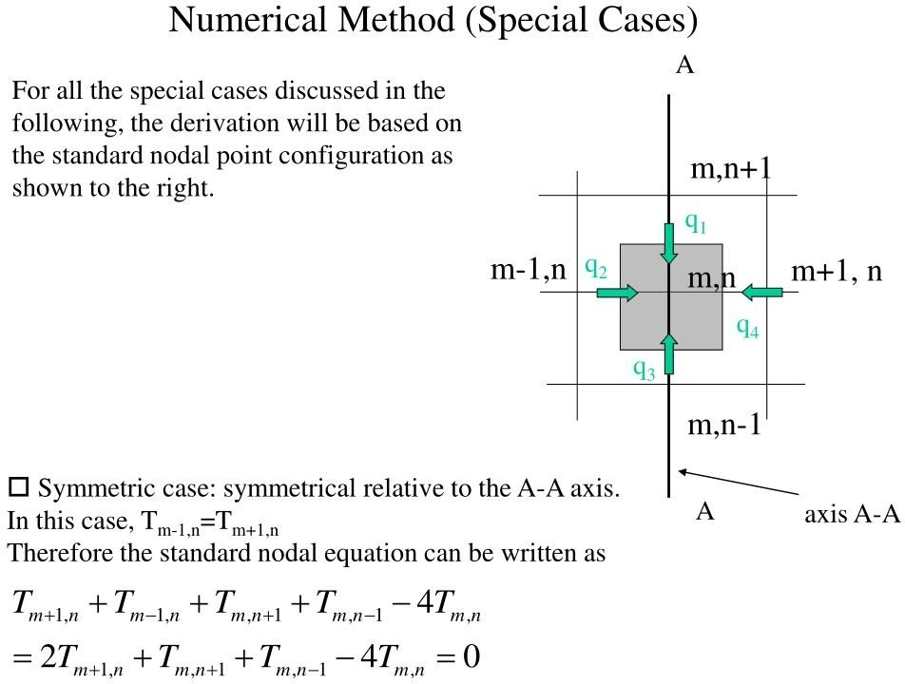

Slide 3
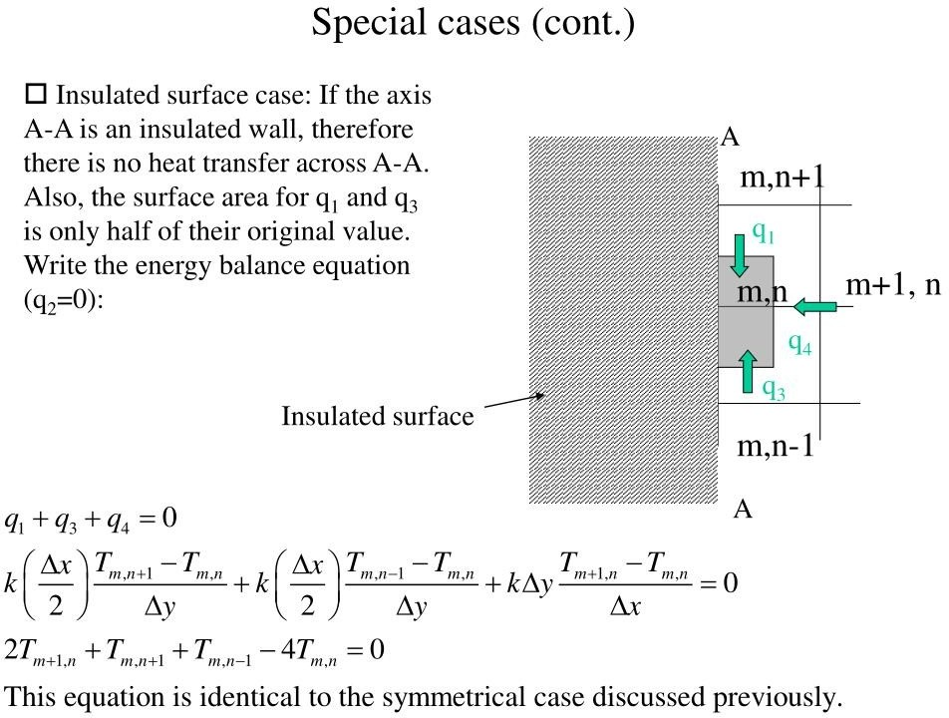

Slide 4
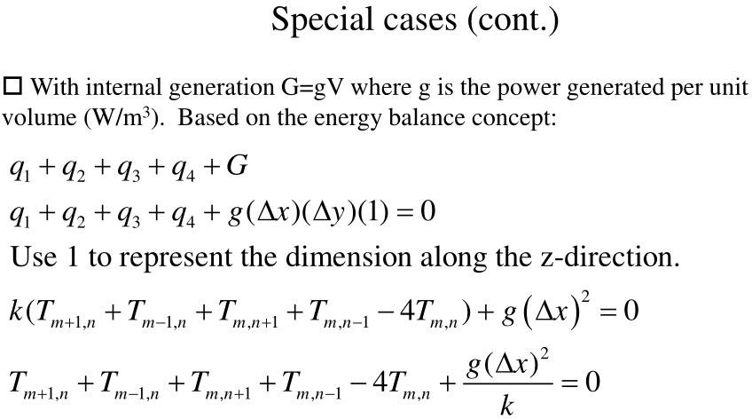

Slide 5
