Slide 1

Sri Ganesh College of Arts and Science
Department of Mathematics
PARTIAL FRACTION
Speaker : T.SARANYA

Slide 2
Partial Fractions
The partial fraction decomposition or partial fraction expansion is used to reduce the degree of either the numerator or the denominator of a rational function/algebraic fraction.
Proper and Improper Fraction Revisited
The fraction is proper, if
degree of the denominator > degree of the numerator
Eg.
The fraction is improper, if
degree of the denominator ≤ degree of the numerator
Eg.

Slide 3
Partial Fractions
with a quadratic factor
Simple denominators
Repeated factor

Slide 4
Partial fraction with simple denominators:
An expression in the form can be split into partial
fractions of the form .
Eg. Express in partial fractions.
Let

Slide 5
Let x=2,
Let x= 0,
So, the partial fractions are

Slide 6
Try:
Split into partial fractions.
Split into partial fractions.

Slide 7
Try:
Answers
1
2

Slide 8
Partial fraction with a repeated factor:
An expression in the form can be split
into partial fractions of the form
Eg.

Slide 9
Express in partial fractions.
Solution:
Let x=3,
x=0,
x= 1,

Slide 10
Try:
Express in partial fractions.

Slide 11
Answer:

Slide 12
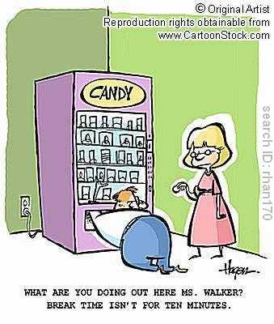

Slide 13
Partial fraction with a quadratic factor:
An expression in the of the form , where
r and s have the same sign, can be split into partial fractions of the form
Eg.

Slide 14
Express in partial fraction.
Solution:
Let x = -2,
x = 0,
x = 1,

Slide 15
Improper fractions:
Eg.
Eg.
Degree of numerator = Degree of denominator:
Degree of numerator > degree of denominator:

Slide 16
Try:
Decompose the following rational function into partial fractions:
Answer:

Slide 17
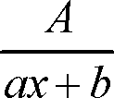


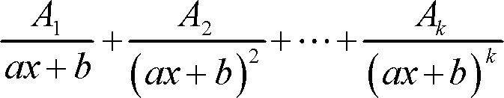


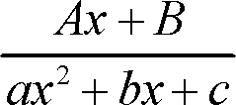

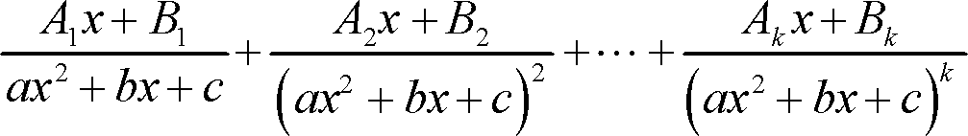
Further information:
Factor in denominator | Term in partial fraction decomposition

