Slide 1

Sri Ganesh College of Arts and Science
Department of Physics
FTIR SPECTROSCOPY
Speaker : K.NITHYA

Slide 2
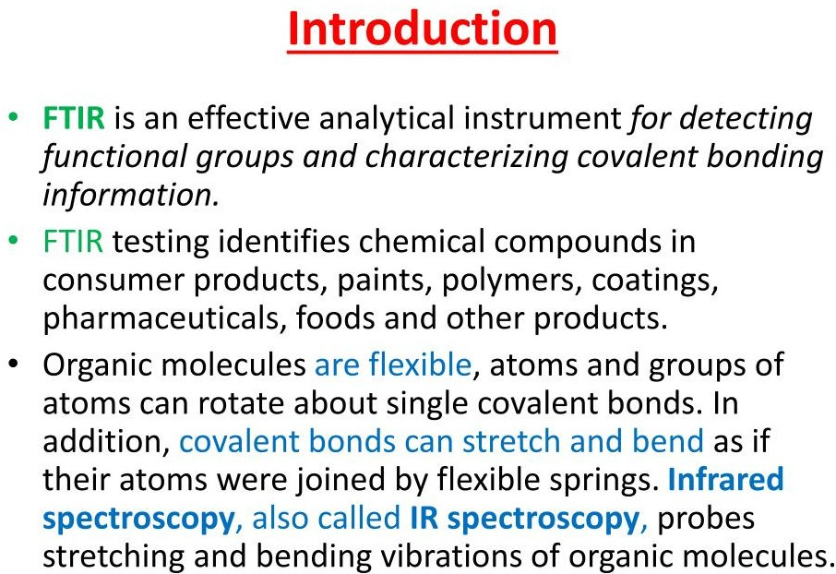

Slide 3
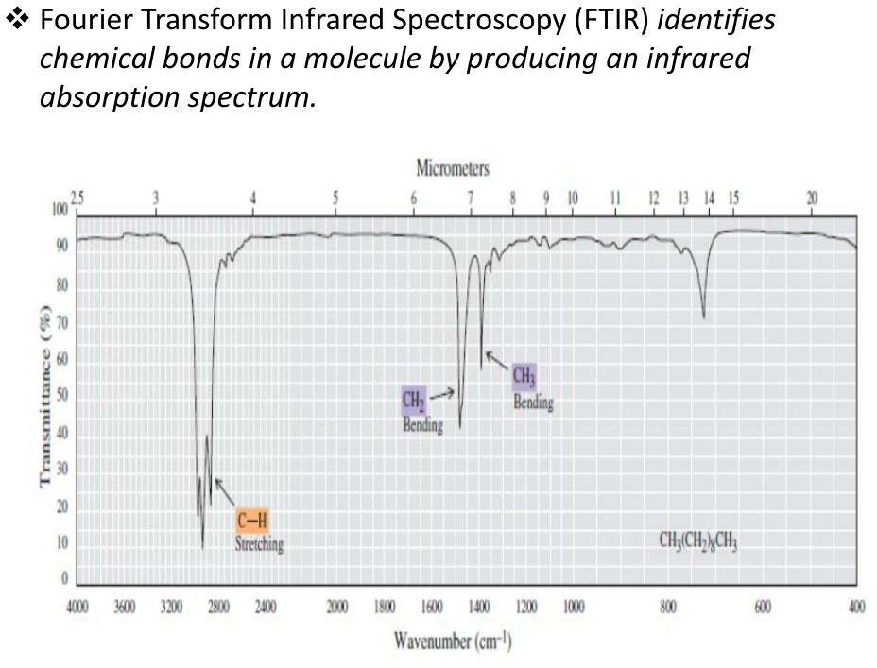

Slide 4
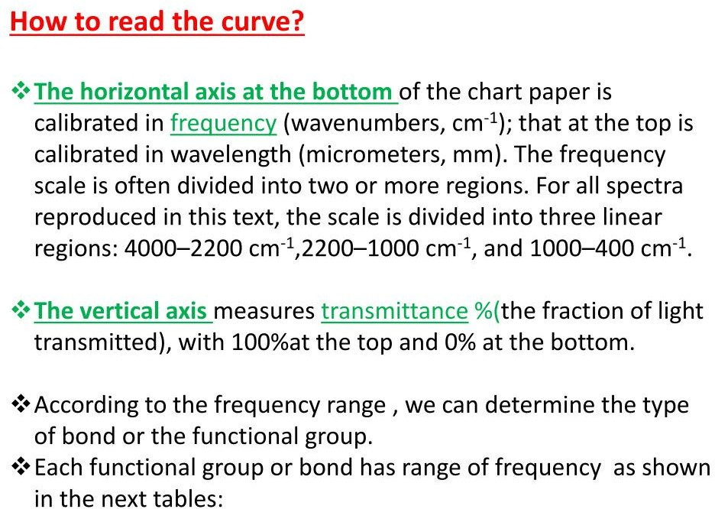

Slide 5
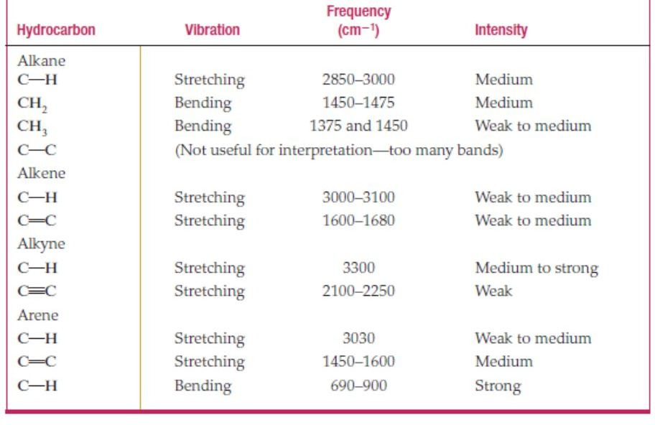

Slide 6
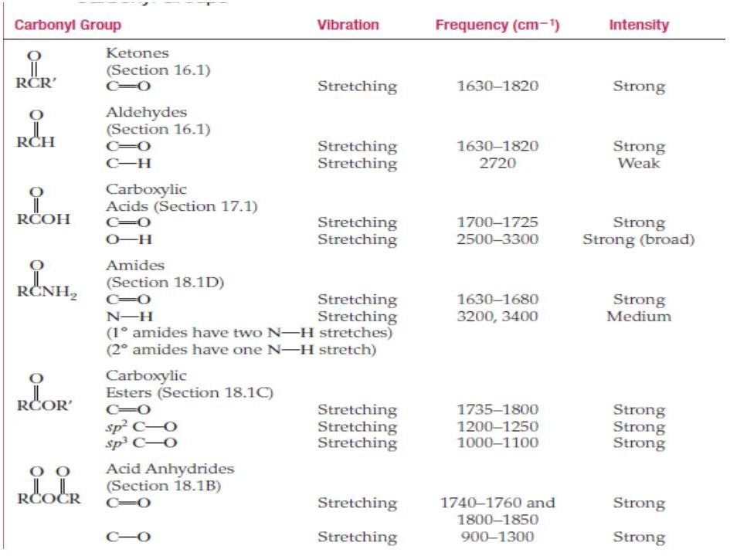

Slide 7
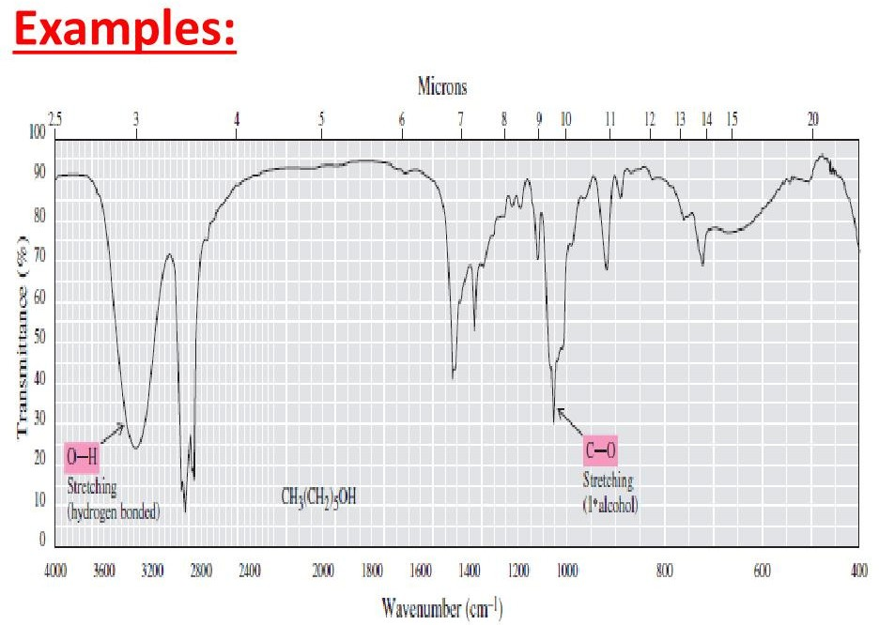

Slide 8
